Slide 1
By Collin Donaldson

Slide 2
What is it?
Shodan is a search engine that allows you to look for devices connected to the internet using service banners.
When you connect to a server listening on a given port, the server (usually) responds with a service banner.
Service Banner: A block of text about the given service being performed.

Slide 3
The How
Shodan uses a technique called “Banner Grabbing”
Banner Grabbing is an enumeration technique used to glean information about computer systems on a network and the services running its open ports.
Indexes banners instead of web content
Admins can use it to keep tabs on the services and systems on their networks
Hackers can use it to expose potential targets

Slide 4
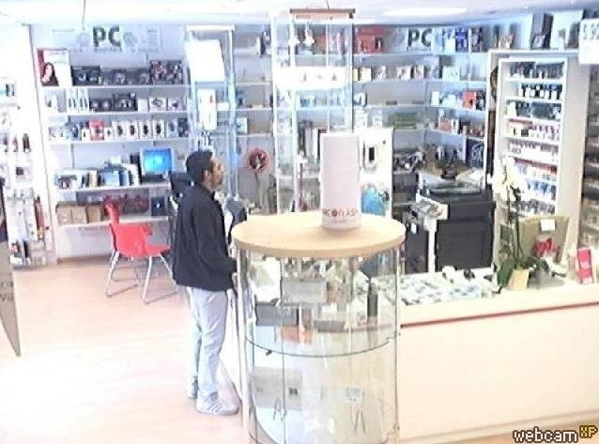
Potential Targets
Routers
Webcams
SCADA systems
Traffic Lights
Note: Be careful what you try to access!

Slide 5
Service Banner Example
We now have the HTTP, Server (Boa is a lightweight server for embedded systems such as Androids), and the default password.

Slide 6
Getting Started: Create an Account

Slide 7
Familiarize Yourself
Shodan has similar features and functionality to other search engines, but the searches are quite different
Check out “popular searches” for some starting tips
You can filter by banner type, port, OS, country, latitude/longitude, etc.
Example: cisco country:IN port:5060 net:125.63.65.0/24
Result on next Slide

Slide 8
Citycom Networks Pvt, New Delhi, India

Slide 9
Some Useful Search Terms
Use net:your.ip.add.ress o r net:your.ip.add.0/24 to pen-test your own network
"iis/5.0“ for Internet Information Services
Network/Company Type names (“Cisco”, “Apache”, “Telnet”, etc.)
Search software for your type of target (i.e. “webcamxp” is common webcam software).

Slide 10
User Authentication
Some servers require authentication
Use lists of common default usernames and passwords such as http://www.phenoelit.org/dpl/dpl.html
You could also use more advanced tools like Cain and Abel if you really want to break a password.

