Slide 1

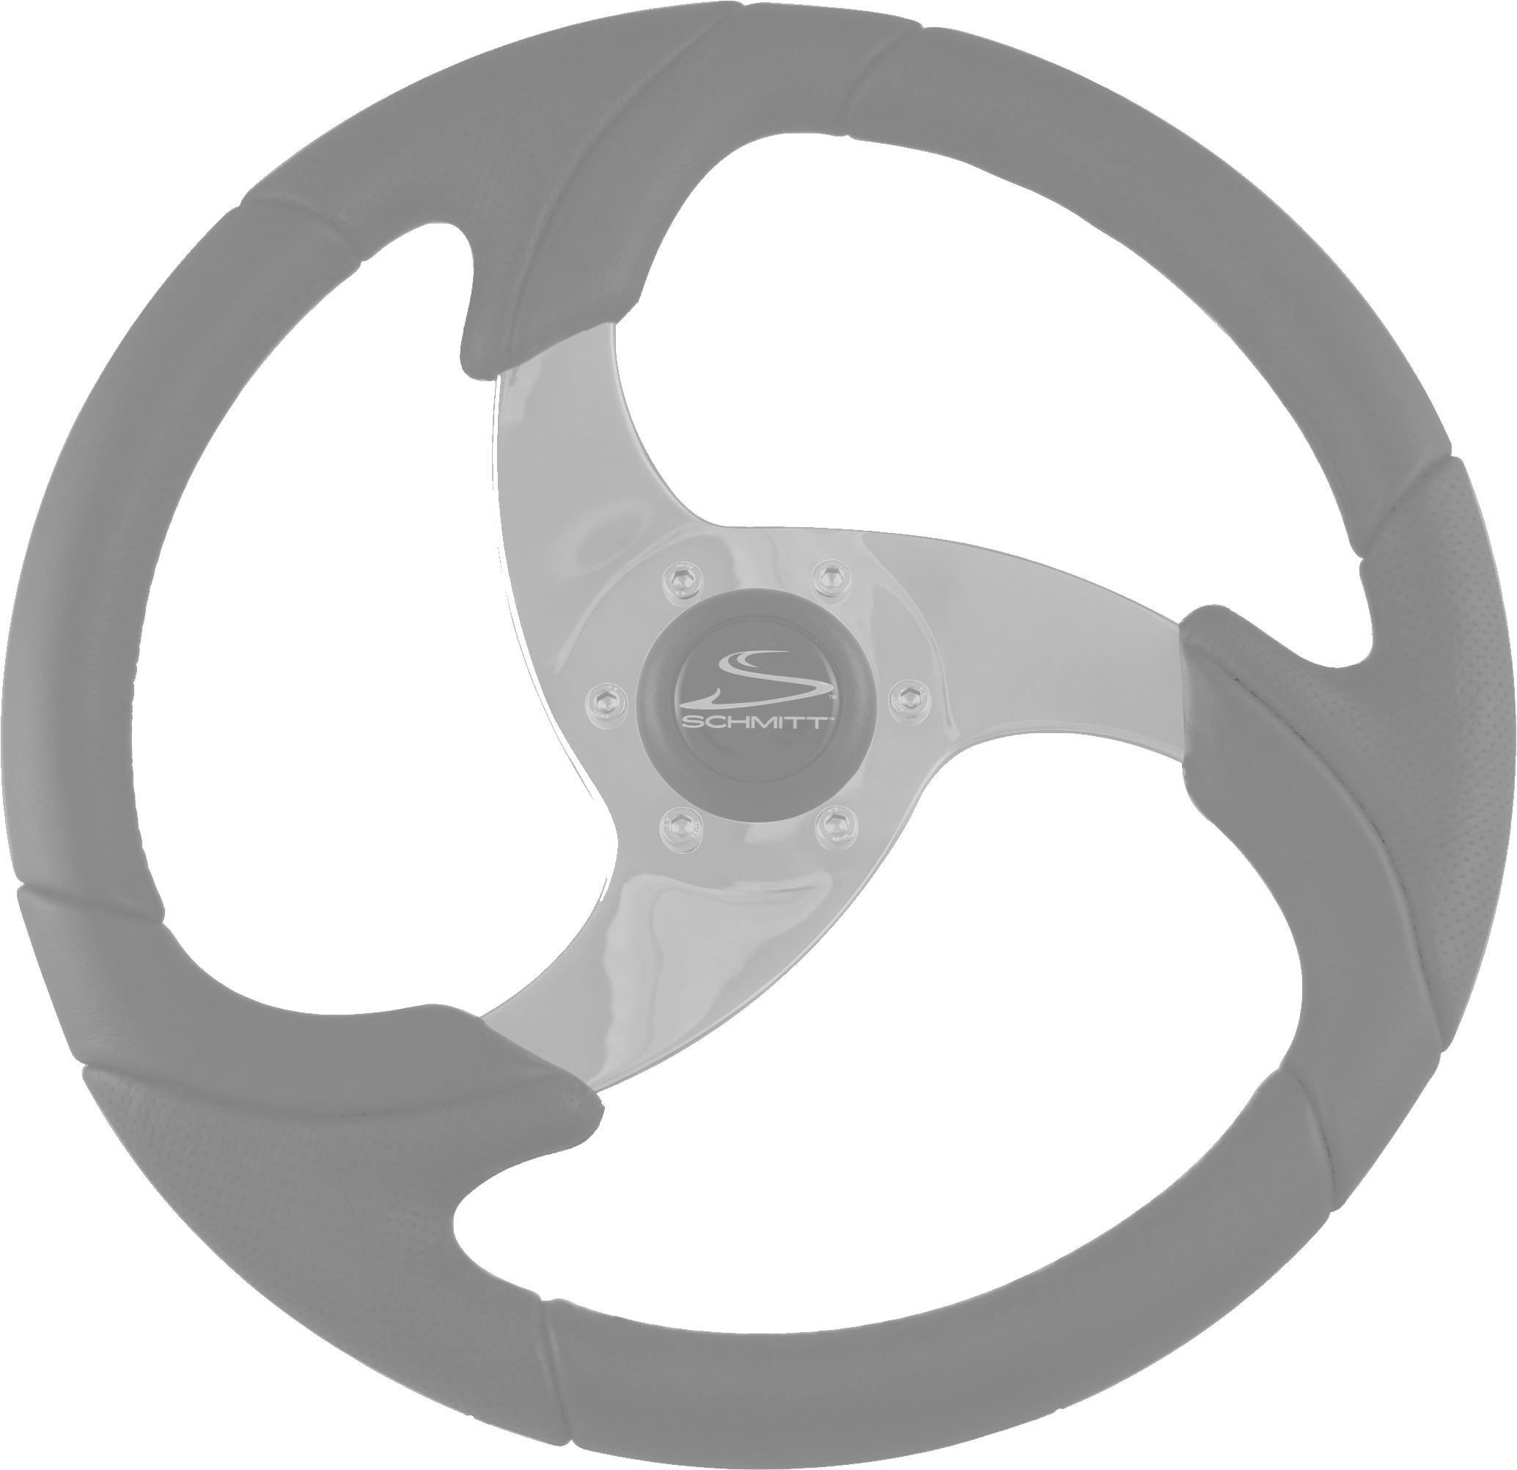
The Perceptual Driving Program
Perception and Driving Strategies for Different Environments
Module III of the
Pennsylvania Enhanced Driver Education Program
A-Session 1 Part 1A Introduction & Rationale
This Photo by Unknown Author is licensed under CC BY-NC

Slide 2
The Perceptual Driving Program
Session One
Introduction and Rationale

Slide 3
A-Session 1 Part 1A
Introduction and Rationale
Goals
Statistics
Links

Slide 4
The Perceptual Driving Program
Every driving action we take is determined by what we sense, identify and process in our brain.
Those actions are:
speed selection, position ,direction and communication.
What we do is all determined by what we identify and evaluate.
Identifying is done with all of our senses, but in driving, it is primarily done with our eyes.
Notes:
Every action we take with our motor vehicle is determined by what we identify and process in our brain. The actions we are referring to are speed selection, position and/or direction selection and communication selection. As drivers, we are constantly adjusting our speed, position and communicating, and this is all determined by what we identify and evaluate. Identifying is done with all of our senses, but in driving, it is primarily done with our eyes.

Slide 5

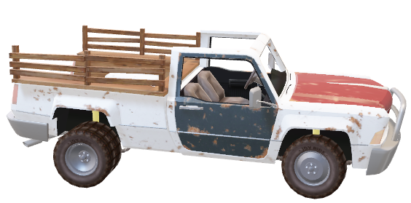
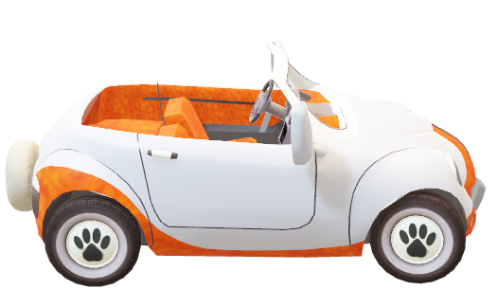
Stated Reasons for Collisions
“I Didn’t See”
(“ I Wasn’t Paying Attention”)
I Didn’t See In Time”
“I Didn’t Think He Would Do It”
(“I Didn’t Know What to Do”)
Notes:
The average driver who is involved in a collision will usually indicate with one of three responses as to why the collision occurred and these are:
"I didn't see him;“ (I wasn’t paying attention)
"I didn't see him in time;" and
"I didn't think he would do what he did.“ (I didn’t know what to do)
These three statements indicate most drivers do not know how to use their eyes in an effective manner. And they do not know what to search for in an orderly manner.

Slide 6

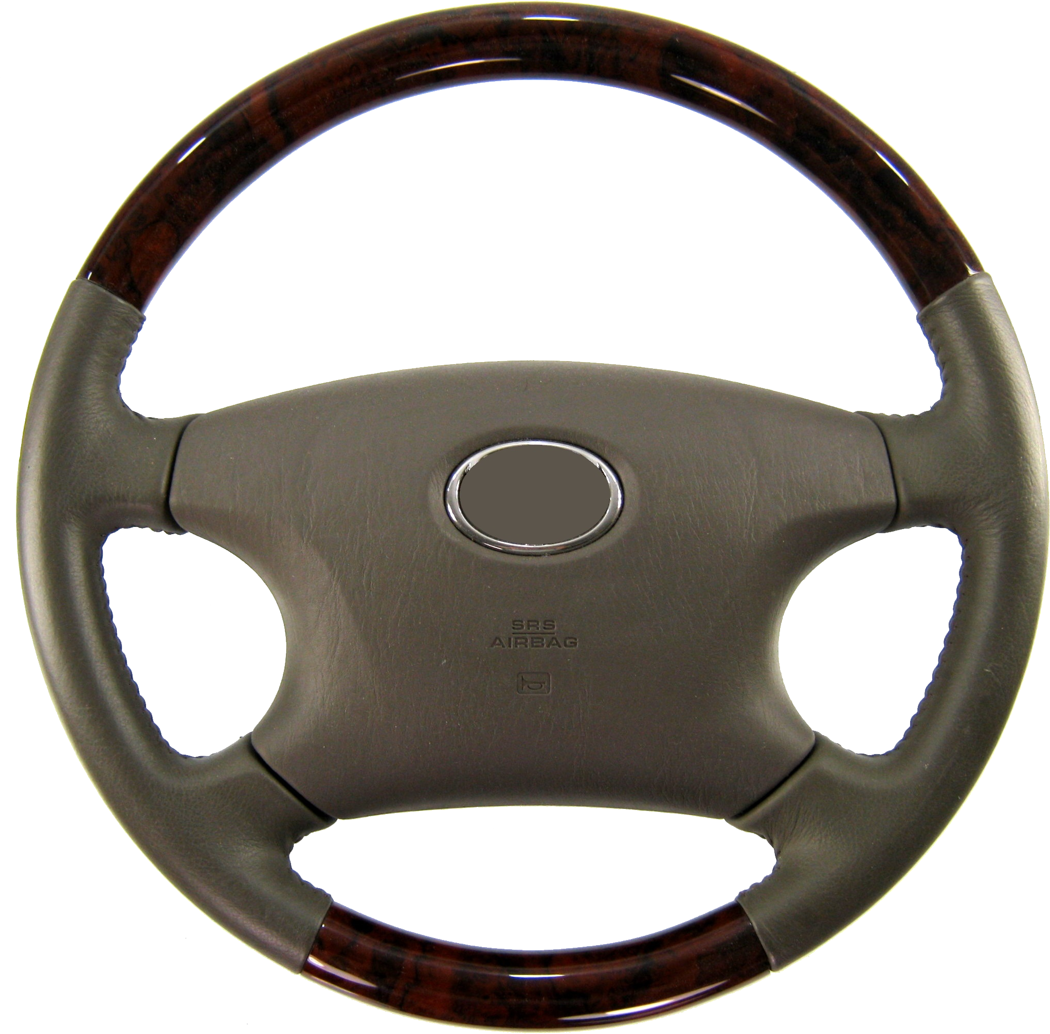
PERCEPTUAL DRIVING PROGRAM
GOALS OF THE PROGRAM
Learn effective and efficient perceptual driving skills
Learn how to make proper responses to problem traffic situations once they are identified and evaluated
This Photo by Unknown Author is licensed under CC BY-SA
Notes:
Two primary purposes of the Perceptual Driving Program
• Learn effective and efficient perceptual driving skills.
• Learn how to make proper responses to problem traffic situations once they are identified and evaluated.

Slide 7
What is a Low Risk Driver?
A driver who:
IDENTIFIES HAZARDS
(real or potential)
and REDUCES the RISK or AVOIDS these HAZARDS by:
ADJUSTING SPEED and/or POSITION and,
COMMUNICATES INTENTIONS
Notes:
"A driver who identifies real and/or potential hazards and reduces the risk of these hazards by adjusting speed and/or position and communicates to others his/her intentions."

Slide 8
PERCEPTUAL DRIVING PROGRAM
  Improving Perceptual Skills
  Identifying Traffic Controls
  Identifying Highway Conditions
  Identifying Other User Actions
  Identifying ALL HTS Events
  Identifying and Evaluating Conflict Probabilities
  Responding to Problem Situations
Seven Sessions
Notes:
This program is divided into seven sessions:
Improving Perceptual Skills
Identifying Traffic Controls
Identifying Highway Conditions
Identifying Other User Actions
Identifying All HTS Events
Identifying and Evaluating Conflict Probabilities
Responding To Problem Situations
Session One introduces the nature of the perceptual process and how it applies to the driving task. Three general perceptual habits are identified which serve as the basis for developing succeeding sessions.
Sessions Two through Five provide drivers with efficient visual habits for "where to search" and "what to search for." These identification habits along with the basic concepts of traction, space, and visibility are applied and evaluated. The four sessions correspond to the textbook chapters on driving environments.
Session Six provides drivers with guidelines for analyzing and interpreting what they have perceived in the traffic scene. This serves as a basis for predicting the actions of other users and the identification of conflict probabilities. Training exercises are conducted with the use of case study diagrams and traffic scenes.
Session Seven provides drivers with guidelines for making proper responses to problem traffic situations. It ties together the mental skills of identifying, evaluating, and deciding into one overall habit pattern. The focus is on timing, positioning, and communication. Problem situations are provided for applications and feedback. Textbook chapters on interacting with other traffic can be used as reading assignments for both Sessions Six and Seven.

Slide 9
TEEN CRASH ERRORS
Teen Drivers are over-represented in crashes involving these driving maneuvers
  Driving on wet pavements
  Distractions from passengers
  Pulling out from a STOP sign
  Left turns across traffic
  Keeping a safe space margin between vehicles
  Negotiating curves
  Maintaining vehicle control (speeding)
  Changing Lanes and Passing
Notes:
Teenage drivers are over represented in crashes involving the following types of driving maneuvers.
Driving on wet pavements.
Driving with passengers causing distractions.
Pulling out from a stop sign.
Turning left across traffic.
Maintaining a safe distance between vehicles.
Negotiating highway curves day and night.
Maintaining vehicle control (effects of speeding).
Changing lanes and passing.

Slide 10
Teen Driver Crash Statistics
2017 PA Crash Facts and Statistics
https://crashinfo.penndot.gov/PCIT/welcome.html or http://www.dotcrashinfo.pa.gov/
Alcohol Related Crashes
Notes:
Introduce the latest crash statistics
Teenage drivers are over represented in crashes involving the following
data involving the 16-& 17types
of driving maneuvers.
year-old driver.
• Driving on wet pavements.
The information to perform
• Driving with passengers causing distractions.
these maneuvers correctly
• Pulling out from a stop sign.
is addressed throughout
• Turning left across traffic.
Module III. The crash data needs to be emphasized as you teach the perception and driving strategy and
• Maintaining a safe distance between vehicles. • Negotiating highway curves day and night. • Maintaining vehicle control (effects of speeding). • Changing lanes and passing.
involve the students in the suggested activities of each lesson.
Note: Students need to know the latest crash data involving their age groups and to be instructed

Slide 11
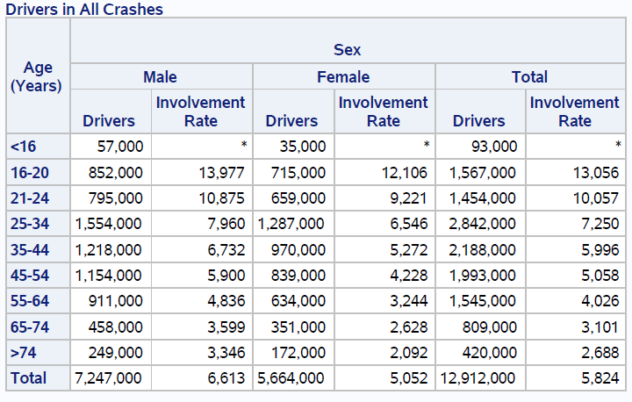
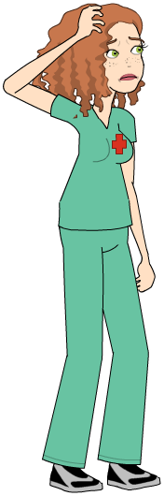
Teen Driver Crash Statistics
2016 NHTSA TSF Report
Notes:
Introduce the latest crash
Teenage drivers are over represented in crashes involving the following
data involving the 16-& 17types
of driving maneuvers.
year-old driver.
• Driving on wet pavements.
The information to perform
• Driving with passengers causing distractions.
these maneuvers correctly
• Pulling out from a stop sign.
is addressed throughout
• Turning left across traffic.
Module III. The crash data needs to be emphasized as you teach the perception and driving strategy and
• Maintaining a safe distance between vehicles. • Negotiating highway curves day and night. • Maintaining vehicle control (effects of speeding). • Changing lanes and passing.
involve the students in the suggested activities of each lesson.
Note: Students need to know the latest crash data involving their age groups and to be instructed

Slide 12

Teen Driver Crash Statistics
Notes:
Introduce the latest crash
Teenage drivers are over represented in crashes involving the following
data involving the 16-& 17types
of driving maneuvers.
year-old driver.
• Driving on wet pavements.
The information to perform
• Driving with passengers causing distractions.
these maneuvers correctly
• Pulling out from a stop sign.
is addressed throughout
• Turning left across traffic.
Module III. The crash data needs to be emphasized as you teach the perception and driving strategy and
• Maintaining a safe distance between vehicles. • Negotiating highway curves day and night. • Maintaining vehicle control (effects of speeding). • Changing lanes and passing.
involve the students in the suggested activities of each lesson.
Note: Students need to know the latest crash data involving their age groups and to be instructed

Slide 13
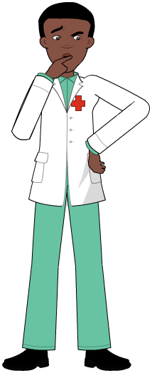
Teen Driver Crash Statistics
Notes:
Introduce the latest crash
Teenage drivers are over represented in crashes involving the following
data involving the 16-& 17types
of driving maneuvers.
year-old driver.
• Driving on wet pavements.
The information to perform
• Driving with passengers causing distractions.
these maneuvers correctly
• Pulling out from a stop sign.
is addressed throughout
• Turning left across traffic.
Module III. The crash data needs to be emphasized as you teach the perception and driving strategy and
• Maintaining a safe distance between vehicles. • Negotiating highway curves day and night. • Maintaining vehicle control (effects of speeding). • Changing lanes and passing.
involve the students in the suggested activities of each lesson.
Note: Students need to know the latest crash data involving their age groups and to be instructed

Slide 14
Teen Driver Crash Statistics
https://webappa.cdc.gov/sasweb/ncipc/leadcause.html
National Center for Injury Prevention and Control, Centers for Disease Control and Prevention
Data Source: National Center for Health Statistics (NCHS), National Vital Statistics System
Notes:
Introduce the latest crash
Teenage drivers are over represented in crashes involving the following
data involving the 16-& 17types
of driving maneuvers.
year-old driver.
• Driving on wet pavements.
The information to perform
• Driving with passengers causing distractions.
these maneuvers correctly
• Pulling out from a stop sign.
is addressed throughout
• Turning left across traffic.
Module III. The crash data needs to be emphasized as you teach the perception and driving strategy and
• Maintaining a safe distance between vehicles. • Negotiating highway curves day and night. • Maintaining vehicle control (effects of speeding). • Changing lanes and passing.
involve the students in the suggested activities of each lesson.
Note: Students need to know the latest crash data involving their age groups and to be instructed

Slide 15
Statistics Resources
IIHS / HLDI
Insurance Institute for Highway Safety
Highway Loss Data Institute
https://www.iihs.org/iihs/topics/t/teenagers/fatalityfacts/teenagers
https://www.iihs.org/iihs/topics
PennDOT PA Crash Information Tool
PCIT
https://crashinfo.penndot.gov/PCIT/welcome.html
https://www-fars.nhtsa.dot.gov/Main/index.aspx
https://www.nhtsa.gov/
National Highway Traffic Safety Administration
CDC Wisqars Reporting
https://webappa.cdc.gov/sasweb/ncipc/leadcause.html
https://www.cdc.gov/injury/wisqars/index.html
Notes:
Links to statistics site. PCIT for Pa specific types, ages, counties.

Slide 16
End Session 1 Part 1A
Next: Session 1-3A
Habits to Improve Perception

