Slide 1
Social Engineering and Internal Threats
By Daniel Saylor
Based off research conducted and presented by Jayson Street

Slide 2
Social Engineering 101
“The use of deception to manipulate individuals into divulging confidential or personal information that may be used for fraudulent purposes.”
The problem with social engineering is that it cannot be combatted by traditional security solutions
Technical Solutions already fail to catch some mass campaign attempts
Spear phishing is so unique/tailored it is hard to detect
Victims are often unaware they are being attacked

Slide 3
Internal Threats
In July 2020, hackers gained access to 130 private and corporate twitter accounts with at least a million followers each.
Barack Obama, Elon Musk, Bill Gates,
Posted a phishing tweet promoting a bitcoin scam
Twitter admins were fooled into thinking the attacker was Twitter’s own IT department and gave attackers access to administration tools
cost Twitter 4% of it’s stock price and lost users nearly 300,000$ in bitcoin currency.

Slide 4
Categorizing Internal Threats
Social engineering should not by itself be considered the only threat vector.
internal threats are the real problem in a social engineering attack
The social engineering is going to occur and by itself cannot compromise security. Rather, an internal user must initiate the compromise on the attacker’s behalf. Thus, we must also address internal threats.
Types of internal threats:
Inadvertent
Just trying to do their job
Negligent
Carelessness/should’ve known better
Malicious
Intentionally trying to disrupt the business from the inside knowingly and willingly

Slide 5
What is failing?
Most employees do not care about your data
Security staff become complacent in violating procedure over time
On perimeter security for small/medium businesses often hinge on a front desk/receptionist
Average glass door requirements are high school diploma and good communication skills
Employees not empowered to question the unusual
There is only one thing that is more dangerous then no security: a false sense of security

Slide 6
Security Complacency
Security Staff are Human beings
Common security knowledge that humans dull with repetitiveness
A guard at the gate of a facility
In 2019, 2 civilians breached an air force base
Only found when one told airmen she had been kidnapped.
“The vehicle did not stop to have their credentials checked [at the main gate]. The [security force] sentry failed to stop the vehicle or initiate gate runner procedures which allowed the vehicle to successfully breach the installation."
Protocols were not followed because the security staff did not have a respect for the protocols in place.

Slide 7
Scenario
An individual approaches your cubical in a corporate building wearing a collared shirt. They claim to be from Regional IT. You have seen them walking around the office earlier in the day but do not recognize them. The office has a receptionist desk and badge-reader secured doors.

Slide 8
Scenario
The individual notifies you that they are doing a permissions right’s check to make sure your USB ports are not allowing cell-phones to be plugged into your computer.

Slide 9
Scenario
The individual plugs in a USB into the port and multiple command prompts appear and disappear on the screen

Slide 10
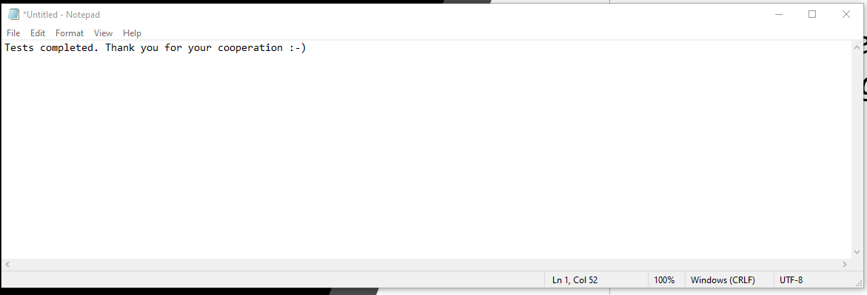
Scenario
A text document opens on the desktop:

Slide 11
Building Internal Resistance
Lunch and learn
teach employees how to protect their own data at home so they will protect yours
If someone practices something at home, they are far more likely to practice it at work
Make it fun
“where’s waldo” badge hunting.
Re-enforce by trainings and protocols
implementation of trainings/protocols alone is generally ineffective, unproductive, and generally a waste of time and money.
Policy should describe punishment and procedure when a staff member leaks information

Slide 12
The Main Points
Social engineering attacks need to combatted internally by your business employees, not solely through products and solutions
Security lapses are a threat to modern businesses and is the job of every employee regardless of title.
Building internal resilience to threats is not about hunting a secret agent, but training staff in a way they want to learn.

Slide 13
Part 2: Sock Puppet Stage
Social Engineering in Practice
Daniel Saylor

Slide 14
What is a sock puppet?

Slide 15
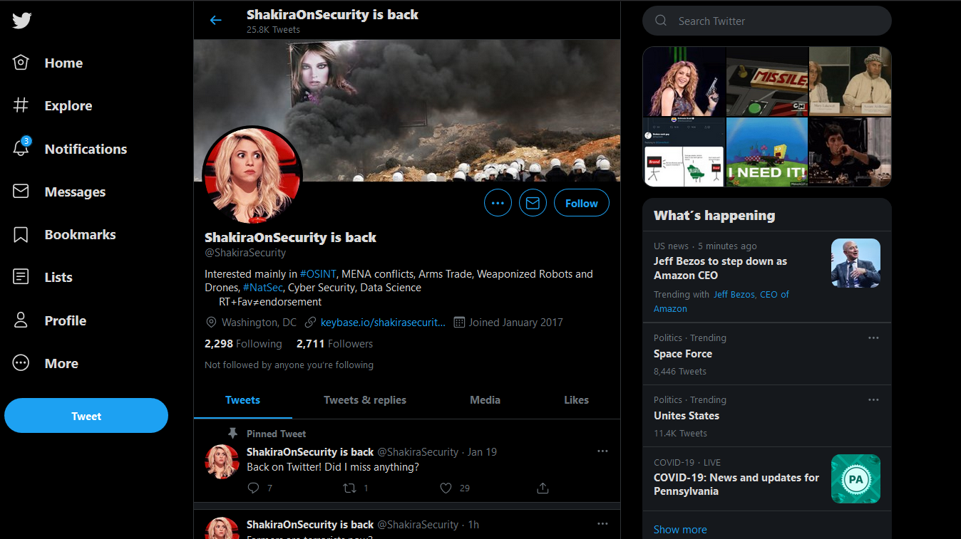
Alternative Identities in Cyber Security
Security Professionals: offensive operations/penetration tests
Criminals: anonymize and lead on police/investigators

Slide 16
False Flag Operations
With modern technology, the ability to create a totally different identity is startingly easy.
Randomized results: AI Generated profile photos, privacy guaranteed services and middleman services allow for the construction of a fake identity for cheap

Slide 17
Verifying Poorly Made Identities
Email Address Lookup/Verify
Hunter.io - https://hunter.io/
Phonebook.cz - https://phonebook.cz/
VoilaNorbert - https://www.voilanorbert.com/
Verifying Email Exists
Email Hippo - https://tools.verifyemailaddress.io/
Email Checker - https://email-checker.net/validate
Clearbit Connect - https://chrome.google.com/webstore/detail/clearbit-connect-supercha/pmnhcgfcafcnkbengdcanjablaabjplo?hl=en

Slide 18
Other tools
Creating an Effective Sock Puppet for OSINT Investigations – Introduction - https://jakecreps.com/2018/11/02/sock-puppets/
The Art Of The Sock - https://www.secjuice.com/the-art-of-the-sock-osint-humint/
Reddit - My process for setting up anonymous sockpuppet accounts - https://www.reddit.com/r/OSINT/comments/dp70jr/my_process_for_setting_up_anonymous_sockpuppet/
Basic Starter
Fake Name Generator - https://www.fakenamegenerator.com/
This Person Does not Exist - https://www.thispersondoesnotexist.com/
Private Credit Cards
Privacy.com - https://privacy.com/join/LADFC - *Referral link. We each get $5 credit on sign up.

Slide 19
How are sock puppets being combatted?
Both criminals and professionals use sock puppets
Typical preventative methods:
Anonymizer active during signup
Tor
VPN
VoIP Phone numbers
Google Numbers
Flagged Email Extensions (10 minute mail, ect)
Money as a Barrier

Slide 20
Activity Scope
While this project has been designed to give you as much freedom as possible to conduct your investigation, straying from the target is always a risk. Activities that fall within the boundaries of the assignment are called ‘in scope,’ and everything else is considered ‘out of scope.’ Therefore, the scope has been defined as follows:
The following URLS are valid and can contain information/flags: steamcommunity.com, Twitter.com, Tumblr.com, Github.com, Facebook.com, drive.google.com, and pastebin.com.
The following URLS can contain useful information for research and solving puzzles: cryptii.com, crypto.interactive-maths.com
The user Gabriel Kruger is out of scope

Slide 21
Rules of engagement
Rules Of Engagement: Because of the nature of this activity, the rules of engagement are as follows:
Under no circumstances ‘follow’ or ‘friend’ the target.
Under no circumstances log in to any account during the investigation.
Under no circumstances attempt to contact the target through direct messaging, commenting or any other means.

Slide 22
Time to hunt
https://steamcommunity.com/id/jackmanser25/

