Slide 1
Cyber Security Club 9/7/21
Franklin may

Slide 2
Cyber Security in the news
Howard University internet outage due to ransomware attack
This past Friday Howard University’s IT team detected unusual activity on the network
The school’s Enterprise Technology Services (ETS) intentionally shut down the network to investigate
Has been announced that this was dur to a ransomware attack, and are actively restoring operations
Classes canceled for today 9/7/2021

Slide 3
News cont.
Malicious Office documents make up 43% of all malware downloads
Millions use Microsoft Office documents daily
Researchers at Atlas VPN
EMOTET is most widely used
EMOTET injected into word files allowing the installation of other malicious software

Slide 4
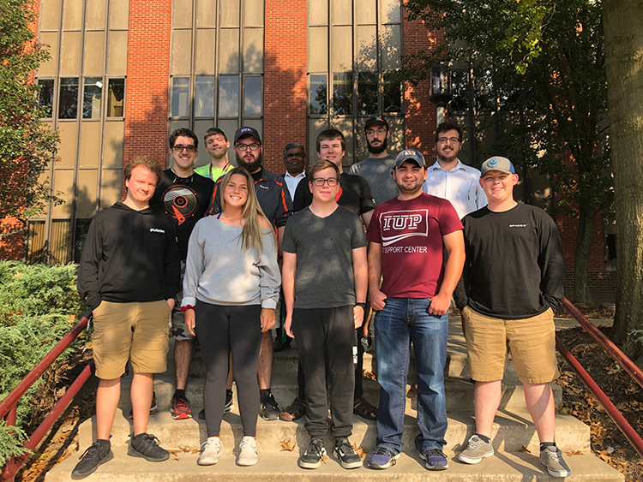
Cyber Security club activities
2019 CAE-NE Hackathon
CTF portion
Blue Team portion
Conducted remotely
First Place for IUP

Slide 5
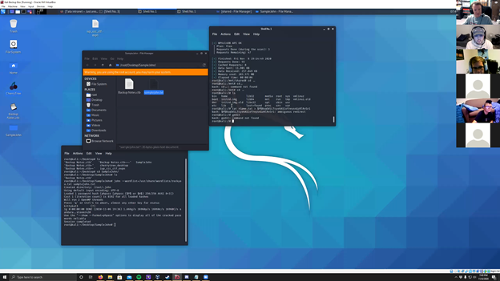
Cyber security club activities cont.
2020 Hackathon
Conducted over zoom due to COVID
Hosted by IUP
Connect to VPN in order to attack vulnerable machine
Goal was to obtain root access

Slide 6
Cyber Security Club Activities Cont.
Hack the Box
Overthewire.org
Introductions of topics such as Ransomware, Keyloggers, Memory Acquisition/Analysis, and Enumeration

Slide 7
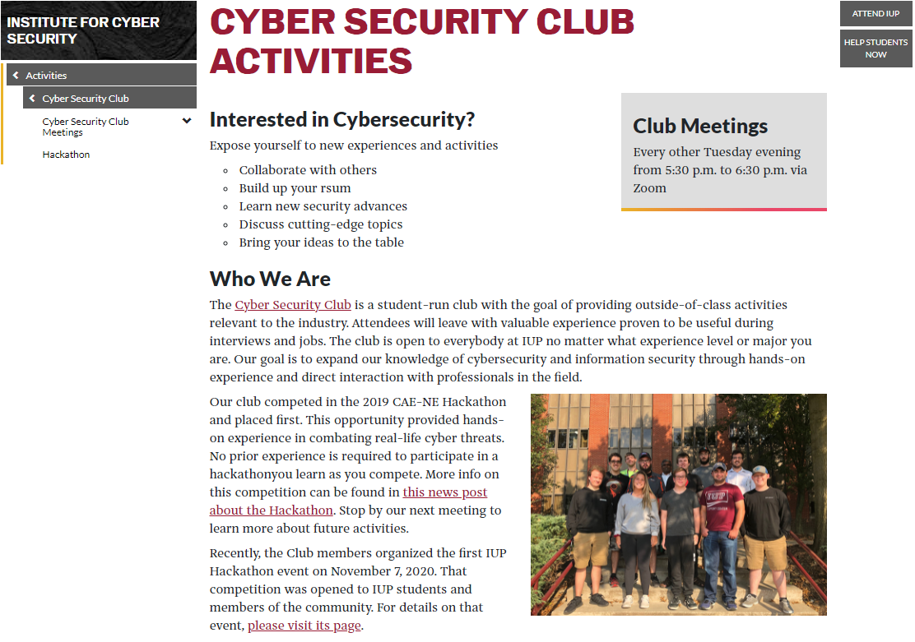

Slide 8
What would you like to see

Slide 9
Elections
President
Provides leadership to officers and members
Leads/teaches majority of meetings
Vice President
Plans/coordinates meetings in cooperation with the President
Leads/teaches meetings in the President’s stead
Secretary
Takes Meeting Minutes
Sends meeting announcement emails
Treasurer
Takes care of financial decisions made by the club

Slide 10
References
https://wjla.com/news/local/howard-university-investigates-alleged-ransomware-attack?&web_view=true
https://www.hackread.com/malicious-office-documents-malware-downloads/?web_view=true
https://www.hackthebox.eu/
https://overthewire.org/wargames/
https://www.iup.edu/cybersecurity/activities/cyber-security-club/

