Slide 1
IUP Cyber Security Club
Meeting 8 - 2/21/2023

Slide 2
Today’s Agenda
Announcements
Hack the Hospital
Professional Development Tips
Resume
LinkedIN
Internships
Personal Projects

Slide 3
Announcements

Slide 4
Hack the Hospital
Blue Team networking hackathon
March 20-24 or March 27-31
https://www.hacktheuniverse.tech/hack-the-building-2-cae-student-pass/

Slide 5
Professional Development Tips

Slide 6
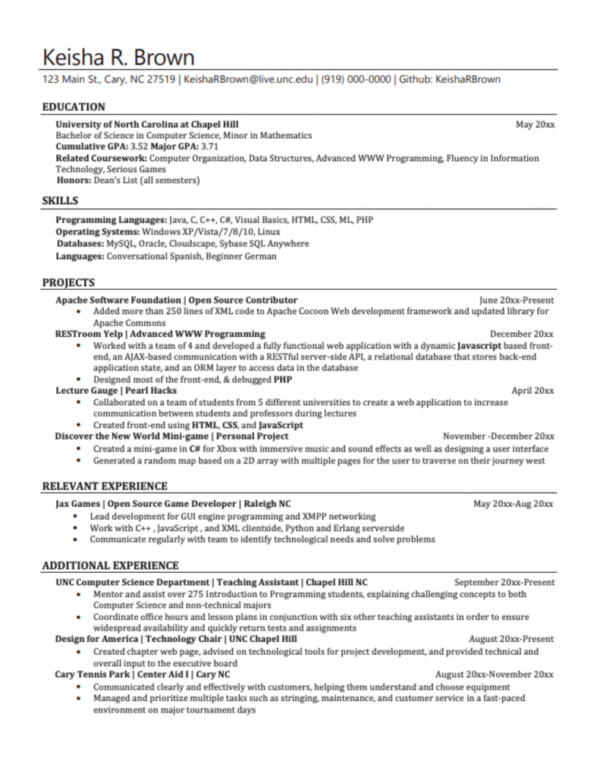
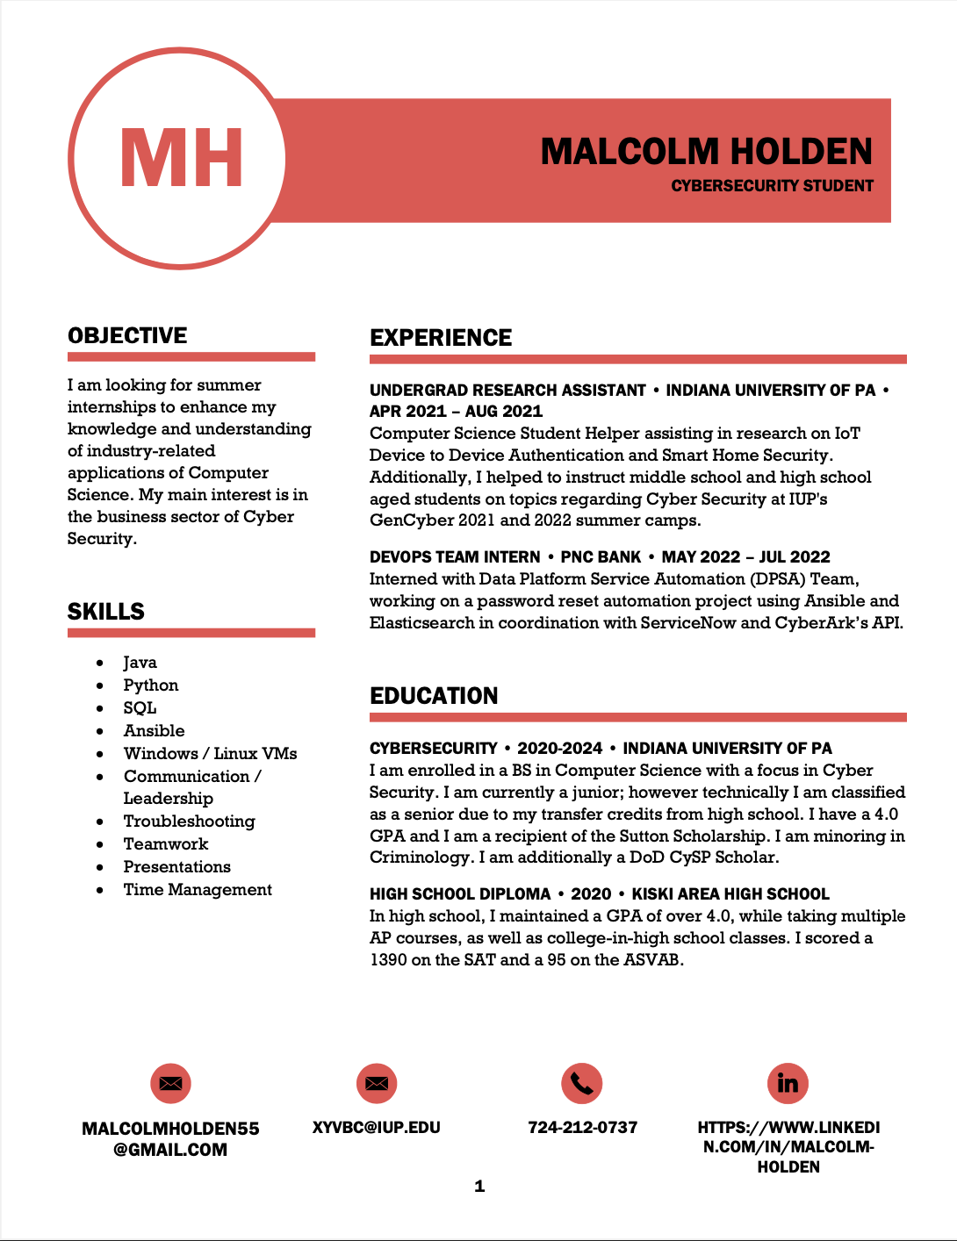
Resumes
Concise
Black/White
Formatted neatly
Eye-Catching
Bright colors
Noticeable
Memorable

Slide 7
Important Resume Information
Contact Information
Education
Skills
Other Experiences (Relevant with most priority)
Personal Projects
Bio? / Intro?

Slide 8
LinkedIN
Digital resume
Make ‘connections’
Used for social networking
Discord
https://www.linkedin.com/in/malcolm-holden/

Slide 9
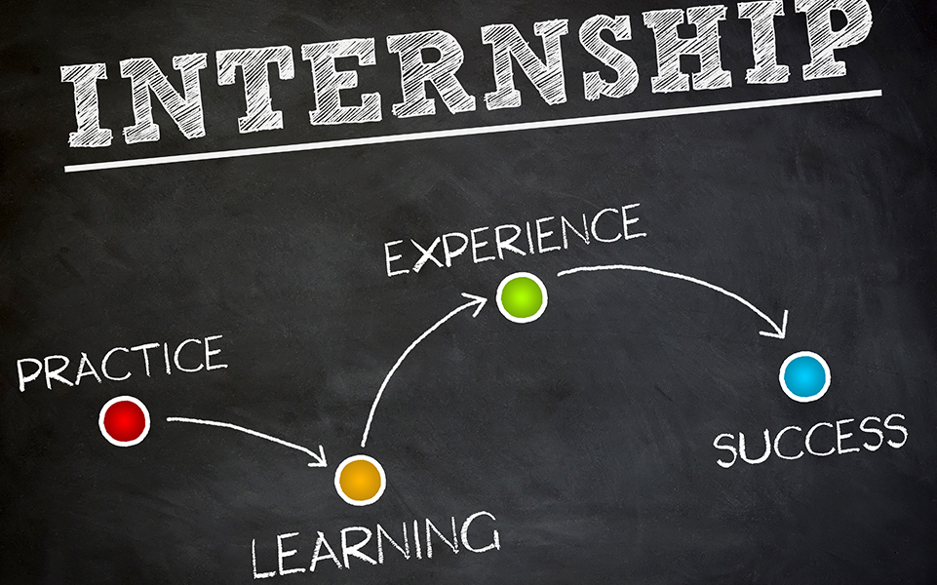
Internships
Can be very important
Apply early, keep applying diversely.
Company ideas:
Tech companies
Banks
Retail companies
In-Person vs Remote
Sources:
Linkedin Jobs
Company Websites
Indeed
Chegg Internships
Career Fairs

Slide 10
Personal Projects
Good extra addition to resume
Lots of different topics and ideas
https://www.simplilearn.com/top-cyber-security-projects-article
https://intellipaat.com/blog/cyber-security-project-ideas/
https://cybercademy.org/project-ideas/

