Slide 1
IUP Cybersecurity Club
Meeting 7:11/13/2024

Slide 2
Housekeeping
Any questions on the previous HTB module?
Any general questions regarding
HTB Binary Badlands competition
Upcoming NCAE competition

Slide 3
Secure Programming
An Overview

Slide 4
What is Secure Programming?
Designing code specifically to prevent vulnerabilities, attacks, and other threats within an application
“Security first” approach (Security by Design)
There are specific approaches for every library, package, language, framework imaginable

Slide 5
Sounds Simple, Right?
I really only have to look out for…
Buffer overflow
Path traversal
Injection
And all that is pretty much inherently handled by standard issue programming languages/frameworks right?

Slide 6
Of Course Not!
As a developer/auditor, you should look for…
Password requirements
Entropy, MFA, disallow reusing old passwords, password change rate
What kind of MFA is acceptable security-wise?
Access control
Admin
Managing admin accounts for applications separately from regular accounts
Stricter security for admin accounts, more control/monitoring
Admins will have their own applications/pages/apis etc.
Preventing access (Zero-Trust principles)
Require validation at every layer
Using tokens to validate API calls application side
Can prevent unauthorized access to data
Error handling/logging
Replace default error logging
Default errors give indication of what software you are using (maybe even the version)
Avoid giving useful information in error logs
Ex. Return an error saying, “Please don’t insert a really long string into this input, it will break this awful validator I’m using on this outdated software version that is also exploitable.”

Slide 7
More Considerations
Input sanitization/validation
Sanitizing/validating input at every layer possible
Output encoding
Encoding any outgoing information
Can give information about the system if not properly configured
Could otherwise be intercepted outright and stolen
Server → Client
Client → Server
Threat modeling
Document
Document all possible vulnerabilities within the scope of your investigation
Locate
Locate the specific points of access/files/etc. that are vulnerable
Address
Fix the actual vulnerabilities with implementation of best security practices
Validate
Test the results to ensure the vulnerabilities are patched

Slide 8
Examples of Insecure Programming
Improper Password Requirements (2015)
Ashley Madison site users had their data stolen
Inadequate password requirements
Short, no special characters/number requirement
Poorly stored passwords
Hashed poorly or sometimes not at all
How to fix?
Hash passwords, require frequent password changes (~1/year minimum)
Implement MFA
Harsher password requirements
Lack of proper access control (2016)
Uber’s cloud servers were illegally accessed
An access token was exposed in Github
57 million user records stolen
How to fix?
Access tokens should have expiration dates
Obviously should NOT be uploaded to a Github repo ever (whether it is public or private)
Can set up detection of keys and other sensitive info, but can also implement security checks in the application pipeline at every step to ensure that these leaks don’t happen

Slide 9
Insecure Programming cont.
Lack of proper error handling/logging (2017)
Cloudflare data was leaked by a buffer overflow error (Cloudbleed)
Lack of error handling – errors where sensitive information was being returned and cached in random users browsers was not detected by Cloudflare’s error handling systems at all
Was discovered by Google’s Project Zero team and reported to Cloudflare
“It turned out that the underlying bug that caused the memory leak had been present in our Ragel-based parser for many years but no memory was leaked because of the way the internal NGINX buffers were used. Introducing cf-html subtly changed the buffering which enabled the leakage even though there were no problems in cf-html itself.” – Cloudflare CTO
1 in 3.3 million requests potentially resulted in memory leakage
How to avoid?

Slide 10
Auditing Insecure Programs (Buffer Overflow)
Computer Memory
Storage of instructions and data
“Von Neumann architecture”
Running process is stored in memory
Allocated memory is accessed in however the way the program is intended
Can be manipulated by the program itself
Demo of stack buffer overflow in C using GNU Debugger (gdb)

Slide 11
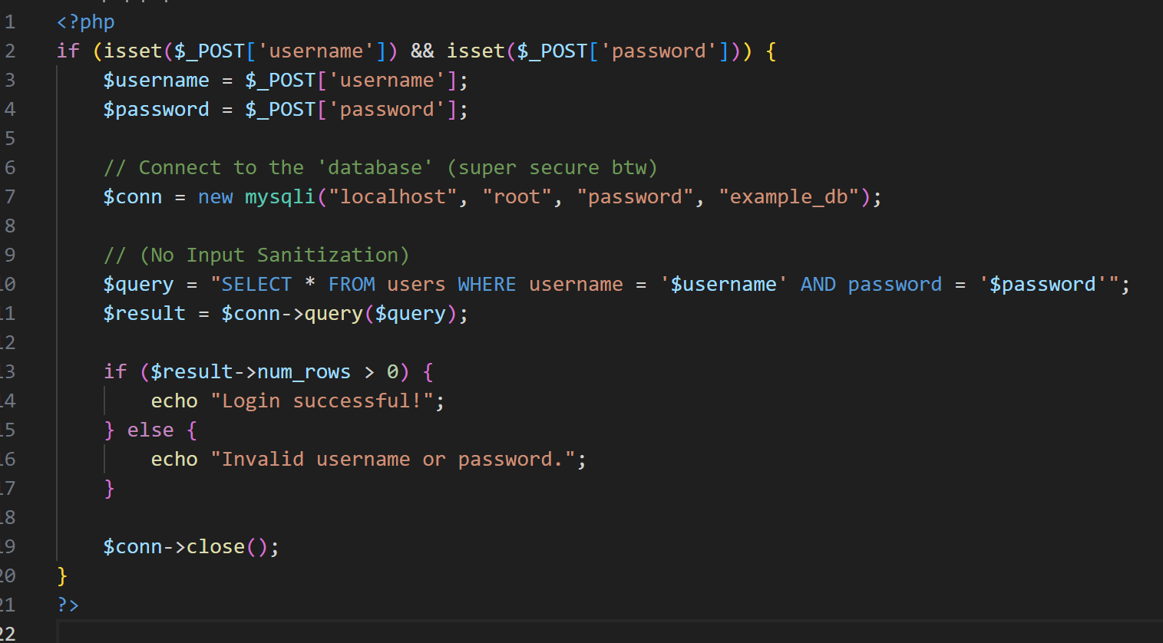
For Today’s exercise (SQL Injection)
Injecting SQL into forms in HTML in order to execute SQL on the client side
By adding ' OR '1'=‘1 to the end of the input, you can escape the quotes and execute and inject SQL into the existing statement

Slide 12
Now time for the exercise!
Complete the following challenges in Pico CTF (SQL Injection)
Go to PicoCTF Gym
SQLiLite
More SQLi (Need Burp Suite for this)
SQL Direct (Uses PostgreSQL)

