Slide 1
IUP Cybersecurity Club
Meeting 6:11/6/2024

Slide 2
Housekeeping
Questions about HTB module this week?
HTB Binary Badlands competition
13th - 15th December, 2024
NCAE signups (more members?!)
Any general questions?

Slide 3
What are we doing today?
NCAE Minihack (for real this time)
Check discord for the FULL GUIDE
Complete the minimum to make all the green lights for the Minihack
Then we can discuss the full competition
What to do with the environment we just created
Backups, DNS, protecting the services/VMs etc.
If you signed up for the competition and want to do infrastructure
Watch the NCAE Youtube tutorial available through their website as well
We have to divide the team for CTFs/Infrastructure
There are CTF labs as well on the NCAE site

Slide 4
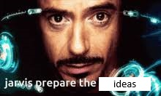
Final Thoughts
If you have any suggestions/requests for topics to cover at club…
Let us know RIGHT NOW
Or later

