Slide 1
Welcome Understanding the New OSHA COVID-19 NEP (National Emphasis Program)
Will begin at 10:30am Presented by: Rick Mason, CSP, CIH, CHMM
Safety & Health Consultant
Pennsylvania OSHA Consultation
Pennsylvania OSHA Consultation Office Phone: 800-382-1241 or 724-357-4095 Website: www.iup.edu/pa-oshaconsultation

Slide 2
Questions
Chat is open to submit questions. We will be answering questions through this chat feature. If due to the technical nature of the question a more thorough response is required, we will post the answer on our website within seven days of the webinar.
Presenter email:
rmason@iup.edu

Slide 3
LEARNING OBJECTIVES
Gain an understanding President Biden’s Executive Order on Protecting Worker Health and Safety as it pertains to OSHA
Gain an understanding of OSHA’s National Emphasis Program – Coronavirus Disease 2019 (COVID-19)
Gain an understanding of recent OSHA Guidance, Protecting Workers: Guidance on Mitigating and Preventing the Spread of COVID-19 in the Workplace, January 29, 2021

Slide 4
Executive Order on Protecting Worker Health and Safety JANUARY 21, 2021
Requires:
Revised guidance on workplace COVID-19 safety – issued January 29
Consider whether any COVID-19 emergency temporary standards are necessary, and if necessary, issue by March 15 – stay tuned
Review enforcement efforts and identify changes that could better protect workers and ensure equity in enforcement - memo March 12
Launch a program to focus enforcement efforts on violations that put the largest number of workers at serious risk or are contrary to anti-retaliation principles – NEP issued March 12
Coordinated outreach campaign to inform workers and their representatives of their rights - special emphasis on communities hit hardest by the pandemic

Slide 5
NATIONAL EMPHASIS PROGRAM
Purpose
Ensure that employees in high-hazard industries are protected from the hazard of contracting SARS-CoV-2 (severe acute respiratory syndrome coronavirus 2)
Targets establishments that have workers with increased potential exposure to this hazard, and that puts the largest number of workers at serious risk
Ensure that workers are protected from retaliation
preventing retaliation where possible
distributing anti-retaliation information
promptly referring allegations of retaliation to the Whistleblower Protection Program

Slide 6
NATIONAL EMPHASIS PROGRAM
Expiration.
This Direction is effective for no more than 12 months from the effective date, unless canceled or extended by a superseding directive.

Slide 7
NATIONAL EMPHASIS PROGRAM
Background
Enhances OSHA’s emphasis on COVID-19-related hazards by
formalizing components for planned/programmed and follow-up inspections in workplaces where employees have a high frequency of close contact exposures and where this hazard is prevalent
reaffirms OSHA’s adherence to longstanding inspection policy that relies predominantly on on-site (in person) inspections

Slide 8
NATIONAL EMPHASIS PROGRAM
XI. Goal.
Significantly reduce or eliminate worker exposures to SARS-CoV-2
targets industries and worksites where employees may have a high frequency of close contact exposures
accomplished by a combination of inspection targeting, outreach to employers, and compliance assistance
perform a high percentage of COVID-19 inspections (at least 5 percent) focusing Agency resources on workplace exposures to SARS-CoV-2 in certain critical industries until further notice

Slide 9
NATIONAL EMPHASIS PROGRAM – Who is covered?
Master List.
Two Master Lists for site selection
All establishments identified as having a NAICS code listed in Appendices A and B
Establishments in Appendices A and B and having an elevated illness rate as indicated by Form 300A data
Generated relying predominantly on Appendix A
Area Offices may add establishments to the generated master lists based on information from appropriate sources

Slide 10
NATIONAL EMPHASIS PROGRAM – Who is covered?
Appendix A. Table 1. Targeted Industries in Healthcare
NAICS codes in Appendix A were derived from a review of OSHA’s enforcement activities in 2020
621111 | Offices of Physicians (except Mental Health Specialists) | 622310 | Specialty (except Psychiatric and Substance Abuse) Hospitals
621210 | Offices of Dentists | 623110 | Nursing Care Facilities (Skilled Nursing Facilities)
621610 | Home Health Care Services | 623210 | Residential Intellectual and Developmental Disability Facilities
621910 | Ambulance Services | 623311 | Continuing Care Retirement Communities
622110 | General Medical and Surgical Hospitals | 623312 | Assisted Living Facilities for the Elderly
622210 | Psychiatric and Substance Abuse Hospitals

Slide 11
NATIONAL EMPHASIS PROGRAM – Who is covered?
Appendix A. Table 2. Targeted Industries for non-Healthcare
*Note: Establishments within the Temporary Help Services (NAICS 561320) industry should not be automatically included in the targeting list for programmed inspections. Although this industry has been among the top industries with OSHA enforcement activities related to COVID-19, this has primarily occurred where services occurred at host healthcare facilities and other high-hazard workplaces.
311612 | Meat Processed from Carcasses | 493110 | General Warehousing and Storage
311611 | Animal (except Poultry) Slaughtering | 561320 | Temporary Help Services*
311615 | Poultry Processing | 722511 | Full-Service Restaurants
445110 | Supermarkets and Other Grocery (except Convenience) Stores | 722513 | Limited-Service Restaurants
452112 | Discount Department Stores | 922140 | Correctional Institutions

Slide 12
NATIONAL EMPHASIS PROGRAM – Who is covered?
Appendix B: Secondary Target Industries for the COVID-19 NEP
11xxxx | Agriculture, Forestry, Fishing & Hunting | 32412x | Asphalt Paving, Roofing, and Saturated Material Manufacturing
236xxx | Construction of Buildings* | 32419x | Other Petroleum and Coal Products Manufacturing
237xxx | Heavy and Civil Engineering Construction* | 325xxx | Chemical Manufacturing
238xxx | Specialty Trade Contractors* | 326xxx | Plastics and Rubber Product Manufacturing
311xxx | Food Manufacturing | 327xxx | Nonmetallic Mineral Product Manufacturing
3121xx | Beverage Manufacturing | 331xxx | Primary Metal Manufacturing
321xxx | Wood Product Manufacturing | 332xxx | Fabricated Metal Product Manufacturing
322xxx | Paper Manufacturing | 333xxx | Industrial Machinery Manufacturing
Page 1 of 2

Slide 13
NATIONAL EMPHASIS PROGRAM – Who is covered?
Appendix B: Secondary Target Industries for the COVID-19 NEP
334xxx | Computer & Electronic Product Manufacturing | 4851xx | Urban Transit Systems
335xxx | Electrical Equipment, Appliance & Component Manufacturing | 4852xx | Interurban & Rural Bus Transportation
336xxx | Transportation Equipment Manufacturing* | 4854xx | School & Employee Bus Transportation
33711x | Wood Kitchen Cabinet & Countertop Manufacturing | 485991 | Special Needs Transportation
3399xx | Other Miscellaneous Manufacturing | 491xxx | Postal Service*
44422x | Nursery, Garden Center & Farm Supply Stores | 54142x | Industrial Design Services
445xxx | Additional Food & Beverage Stores | 811219 | Other Electronic & Precision Equipment Repair & Maintenance
4523xx | General Merchandise Stores, including Warehouse Clubs & Centers | 81131x | Commercial & Industrial Machinery & Equipment (except Automotive & Electronic) Repair & Maintenance
Page 2 of 2

Slide 14
NATIONAL EMPHASIS PROGRAM
* NOTE: For certain industries such as these (Postal Services, NAICS 491110, Ship Building and Ship Repairing, NAICS 336611, and Construction, NAICS 236xxx, 237xxx, 238xxx), some of which have had a large number or high rate of COVID-19-related complaints in some communities during 2020, Area Directors should use discretion based on local information pertaining to COVID-19-related workplace exposures, to determine whether an industry should be considered in the generating of their master lists of establishments.

Slide 15
NATIONAL EMPHASIS PROGRAM
Area Offices have discretion to delete establishments:
that had a comprehensive or partial health inspection that addressed COVID-19 hazards occurring within the twelve (12) previous months and:
a. Issued serious citations related to COVID-19 hazards which are under contest or for which the abatement period has not yet expired; or
b. No serious citations were issued for hazards related to exposure to SARS-CoV-2; or
Serious citation(s) were issued for hazards related to exposure to SARS-CoV-2 but a follow-up inspection documented appropriate and effective efforts by the employer to abate the serious hazards

Slide 16
NATIONAL EMPHASIS PROGRAM
Inspection Procedures.
Inspections are normally not initiated under an NEP until the required 90-day outreach is conducted
However, because OSHA has continually conducted outreach at the National, Regional, and Area Office levels throughout the duration of the pandemic outbreak, the 90-day outreach threshold has been met and Area Offices may begin to initiate inspections under this NEP on the effective date – March 12, 2021
Targeting should begin at least two weeks after the date of issuance

Slide 17
NATIONAL EMPHASIS PROGRAM
Whistleblower Protections
Workers:
requesting inspections,
complaining of SARS-CoV-2 exposure
reporting injuries or illnesses or retaliation
may be covered under one or more whistleblower protection statutes
Inform the workers of their protections from retaliation and refer them to www.whistleblowers.gov for more information, including how to file a retaliation complaint
If the worker is alleging some form of retaliation, the Area Office must submit a referral to the Regional Whistleblower Protection Program

Slide 18
NATIONAL EMPHASIS PROGRAM
Cooperative Programs.
Employers participating in cooperative programs may be exempt from programmed inspections
if an on-site consultation visit is in progress, or
if the establishment is a participant in OSHA’s Voluntary Protection Programs (VPP) or the Safety and Health Achievement Recognition Program (SHARP) or Pre-SHARP

Slide 19
Protecting Workers: Guidance on Mitigating and Preventing the Spread of COVID-19 in the Workplace
Guidance posted January 29, 2021

Slide 20
COVID-19 Guidance
OSHA has not yet issued an Emergency Temporary Standard per the Presidential Executive Order on Protecting Worker Health and Safety, January 21, 2021
In the meantime, OSHA issued the Updated Interim Enforcement Response Plan on March 12, 2021 referring employees to Protecting Workers: Guidance on Mitigating and Preventing the Spread of COVID-19 in the Workplace, posted January 29, 2021

Slide 21
COVID-19 Guidance Executive Summary & Purpose
Employers should implement COVID-19 Prevention Programs in the workplace
OSHA will continue to update this guidance over time to reflect developments in science, best practices, and standards
This guidance is not a standard or regulation, and it creates no new legal obligations
Pursuant to the Occupational Safety and Health Act's General Duty Clause, Section 5(a)(1), requires employers to provide their workers with a workplace free from recognized hazards that are causing or likely to cause death or serious physical harm

Slide 22
COVID-19 Guidance The Roles of Employers and Workers – 16 steps
A workplace COVID-19 prevention program
Most effective way to mitigate the spread
Effective programs engage workers and their representatives at every step
Include the following 16 elements

Slide 23
COVID-19 Guidance The Roles of Employers and Workers – 16 steps
Workplace Coordinator
- responsible for COVID-19 issues on the employer's behalf.

Slide 24
COVID-19 Guidance The Roles of Employers and Workers – 16 steps
2. Hazard Assessment
- Identify where and how workers might be exposed to COVID-19 at work
- Most effective if it involves workers because they are most familiar with the conditions they face
occupational risk pyramid for COVID-19
https://www.osha.gov/Publications/OSHA3993.pdf
.

Slide 25
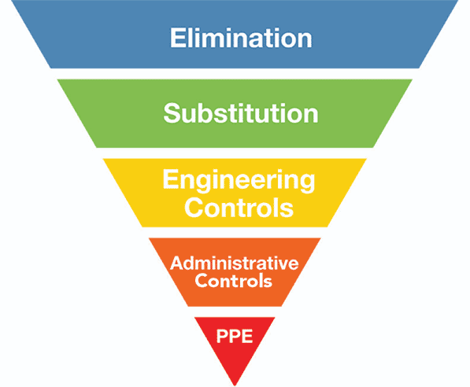
COVID-19 Guidance The Roles of Employers and Workers – 16 steps
Identify measures that will limit the spread of COVID-19, in line with the principles of the hierarchy of controls:
Eliminating the hazard, physical distancing in all communal work areas, remote work, telework; separating and sending home infected or potentially infected people from the workplace;
Engineering Controls, such as ventilation and barriers;
Administrative Policies, face coverings, staggered work shifts and traffic flow patterns, hygiene supplies, routine cleaning & disinfection
Personal Protective Equipment (PPE), respiratory protection programs, gloves

Slide 26
COVID-19 Guidance The Roles of Employers and Workers – 16 steps
Workers at Higher Risk - Consideration of protections for older adults and people who have serious underlying medical conditions
Workers with disabilities may be legally entitled to "reasonable accommodations" that protect them from the risk of contracting COVID-19
Employers should consider reasonable modifications for workers identified as high-risk including some or all work at home, or in less occupied, better-ventilated facilities

Slide 27
COVID-19 Guidance The Roles of Employers and Workers – 16 steps
System for communicating with workers - in a language they understand, and in a manner accessible to individuals with disabilities
Ask workers to report COVID-19 symptoms, possible exposures, and possible COVID-19 hazards at the workplace - without fear of reprisal
Communicate all policies and procedures implemented for responding to sick and exposed workers
See below additional elements involving educating and training workers of COVID-19 procedures
Best Practice is to create and test two-way communication systems that workers can use to self-report if they are sick or have been exposed, and that employers can use to notify workers of exposures and closures

Slide 28
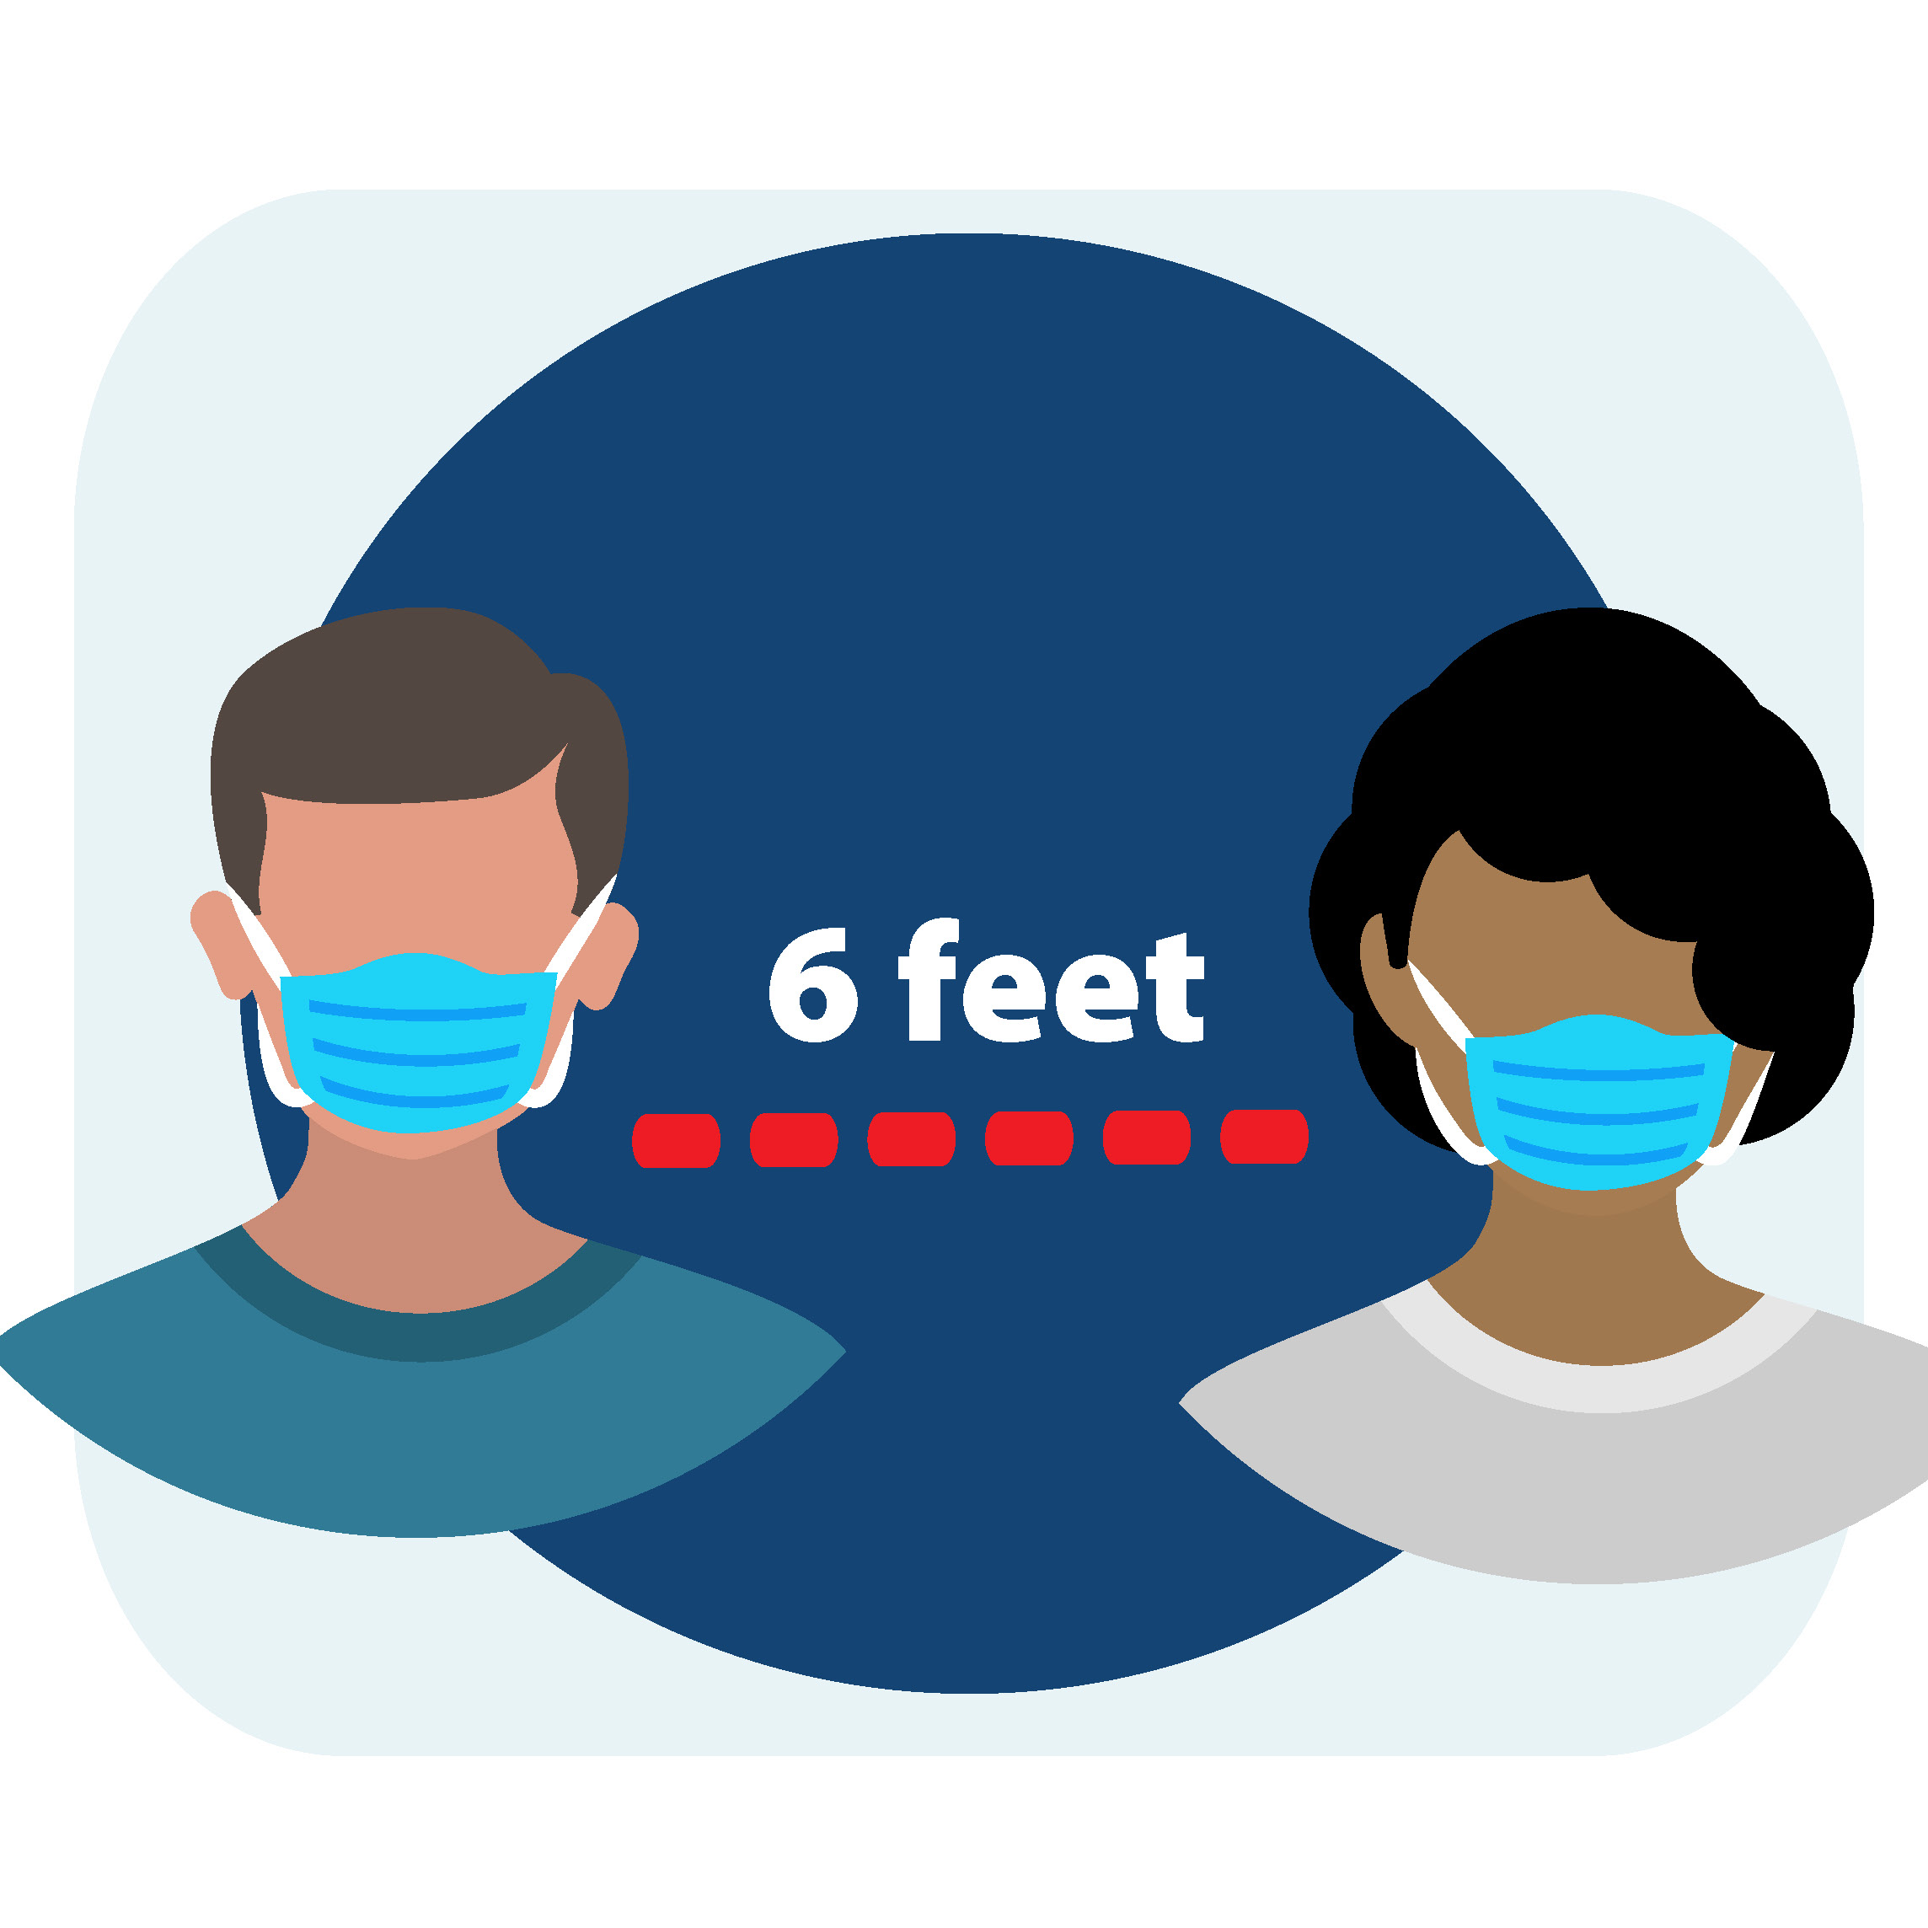
COVID-19 Guidance The Roles of Employers and Workers – 16 steps
Train workers on COVID-19 policies and procedures - use accessible formats and language. Communicate policies clearly, frequently, in plain language (including non-English languages, Sign Language or other accessible communication methods, if applicable), and in a manner accessible to individuals with disabilities. Communicate methods to employees, contractors, and any other individuals on site. Communications should include:
Basic facts about COVID-19 - how it is spread; importance of physical distancing, use of face coverings, and hand hygiene
Workplace policies and procedures implemented to protect workers from COVID-19 hazards (the employer's COVID-19 prevention program)
Track which workers have been informed and when.
Ensure workers understand their rights to a safe and healthful work environment, whom to contact with questions or concerns, and their right to raise safety and health concerns free of retaliation
Ensure supervisors are familiar with workplace flexibilities and other human resources policies and procedures

Slide 29
COVID-19 Guidance The Roles of Employers and Workers – 16 steps
Instruct workers who are infected or potentially infected to stay home and isolate or quarantine
Ensure absence policies are non-punitive
Policies should not encourage workers to come to work sick or when they have been exposed to COVID-19

Slide 30
COVID-19 Guidance The Roles of Employers and Workers – 16 steps
Minimize the negative impact of quarantine and isolation on workers
When possible, allow telework, or work in an area isolated from others
If those are not possible, allow workers to use paid sick leave, if available, or consider implementing paid leave policies to reduce risk for everyone at the workplace (The Families First Coronavirus Response Act provided certain employers 100% reimbursement through tax credits to provide employees with paid sick leave or expanded family and medical leave for specified reasons related to COVID-19 through March 31, 2021)

Slide 31
COVID-19 Guidance The Roles of Employers and Workers – 16 steps
Isolate workers who show symptoms at work - immediately separate from other workers, customers, and visitors, send home, and encourage to seek medical attention

Slide 32
COVID-19 Guidance The Roles of Employers and Workers – 16 steps
Perform enhanced cleaning and disinfection if someone in the facility is suspected or confirmed:
Once area is disinfected, it can be opened for use
Workers without close contact with the potentially infected person can return to the area immediately after disinfection
If it is more than 7 days since the infected person visited the facility, additional cleaning and disinfection is not necessary

Slide 33
COVID-19 Guidance The Roles of Employers and Workers – 16 steps
Enhanced cleaning and disinfection (continued)
Close areas used by the potentially infected person.
Open outside doors and windows to increase air circulation.
Wait as long as practical before cleaning or disinfecting - 24 hours is best.
Clean and disinfect all work areas and equipment used, such as offices, bathrooms, shared tools and workplace items, work surfaces, and shared electronics.
Vacuum if needed. If available use a HEPA vacuum (high-efficiency particulate air filter) and wait for space to be unoccupied.
Provide cleaning workers with disposable gloves and additional PPE (safety glasses, goggles, aprons) as required.
After cleaning, disinfect. Use an appropriate EPA-registered disinfectant, following requirements in OSHA standards 29 CFR 1910.1200 and 1910.132, 133, and 138 for hazard communication and PPE appropriate for exposure to cleaning chemicals.

Slide 34
COVID-19 Guidance The Roles of Employers and Workers – 16 steps
Providing guidance on screening and testing: inform workers of employer testing requirements, if any, and availability of testing options.
Note: Performing screening or health checks is not a replacement for other protective measures such as face coverings and physical distancing. Asymptomatic individuals or individuals with mild non-specific symptoms may not realize they are infected and may not be detected through screening.

Slide 35
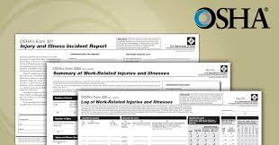
COVID-19 Guidance The Roles of Employers and Workers – 16 steps
Recording and reporting COVID-19 infections and deaths: Employers are responsible for recording work-related cases of COVID-19 illness on their Form 300 logs if the following requirements are met:
(1) the case is a confirmed case of COVID-19
(2) the case is work-related (as defined by 29 CFR 1904.5)
(3) the case involves one or more relevant recording criteria (set forth in 29 CFR 1904.7)

Slide 36
COVID-19 Guidance The Roles of Employers and Workers – 16 steps
Implementing protections from retaliation and setting up an anonymous process for workers to voice concerns about COVID-19-related hazards:
Section 11(c) of the OSH Act prohibits discharging or discriminating against an employee for engaging in various occupational safety and health activities.
Employers may not discriminate against employees for raising a reasonable concern about infection control to:
the employer
the employer's agent
other employees
a government agency
the public
or against an employee for voluntarily providing and wearing personal protective equipment, such as a respirator, face shield, gloves, or surgical mask

Slide 37
COVID-19 Guidance The Roles of Employers and Workers – 16 steps
Ensure workers know:
whom to contact with questions or concerns about safety and health
there are prohibitions against retaliation for raising concerns
NOTE: Consider using a hotline or other method for workers to voice concerns anonymously

Slide 38
COVID-19 Guidance The Roles of Employers and Workers – 16 steps
Make a COVID-19 vaccine or vaccination series available at no cost to all eligible employees
Provide information and training on the benefits and safety of vaccinations

Slide 39
COVID-19 Guidance The Roles of Employers and Workers – 16 steps
Do not distinguish between workers who are vaccinated and those who are not:
Workers who are vaccinated must continue to follow protective measures, such as wearing a face covering and social distancing
There is no evidence that vaccines prevent transmission of the virus from
The CDC explains that experts need to understand more about the protection that COVID-19 vaccines provide before deciding to change recommendations

Slide 40
COVID-19 Guidance The Roles of Employers and Workers – 16 steps
Other applicable OSHA Standards: OSHA's standards that apply to protecting workers from infection remain in place including:
requirements for PPE (29 CFR 1910, Subpart I (e.g., 1910.132 and 133))
respiratory protection (29 CFR 1910.134)
sanitation (29 CFR 1910.141),
protection from bloodborne pathogens: (29 CFR 1910.1030)
employee access to medical and exposure records (29 CFR 1910.1020)
There is no OSHA standard specific to COVID-19; however, employers still are required under the General Duty Clause, Section 5(a)(1) of the OSH Act, to provide a safe and healthful workplace that is free from recognized hazards that can cause serious physical harm or death

Slide 41
COVID-19 Guidance The Roles of Employers and Workers
Return To Work:
Employees who think or know they had COVID-19 and had symptoms, can return after:
At least 10 days since symptoms first appeared and
At least 24 hours with no fever without fever-reducing medication and
Other symptoms of COVID-19 are improving (loss of taste and smell may persist for weeks and need not delay the end of isolation)
Some workers might need to stay home and isolate longer than 10 days, as recommended by their healthcare providers:
A healthcare provider may recommend that a worker who had severe illness from COVID-19 (admitted to a hospital and needed oxygen) stay in isolation for up to 20 days after symptoms first appeared
Workers who had COVID-19 or tested positive for COVID-19 and have a weakened immune system should consult with their healthcare providers for more information Their doctors may work with infectious disease experts at the local health department to determine when they can be around others

Slide 42
COVID-19 Guidance The Roles of Employers and Workers
Notes:
The Americans with Disabilities Act permits employers to require a doctor's note from workers to verify that they are healthy and able to return to work
Given potential delays on the healthcare system, requiring a COVID-19 test or healthcare provider's note may cause delays
A worker who has recovered from symptoms after testing positive may continue to test positive for three months or more without being contagious to others
For this reason, these workers should be tested only if they develop new symptoms
If they have new symptoms, they should discuss getting tested again with healthcare provider, especially when they have been in close contact with another person who has tested positive in the last 14 days
CDC reports that instances of reinfection have so far been infrequent.
CDC does NOT recommend antibody tests to determine which workers can work
Antibody tests check a blood sample for past infection and are not very reliable
Viral tests check a respiratory sample (such as swabs inside of the nose) for current infection

Slide 43
COVID-19 Guidance The Roles of Employers and Workers
Workers should quarantine if they have been exposed to COVID-19, which means:
They were within 6 feet of someone who has COVID-19 for a total of 15 minutes or more within a 24-hour period, starting from 2 days before illness onset (or, for asymptomatic patients, 2 days prior to test specimen collection) until the time the patient is isolated, or
They provided care at home to someone who is sick with COVID-19, or
They had direct physical contact with a person who has COVID-19 (hugged or kissed them), or
They shared eating or drinking utensils with a person who has COVID-19, or
Someone who has COVID-19 sneezed, coughed, or somehow got respiratory droplets on them

Slide 44
COVID-19 Guidance The Roles of Employers and Workers
CDC guidance provides that individuals who have been exposed should:
Stay home for 14 days after last contact with a person who has COVID-19
Watch for fever (100.4°F), cough, shortness of breath, or other symptoms
Stay away from others, especially people who are at higher risk
Local public health departments may consider other options for ending quarantine; e.g, end quarantine after day 10 without testing, or after day 7 after receiving a negative test (test on day 5 or later)
CDC endorses quarantining for 14 days and recognizes that any quarantine shorter than 14 days balances reduced burden against a small possibility of contagion. Therefore, after stopping a quarantine of less than 14 days, these individuals should:
Watch for symptoms until 14 days after exposure
Immediately self-isolate, contact local public health authority/ healthcare providers if symptoms appear
Wear a face covering, social distance, wash hands, avoid crowds, and take other steps
Employers may consider permitting critical infrastructure workers to continue in limited instances to preserve the function of critical infrastructure workplaces

Slide 45
COVID-19 Guidance Additional Detail on Key Measures
Implement Physical Distancing in All Communal Work Areas
Limit the number of people in one place at any given time
Implement flexible worksites (e.g., telework)
Implement flexible work hours (e.g., rotate or stagger shifts)
Deliver services remotely (e.g., phone, video, or web)
Implement flexible meeting and travel options
Increase physical space:
Between workers at the worksite to at least 6 feet, possibly by modifying the workspace or slowing production lines
Between workers and customers - for example, by moving the electronic payment terminal/credit card reader farther away from the cashier, or by providing drive-through service, click-and-collect online shopping, shop-by-phone, curbside pickup, and delivery options

Slide 46
COVID-19 Guidance Additional Detail on Key Measures
Implement Physical Distancing in All Communal Work Areas(continued)
Alter workspaces to allow physical distancing; physically separate workers by at least 6 feet
Methods of physical distancing include signs, tape marks, decals, or other visual cues, placed 6 feet apart, to indicate where to stand
Shift primary stocking activities to off-peak or after hours
Offer vulnerable workers duties that minimize (e.g., restocking shelves rather than working as a cashier), if the worker agrees to this
Other measures that may reduce close contact
Close or limit access to common areas where workers are likely to congregate and interact
Prohibit handshaking or other forms of physical contact
Ensure that all businesses and employers sharing the same workspace follow this guidance
When work tasks do not allow for adequate physical distancing, employers should check for additional industry-specific guidance

Slide 47
COVID-19 Guidance Additional Detail on Key Measures
Installing Barriers Where Physical Distancing Cannot Be Maintained
At fixed workstations, transparent shields or other solid barriers (e.g., plexiglass, flexible strip curtains) should be installed to separate workers from other people
The barriers should block face-to-face pathways between individuals in order to prevent direct transmission of respiratory droplets
Where an opening in the barrier is necessary to permit the transfer of items, the opening should be as small as possible
Barriers do not replace the need for physical distancing – 6 feet of separation should be maintained between individuals whenever possible

Slide 48
COVID-19 Guidance Additional Detail on Key Measures
Suppressing the Spread of the Hazard Using Face Coverings
Provide all workers with face coverings, unless their work task requires a respirator
Face coverings -at least two layers, tightly woven breathable fabric e.g. cotton, no exhalation valves, fit snugly over the nose, mouth, and chin
Provide face coverings to workers at no cost
Discuss "reasonable accommodation" for workers with disabilities unable or having difficulty wearing masks
Consider masks with clear mouth coverings for deaf /have hearing deficits employees
Require anyone at the workplace to wear a face covering - unless age <2; eating/drinking
Face covering does not eliminate the need for physical distancing at least 6 feet apart
Where face coverings become wet and soiled, provide replacements daily or more often
Face shields may be provided with face coverings to protect them from getting wet and soiled, but do not provide protection by themselves
Where face coverings increase the risk of heat-related illness or cause safety concerns due to introduction of a hazard (e.g. straps getting caught in machinery) consult with an occupational safety and health professional

Slide 49
COVID-19 Guidance Additional Detail on Key Measures
Improving Ventilation (slide 1 of 3)
The CDC has released guidance about ways to improve ventilation
Some based on ASHRAE Guidance for Building Operations During the COVID-19 Pandemic
Ensure ventilation systems operate properly and provide acceptable air quality
Increase ventilation rates when possible
If conditions allow, increase fresh outdoor air by opening windows and doors. Do not open windows and doors if a safety or health risk (e.g., risk of falling, triggering asthma symptoms)
Use fans to increase the effectiveness of open windows
Avoid placing fans that could cause air to flow directly from one person over another
One strategy –place fan safely and securely in a window to exhaust room air to the outdoors. This will help draw fresh air into the room via other open windows and doors without generating strong room air currents.
Disable demand-controlled ventilation (DCV).
Reduce or eliminate recirculation - for example by opening outdoor air dampers
In mild weather, this will not affect thermal comfort or humidity
This may be difficult in cold or hot weather

Slide 50
COVID-19 Guidance Additional Detail on Key Measures
Improving Ventilation (slide 2 of 3)
Improve central air filtration to the MERV-13 (the grade of filter recommended by ASHRAE) or the highest compatible with the filter rack, and seal edges of the filter to limit bypass
Check filters to ensure they are within service life and appropriately installed
Keep systems running longer hours, 24/7 if possible, to enhance air exchanges
Ensure restroom exhaust fans are functional and operating at full capacity
Inspect and maintain local exhaust ventilation in areas such as kitchens/ cooking areas
Use portable high-efficiency particulate air (HEPA) fan/filtration systems to enhance air cleaning (especially in higher-risk areas such as a nurse's office, etc.)
Generate clean-to-less-clean air movement by re-evaluating the positioning of supply and exhaust air diffusers and/or dampers (especially in higher-risk areas)

Slide 51
COVID-19 Guidance Additional Detail on Key Measures
Improving Ventilation (slide 3 of 3)
Consider using ultraviolet germicidal irradiation (UVGI) to help inactivate virus
Upper-room UVGI systems can be used to provide air cleaning within occupied spaces
In-Duct UVGI systems can help enhance air cleaning inside central ventilation systems
If ventilation cannot be increased, reduce occupancy level in the building. This increases the effective dilution ventilation per person

Slide 52
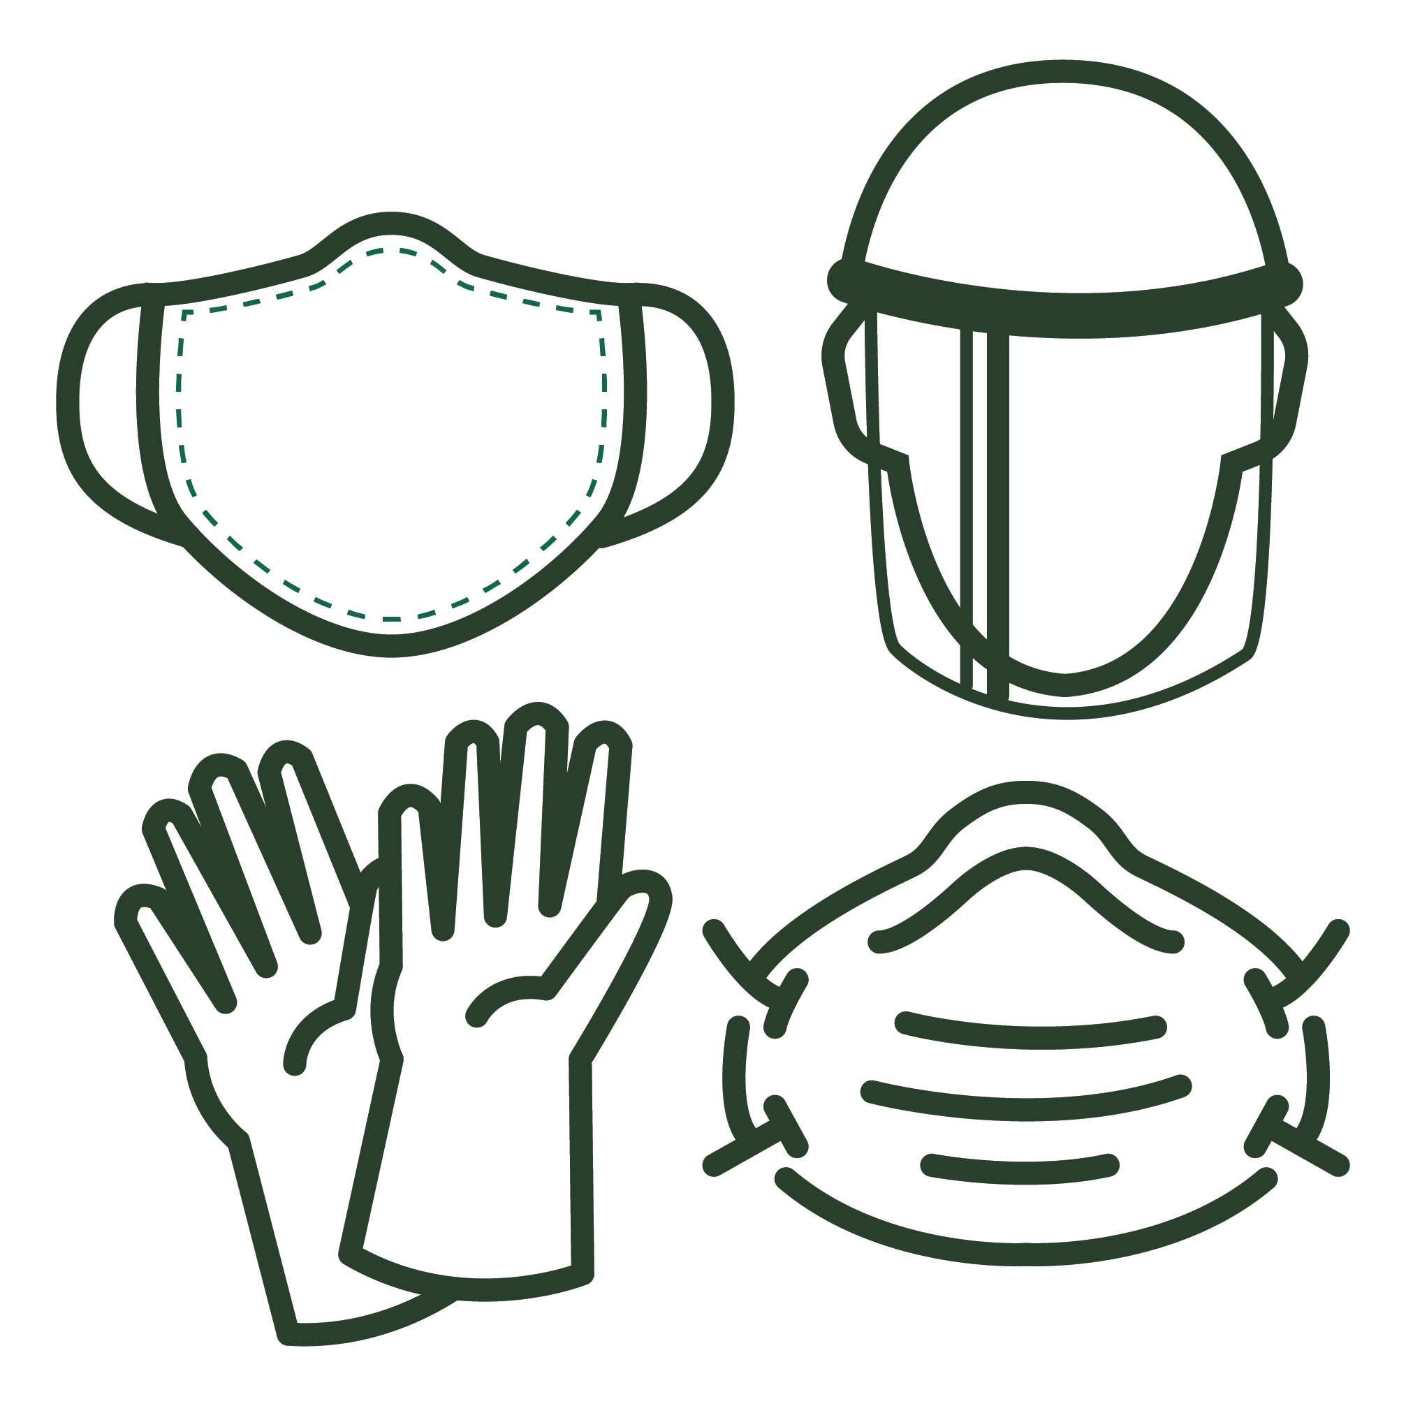
COVID-19 Guidance Additional Detail on Key Measures
Use Personal Protective Equipment When Necessary
Provide all necessary PPE to workers at no cost
respirators (N95 filtering facepiece respirators or better, including elastomeric respirators, without exhalation valves or vents)
face shields
protective gowns
gloves
Provide PPE in accordance with relevant OSHA standards and industry-specific guidance.
See applicable standards in 29 CFR 1910, Subpart I (e.g., 1910.132 and 133). See additional information on PPE flexibilities and prioritization in the Personal Protective Equipment Considerations section within the Interim Guidance for U.S. Workers and Employers of Workers with Potential Occupational Exposures to SARS-CoV-2.
There are times when PPE not required under OSHA standards, but some workers may have a legal right to PPE as a "reasonable accommodation" under the Americans with Disabilities Act
Other workers may want to use PPE if they are still concerned about their personal safety
Encourage and support voluntary use of PPE in these circumstances

Slide 53
COVID-19 Guidance Additional Detail on Key Measures
Respirators
Respirators, if necessary, must be provided and used in compliance with 29 CFR 1910.134
written program
medical determination
fit testing
training on proper use and care
includes certain provisions for voluntary use when workers supply their own respirators
See additional information on PPE flexibilities and prioritization in the Personal Protective Equipment Considerations section within the Interim Guidance for U.S. Workers and Employers of Workers with Potential Occupational Exposures

Slide 54
COVID-19 Guidance Additional Detail on Key Measures
Provide supplies
Ensure that workers, customers, and visitors have supplies to clean their hands frequently and cover their coughs and sneezes:
tissues and no-touch trash cans.
soap and warm or tepid water
If no soap and water, use alcohol-based hand sanitizer - at least 60% ethanol or 70% isopropanol.
Follow safe handling and storage requirements for flammable sanitizer.
touchless hand sanitizer stations in multiple locations

Slide 55
COVID-19 Guidance Additional Detail on Key Measures
Provide time to wash hands often
Inform workers if hands are visibly dirty, soap and water is preferable to hand sanitizer.
Key times for workers to clean their hands:
Before and after work shifts
Before and after breaks
After blowing their nose, coughing, or sneezing
After using the restroom
Before and after eating or preparing food
After putting on, touching, or removing PPE or face coverings
After coming into contact with surfaces touched by other people
Place posters that encourage hand hygiene and physical distancing.
Include non-English speakers as needed

Slide 56
COVID-19 Guidance Additional Detail on Key Measures
Routine Cleaning and Disinfection
Develop, implement, and maintain a plan
Routinely clean all frequently touched surfaces
For dirty surfaces, clean first using a detergent or soap and water
For disinfection, EPA-registered, household disinfectants should be effective
Follow manufacturer's instructions - concentration, application method, and contact time
Clean and disinfect shared tools between uses
Provide disinfecting wipes to wipe down surfaces before each use
Store and use disinfectants according to the label
Wear gloves and other PPE appropriate for the chemicals being used
NOTE: Do not mix bleach or other products together!

Slide 57
COVID-19 Guidance
specific guidance is available for certain industries.
All Industries | Emergency response and public safety | Nursing Homes and Long Term Care Facilities
Agriculture | Food Manufacturing and Processing | Oil and Gas Operations
Airline Operations | Food Service and Beverage Services | Pharmacies
Automotive Services | Food Trucks | Postmortem Care
Border Protection and Transportation Security | Hair and Nail Salons | Restaurants
Cleaning Services | Healthcare | Retail
Construction | In-Home Repair Services | Rideshare/Taxi/Car Services
Correctional Facility Operations | Laboratories | Seafood Processing
Delivery | Manufacturing | Warehousing and Package Handling
Dentistry | Meat and Poultry Processing | Waste Management
https://www.osha.gov/coronavirus/guidance/industry

Slide 58
References:
OSHA Direction; Current Directive Number: DIR 2021-01(CPL-03): National Emphasis Program – Coronavirus Disease 2019 (COVID-19), March 12, 2021. https://www.osha.gov/sites/default/files/enforcement/directives/DIR_2021-01_CPL- 03.pdf
OSHA Memorandum, Updated Interim Enforcement Response Plan for Coronavirus Disease 2019 (COVID-19), March 12, 2021. www.osha.gov/memos/2021-03-12/updated-interim-enforcement-response- plan-coronavirus-disease-2019-covid-19
OSHA Guidance, Protecting Workers: Guidance on Mitigating and Preventing the Spread of COVID-19 in the Workplace, January 29, 2021. www.osha.gov/coronavirus/safework
Virginia Final Standard For Infectious Disease Prevention: SARS-CoV-2 Virus That Causes COVID-19, 16 VAC25-220, January 27, 2021.
https://www.doli.virginia.gov/proposed-permanent-standard-for-infectious- disease-prevention-for-covid-19

Slide 59
Contact PA OSHA Consultation
Pennsylvania OSHA Consultation Office
Phone: 800-382-1241
Web: www.iup.edu/pa-oshaconsultation/
Facebook: https://www.facebook.com/Pennsylvania-OSHA-Consultation-Program-548810235234647/
Twitter: https://twitter.com/search?q=PA%20OSHA%20Consultation&src=savs

Slide 60
Questions?
OSHA DIRECTIVE: National Emphasis Program – Coronavirus Disease 2019 (COVID-19) March 12, 2021
Rick Mason, CSP, CIH, CHMM
Health & Safety Consultant
814.795.8960
rmason@iup.edu

Slide 61
How to Request Assistance:
Phone: 800-382-1241
Website: http://www.iup.edu/pa-oshaconsultation

Slide 62
Free Safety Training: Pennsylvania Training for Safety & Health (PATHS)

Slide 63
Thank You
Upcoming Webinar:
Impact of Mental Health on Safety
May 12, 2021 @ 10:30am
Pennsylvania OSHA Consultation Office
Phone: 800-382-1241 or 724-357-4095
Website: www.iup.edu/pa-oshaconsultation

