Slide 1


Distracted Driving and Cell Phones
BE READY, BE SAFE, BE RESPONSIBLE
This Photo by Unknown Author is licensed under CC BY-NC
This Photo by Unknown Author is licensed under CC BY-SA
This Photo by Unknown Author is licensed under CC BY-NC-ND
This Photo by Unknown Author is licensed under CC BY-SA
This Photo by Unknown Author is licensed under CC BY-SA
Notes:
Part 2 of Session 1, deals with distractions and their effects on perception and driving. Special focus is on cell phone distractions and driving with the objective of informing and guiding the novice driver and passengers to the conscious decision and commitment to avoid cell phone tasks when driving. A format to be introduced will be a simple catchphrase that may be used throughout is for the novice driver to: “Be Ready, Be Safe, Be Responsible”. (For instructors and schools involved in SWPBIS, this may also serve as an optional specific matrix for student drivers.)

Slide 2

Distractions and Perception
CELL PHONE DISTRACTED DRIVING
What is the Ultimate Goal of Driving?
To be able to drive from point A to point B-
              Safely
              Efficiently
A
HOW?
B
Notes:
Distractions and Perception
The Ultimate Goal
What is the ultimate goal of driving?
The “ultimate goal” of driving is to be able to travel to a destination safely and efficiently.
Distracted driving affects a great deal of the task of driving and is a major obstacle to achieving this goal.
How can you increase your chances of achieving this ultimate goal regularly?

Slide 3
Distractions and Perception
The Ultimate Goal
HOW?
    By developing the Habits, Skills, Attitudes and Behaviors To:
    Protect YOURSELF
    Protect OTHERS
BE READY, BE SAFE, BE RESPONSIBLE
Notes:
HOW?
Being a safe driver is more than just applying physical skills.
Everyone has habits, both good and harmful. A habit is a routine that we practice as a part of our everyday lives. Many of these behaviors that we develop are things that we’ve learned and practiced to the point that we don’t even think of them. They become second nature. We are conditioned to these practices.
It is possible to break or avoid harmful habits and learn attitudes and behaviors that can help you as a driver to:
protect yourself, and
protect others

Slide 4
Distractions and Perception
The Ultimate Goal
HOW?
  Driving Skills and Habits can be learned and improved upon.
  So can Attitudes and Behaviors.
BE READY, BE SAFE, BE RESPONSIBLE

Slide 5
Distractions and Perception
The Ultimate Goal
HOW?
    Decision Making Process:
    The Choice to be AWARE of:
      Right and Wrong Behavior
      Correct and Incorrect Decisions
BE READY, BE SAFE, BE RESPONSIBLE
Notes:
Decision Making Process
We make conscious and unconscious decisions.
Everything involved in the driving task involves making decisions.
In the decision making process, you have the opportunity to consciously choose according to what you perceive and know.
To help achieve the “ultimate goal” the choice is to be aware of the correct behaviors that will help you to avoid incorrect decisions.

Slide 6
The Driving Task
MATURITY
RESPONSIBILITY
PERCEPTUAL SKILLS
MOTOR SKILLS
KNOWLEDGE
SAFE
&
SUCCESSFUL
DRIVING
DECISION MAKING SKILLS
THINK OF IT AS A CHAIN-
IT IS COMPLEX (HAS MANY LINKS)
IT REQUIRES:
Notes:
The Driving Task
Think of the driving task as a chain
It has many links that depend on each other to attain the ‘ultimate goal”
You need all of these links:
good motor skills, good perceptual skills, knowledge of the task, maturity and responsibility for lives and property, and good decision making skills.

Slide 7
Links in the Driving Task
RESPONSIBILITY & MATURITY
MOTOR SKILLS
KNOWLEDGE
SAFE
&
SUCCESSFUL
DRIVING
DECISION MAKING SKILLS
PERCEPTUAL SKILLS
What happens when you remove any of the links?
Or the links are weak?
Notes:
Links The Driving Task
What will happen if any of the links are removed, or not as strong as the others?

Slide 8
Distractions and Perception
The HTS and the Driving Task are Complex
Remember,
You must BE AWARE and ACT ON:
  Signs, Signals, Markings
  Roadway Conditions
  Other Users
  PERCEPTION = AWARENESS
Notes:
Perception and Distractions
Remember you must be aware and be able to act on
signs, signals, markings, road conditions and other users
Good perception skills allow you to be more aware of these things.

Slide 9

Distractions and Perception
The Ultimate Goal
HOW?
    Drivers Must:
    Be PROACTIVE, not just REACTIVE
    Be able to Perceive and Adjust to Avoid Risk
BE READY, BE SAFE, BE RESPONSIBLE
Notes:
Remember:
Being perceptive allows the driver to be proactive (to act before), not just react due to surprise or inattention.
To be proactive you must be able to perceive and adjust to avoid in time anything that is a risk.

Slide 10
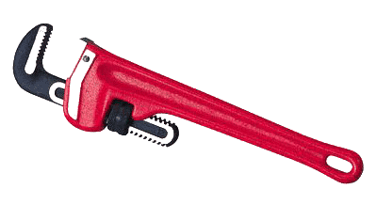
Affecting the Complexity
Condition
HTS
Age
Signs
Type
Vehicle
Condition
Laws
Roads
Experience
Drivers
Type
Signals
Vehicles

Slide 11

Distractions and Perception
WHAT IS DISTRACTED DRIVING?
DECISIONS AND ACTIONS MADE BY A DRIVER THAT:
    Interfere with that driver’s ability to perceive and adjust.
There are many distractions outside and inside of the vehicle.
A MAJOR distraction is CELL PHONE USE
Notes:
What is Distracted Driving?
It is a decision made by a driver that interferes with that drivers ability to perceive and adjust to risk.
There are many things both outside and inside of a vehicle that are distractions to a driver.
Research shows that a major part of distracted driving is the use of a cell phone.

Slide 12
Distractions and Perception
WHAT IS DISTRACTED DRIVING?
3 TYPES OF DISTRACTION
    Manual
    Visual
    Cognitive
        These can be individual or in any combination
        CELL PHONE USE IS FOUND IN ALL THREE TYPES AND INTERFERES WITH ALL THREE PROCESSES

Slide 13
Distractions and Perception
DISTRACTED DRIVING
    Manual- One or both hands not grasping the wheel, doing some other physical task while driving.
    What are some examples?
    Have you? ……Do you?
BE READY, BE SAFE, BE RESPONSIBLE
Notes:
Manual
One or both hands not grasping the wheel while driving, The driver is involved in some other physical task.
Examples-eating, drinking, grooming, reading, etc.
Have you as a driver done any of these things? Have you been a passenger where the driver does?

Slide 14
Distractions and Perception
CELL PHONE DISTRACTED DRIVING
    CELL PHONE TASKS
    Manual- Hand(s) not on wheel
        Locating the phone from - pocket, purse, backpack
        Holding the phone - talking, dialing, texting, scrolling
BE READY, BE SAFE, BE RESPONSIBLE
Notes:
CELL PHONE TASKS
Manual- the driver is doing some other physical task. Hands off of the wheel
Examples:
Locating the phone from pocket, purse, backpack, under the seat, storage, etc.
Holding the phone while talking, dialing texting, scrolling
It is a decision made by a driver that interferes with that drivers ability to perceive and adjust to risk.

Slide 15
Distractions and Perception
DISTRACTED DRIVING
    Visual- Taking eyes from the search for two or more seconds.
        “Sightseeing” “Rubbernecking”
        Reading
        Grooming
        Looking for something
BE READY, BE SAFE, BE RESPONSIBLE
Notes:
Visual- Taking your eyes away from the driving search or scanning process for two or more seconds.
Examples:
“Sightseeing” / “Rubbernecking”paying more attention to objects, or occurrences outside of the vehicle
Reading something while driving
Grooming
Looking for something in the car

Slide 16
Distractions and Perception
CELL PHONE DISTRACTED DRIVING
    CELL PHONE TASKS
    Visual- Eyes not on road
    Looking for the phone
    Looking at:
    Screen
    Reading - scrolling
    Keyboard - typing
BE READY, BE SAFE, BE RESPONSIBLE
Notes:
CELL PHONE TASKS
Visual- Taking your eyes away from the driving search or scanning process for two or more seconds.
Looking for the phone
Looking at the screen to read or scroll ,the keyboard to type

Slide 17
Distractions and Perception
DISTRACTED DRIVING
    Cognitive- Dividing the thought process by trying to focus too many tasks.
    Attention is on:
    Talking with passengers
    Preoccupied with “issues”, personal, home, school
    Aimless thoughts
    Listening to music, podcasts
BE READY, BE SAFE, BE RESPONSIBLE

Slide 18
Distractions and Perception
CELL PHONE DISTRACTED DRIVING
    Cognitive – Mind is not on driving
    Attention is on :
    Answering the call
    The conversation
    Replying to texts
    Dealing with incorrect replies from voice activation system
    Following wrong GPS directions
    Finding music, podcasts
    Multiples of the above
    NOT ABLE TO THINK ABOUT DRIVING
Notes:
CELL PHONE TASKS
Cognitive –your mind is not on driving.
Driver’s attention is split between driving and :
Answering the phone
The conversation Not all calls are good news or friendly conversation.
Replying to texts or missed calls
Dealing with incorrect replies from voice systems
Dealing with wrong GPS directions
Finding music from device.
Multiple events

Slide 19
Distractions and Perception
CELL PHONE DISTRACTED DRIVING
    RESULTS OF CELL PHONE USE
    Competing tasks “multi-tasking”
    Competes for the processing resources of the brain.
    Multi-tasking impairs performance of complex tasks.
        Decreased perception to risk= slower ability to act and react
    Inattention Blindness- looking, but not perceiving
      Missing important visual clues
      Brain is not processing quickly enough or ignores what is seen.
Notes:
RESULTS OF CELL PHONE TASKS
Competing tasks- while attempting to “multi task”, regions of the brain compete for resources to process the information needed to complete tasks effectively.
This competition results in:
Inattention blindness is where the driver misses important clues. The person is looking but not perceiving , the brain may be ignoring what is seen or minimizing the importance of what is seen.

Slide 20
Distractions, Perception
    CELL PHONE USE INTERFERES WITH:
    PHYSICAL TASKS
    STEERING
      Evasive steering (emergency steering)
      Make multiple steering maneuvers
    SIGNALING TURNS
      Direction change warning
    HORN USE
      Warning communication
    FLASHING HEADLIGHTS (warning communication)
    USING WINDSHIELD WIPERS AND WASHER
    TURNING ON DEFROSTER OR DEFOGGER
    SHIFTING GEARS / EMERGENCY SHIFTING
    EMERGENCY BRAKE FAILURE TASKS
    SCANNING AND BLIND SPOT CHECKS
    COGNITIVE TASKS
    JUDGEMENTS AND DECISIONS ON:
    SPACE AND POSITION
    SPEED
    TIMING FOR CROSSING LANES, TURNING GAPS
    MERGING
    PASSING
    FOLLOWING
    MISSED SIGNALS AND SIGNS
    ANTICIPATING OTHER USERS ACTIONS
Notes:
Distracted Driving
CELL PHONE USE INTERFERES WITH:
The Physical Tasks of STEERING, especially evasive steering, the ability to make multiple steering maneuvers, and fine control steering.
The use of TURN SIGNALS, direction change warnings. HORN USE, HEADLIGHT USE,, WIPER AND WASHER USE, DEFOGGERS AND DEFROSTER USE. The ability to SHIFT GEARS AND EMERGENCY SHIFTING.
BRAKE FAILURE TASKS
BLIND SPOT CHECKS on lane changes.
Cognitive tasks ,especially judgements and decisions on SPACE MARGINS AND LANE POSITION, SPEED, TIMING AND GAP SELECTION FOR TURNS AND CROSSING, MERGING, PASSING, FOLLOWING, SIGNALS AND SIGNS AND ANTICIPATING OTHER USER ACTIONS.

Slide 21
Distractions, Perception
CELL PHONE DISTRACTED DRIVING
    CELL PHONE USE = DRUNK DRIVING
    The National Safety Council* findings on cell phone use, even hands free, while driving is comparative to DRIVING DRUNK.
    Studies show that driving :
    with a .08 BAC can result in a 4X greater chance of being in a crash
    while talking on a cell phone also can result in a 4X greater chance
    while texting, an 8X greater chance of crashing
    *https://www.nsc.org/road-safety/safety-topics/distracted-driving/cell-phone-distracted-driving
Notes:
CELL PHONE USE = DRUNK DRIVING
Results of research on cell phone use and driving, by the National Safety Council and other groups has shown that cell phone use, even hands free , while driving is comparative to driving drunk.
The research show that driving with a .08 BAC can result in a four time greater chance of being involved in a crash.. Driving while talking on a cell phone also can result in a four time greater chance of being in a collision. Driving while texting doubles the chance of crashing to eight times.

Slide 22
Distractions, Perception
CELL PHONE DISTRACTED DRIVING
    STATISTICS AND NUMBERS

Slide 23
Distractions, Perception
CELL PHONE DISTRACTED DRIVING
    STATISTICS AND NUMBERS

Slide 24
Distractions, Perception
CELL PHONE DISTRACTED DRIVING
    CELL PHONE STATS AND NUMBERS
Fatality Statistics
Nationwide, There can be an average rate of:
10 + per day
75 + per week
300+ per month.

Slide 25
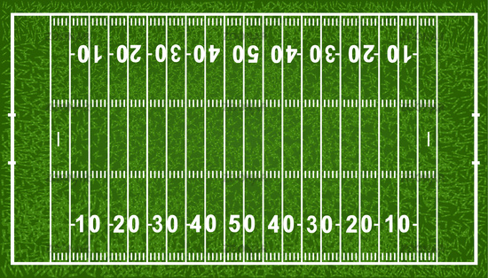
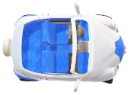
Distractions, Perception
CELL PHONE DISTRACTED DRIVING
    TEXTING AND DRIVING
    8X greater chance of crashing
  On average, while texting, a driver’s eyes are off the road for over four seconds. (4s)
  So, for every 10 mph a car travels = 15 ft. per second.
  Travelling at 50 mph, it travels 75 fps. 4s x75 fps=300 ft (100yd.)
This Photo by Unknown Author is licensed under CC BY-NC-ND
Notes:
Texting and Driving
On average a driver’s eyes may be off the road for four or more seconds.
A vehicle will travel 15 feet per second for every 10 mph of speed.
If the driver is going 50 mph, the vehicle is moving at 75 fps (feet per second). So if that driver decides to text , and his eyes are off the road for four seconds, that vehicle has travel 300 feet ( 100 yards) with that driver being distracted manually, visually, and cognitively

Slide 26
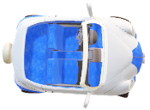
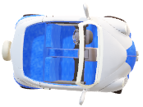
Distractions, Perception
CELL PHONE DISTRACTED DRIVING
    TEXTING AND DRIVING
    8X greater chance of crashing
  At 50 mph, it travels 75 fps. Undistracted reaction and braking @ 50 mph, car will travel about 195 ft. (65 yd.) before stopping.
This Photo by Unknown Author is licensed under CC BY-NC-ND

Slide 27
Distractions, Perception
CELL PHONE DISTRACTED DRIVING
    TEXTING AND DRIVING
    8X greater chance of crashing
CELL PHONE & TEXTING LAWS
    Pennsylvania enforces an ANTI – TEXTING law. ILLEGAL TEXT & DRIVE
    It is a primary (you can be stopped for IT), summary offense ( it can be heard by a District Judge) for a $50 fine and possible points against license. (Along with any other violations that occur because of it)
    There are local statutes that prohibit cell phone use of any type.
    Some neighboring states prohibit cell phone use.
    Some states prohibit ANY type of cell phone use for drivers under 18.
    Fines and penalties can vary in other states to $300, or loss of license.
This Photo by Unknown Author is licensed under CC BY-NC-ND

Slide 28
Distractions, Perception
CELL PHONE DISTRACTED DRIVING – Working to a Solution
Think about it…
Do athletes use cell-phones or text while practicing or during a game?
What do you think the results would be if this occurred regularly?
If you’re on a team, what would coaches and teammates do to you?
What about musicians or actors while they are performing?
Ever see someone on stage stop a performance to text, answer a call, tweet, Instagram, etc.?
What do you think the results would be if this occurred ?
WHAT IS YOUR CHOICE? WHAT ARE THE CONSEQUENCES?
This Photo by Unknown Author is licensed under CC BY-NC-ND
Notes:
Working to a Solution
Think About It
What are some situations that you do not see cell phones being used.? Sporting events, concerts, performances on stage,. These are simple examples . Do athletes on the field competing or practicing use their cells? Do musicians, or actors stop their show to answer a call or post something?
What could some results be if this occurred of if you or a teammate would do this during practice or a game or show?
Coaches reaction?
Ultimately, it is your choice, what are the consequences of your choice?

Slide 29
Distractions, Perception
CELL PHONE DISTRACTED DRIVING - Working to a Solution
Think about it…
SO, what’s the difference between those people doing those things and someone driving while distracted by their cell phone/texting ?
More at stake:
Higher risk and more dangerous.
  Death
  Injury
  Destruction
  Financial Loss
  All Negative results
  Affects more than one life
  Affects more than one future
This Photo by Unknown Author is licensed under CC BY-NC-ND

Slide 30
Distractions, Perception
CELL PHONE DISTRACTED DRIVING - Working to a Solution
    LAWS AND ENFORCEMENT - Can be effective, BUT:
      Sometimes enforcement is difficult
      No national standard for either one. Many variations
      Not all drivers know or obey the laws (CHOICE & HABIT)
    EDUCATION (Driver ed, public service programs)– Also effective, BUT:
    Difficult to reach everyone. Not everyone is aware of information or solutions.
    Programs and approaches may lack focus
    Sometimes short-term results
    Not all drivers obey the laws even though they know them (CHOICE & HABIT)
WHAT CAN BE DONE?
BE READY, BE SAFE, BE RESPONSIBLE
This Photo by Unknown Author is licensed under CC BY-NC-ND

Slide 31
Distractions, Perception
CELL PHONE DISTRACTED DRIVING - Working to a Solution
WHAT CAN BE DONE?
  CHANGE BEHAVIORS AND HABITS
  Knowledge of consequences, BUT we still react because using the phone while driving is a habit.
  What influence do different sounds have on us? Give some examples.
  What influence does a phone have on us?
    CONDITIONED to look at a sound alert
    CONDITIONED to answer the phone
    CONDITIONED to read or reply to a text, email or notification
    CONDITIONED to … post, video, photograph, search
This Photo by Unknown Author is licensed under CC BY-NC-ND
Notes:
What effect do sounds have on the way we react?

Slide 32
Distractions, Perception
CELL PHONE DISTRACTED DRIVING - Working to a Solution
    DELIBERATE DECISIONS
    WHAT ARE SOME OF THE BEST DECISION OPTIONS?
    MAKE THE CHOICE NOT TO DRIVE AND CALL, ANSWER, TEXT, POST OR E-MAIL
WHAT CHANGES CAN YOU MAKE?
    MAKE THE COMMITMENT TO:
    TURN OFF OR MUTE WHILE DRIVING
    TURN ON DO NOT DISTURB OR DRIVING MODE
    WAIT OR IGNORE UNTIL YOU CAN DO IT SAFELY. PARK OR PULL OVER
    CALL OR MESSAGE BEFORE YOU DRIVE
    HAVE A PASSENGER MANAGE YOUR PHONE TASKS
This Photo by Unknown Author is licensed under CC BY-NC-ND
Notes:
NOT TO DRIVE AND CALL, ANSWER, TEXT, POST OR E-MAIL

Slide 33
Distractions, Perception
CELL PHONE DISTRACTED DRIVING - Working to a Solution
    DELIBERATE DECISIONS
    BEST DECISION OPTIONS:
    MAKE THE COMMITMENT NOT TO DRIVE AND CALL, ANSWER, TEXT, POST OR E-MAIL
WHAT CHANGES CAN YOU MAKE?
    MAKE THE COMMITMENT TO:
    LIMIT USE WHILE DRIVING TO EMERGENCY ONLY
    HANDS FREE ONLY IF IMPORTANT AND UNABLE TO PULL OVER
    PROGRAM NAVIGATION BEFORE DRIVING
    PRESET ANY APPS YOU MIGHT NEED
This Photo by Unknown Author is licensed under CC BY-NC-ND

Slide 34
Distractions, Perception
CELL PHONE DISTRACTED DRIVING - Working to a Solution
DELIBERATE CHOICES BY OTHERS
      PASSENGER – help to protect yourself and others
        REMIND DRIVER NOT TO USE CELL AND DRIVE
          (You know that the risk is the same as riding with a drunk driver.)
        DESIGNATED PHONE MANAGER
          You handle cell phone tasks for the driver
            Your phone, or the driver’s
    OTHERS – If you know that someone is driving:
    Don’t text or call them, wait.
WHAT ELSE CAN BE DONE?
BE READY, BE SAFE, BE RESPONSIBLE
This Photo by Unknown Author is licensed under CC BY-NC-ND

Slide 35
VIDEO LINKS DISTRACTED DRIVING
AAA video on University of Utah driver distraction research | 3 min 8 min | http//vimeo.com/107880466 https://vimeo.com/107880613
Cognitive Distraction | 7:41 | https://vimeo.com/67329578
Cell Phones | 4:02 | https://vimeo.com/51714533
AAA Distracted Teens Crash Causation | 2:20 | https://vimeo.com/339352838
Tips for Preventing a Distracted Driving Accident | 3:11 | https://vimeo.com/51622686
External Distractions | 3:11 | https://vimeo.com/51714524
The Challenge of Distracted Driving | 3:45 | https://vimeo.com/51714647
Texting and Driving: The Dangers | 1:47 | https://vimeo.com/31471618
Text Messaging | 3:09 | https://vimeo.com/51714975

Slide 36

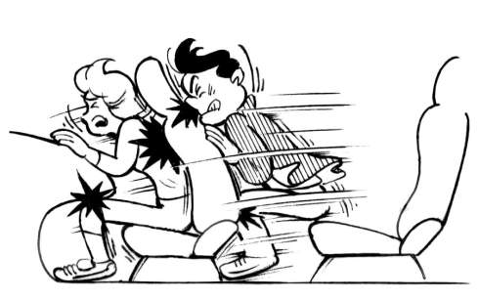
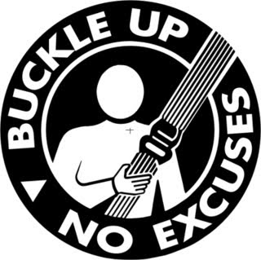
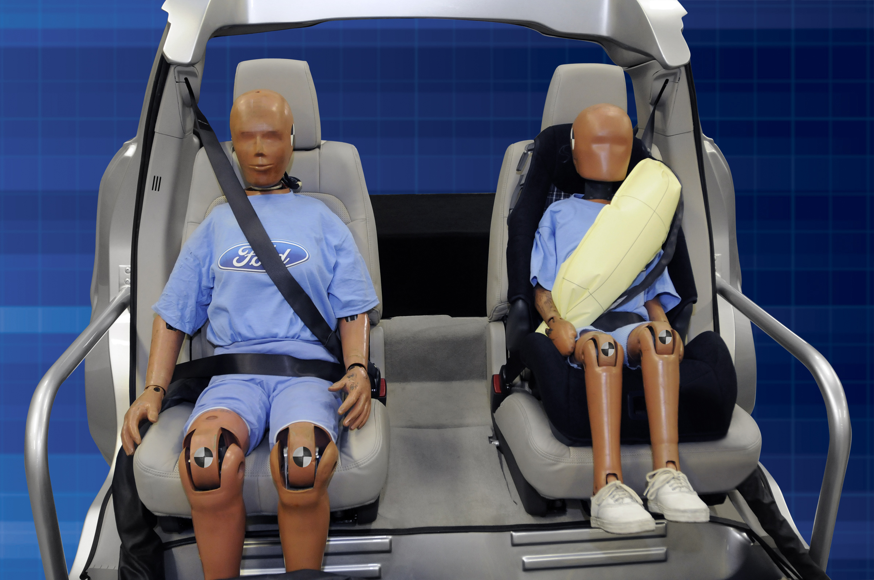
OCCUPANT PROTECTION FROM INJURY
RESTRAINT SYSTEMS
SEAT BELTS, AIRBAGS
This Photo by Unknown Author is licensed under CC BY-SA
This Photo by Unknown Author is licensed under CC BY-NC
This Photo by Unknown Author is licensed under CC BY-NC
Notes:
OCCUPANT PROTECTION FROM INJURY
RESTRAINT SYSTEMS SEAT BELTS, AIR BAGS
This segment is the second addition to this curriculum.
It should be emphasized that driver error in operation, judgement and poor decision making is the major cause of vehicle crashes. Collisions due to purely accidental reasons are very rare.
These protection systems are intended to protect the occupants in the event of drivers errors previously mentioned. (Especially from distracted driving.)
The focus is on occupant protection systems, both passive and active
A system is a combination of vehicle devices and driver actions working in unison to protect occupants in the event of collision.
Protection by helping to reduce injuries and their severity. Protection to reduce the risk of fatality.
Students should know the types of injuries their causes and the importance of the role they have in protecting themselves and their passengers.

Slide 37


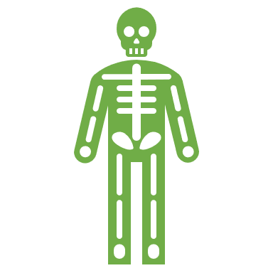
OCCUPANT PROTECTION
INJURY
2 TYPES OF INJURY
Injury - any damage to the body resulting from acute exposure to thermal, mechanical, chemical or electrical energy
NON - FATAL
FATAL
NONINCAPACITATING
SLIGHT TO SERIOUS “NOT” LIFE THREATENING OR PERMANENT THREAT TO QUALITY OF LIFE
  LACERATIONS
  BRUISES, CONTUSSIONS
  CONCUSSION
MINOR BURNS
INCAPACITATING
INJURIES THAT DO NOT ALLOW THE VICTIM TO LIVE AS THEY HAD PREVIOUSLY (QUALITY OF LIFE)
PERMANENT, SERIOUS EFFECTS/MAY EVENTUALLY DEGRADE TO FATAL
  LOSS OF LIMB, PARALYSIS- FULL OR PARTIAL
  COMA, BRAIN DAMAGE, SPINAL DAMAGE
  BURNS, SERIOUS FRACTURES
Any injury resulting in death
  May be immediate
or
  Start as non-fatal incapacitating and degrade to fatal
Notes:
OCCUPANT PROTECTION
INJURY
2 Types of Injuries
Defining injury as any damage to the body from acute exposure to thermal, mechanical, chemical or electrical energy. Examples may be given, with the emphasis on that one or more of these can result from vehicle collision.
Non-Fatal
Non-incapacitating
Range from slight to serious, not life threatening or a permanent threat to a person's quality of life. Examples of cuts, bruises, slight concussion, etc.
Incapacitating
Permanent, serious injuries that won’t allow the victim to enjoy their previous quality of life. The effects may lead to death eventually. Examples of loss of limb, any type of paralysis, coma, brain and spinal damage, burns and serious fractures
Fatal
Any injury resulting in death, either immediate or eventual.

Slide 38
OCCUPANT PROTECTION
INJURY
CAUSES OF INJURIES
  COLLISION
  TYPES
    BODY TO OBJECT
    Body hits something inside or out of the vehicle
    OBJECT TO BODY
    Something hits a part of the body
    INTERNAL
      Internal organs collide inside the body
Due to:
EJECTION
TYPES
PARTIAL
Part of the body is outside of the vehicle during a crash
COMPLETE
  The body is thrown from the vehicle during a crash
Notes:
CAUSES OF CRASH INJURIES
Two main causes of injuries in a crash are a result of :
COLLISION-Three types of collision to discuss will be,
Body to object, where the body strikes something inside or out of the vehicle. This includes body to body of passengers.
Object to body , where an object in or out of the vehicle strikes a part of the body. Other vehicle, loose items, body to body.
Internal-internal organs collide inside the body due to stopping force. Results in internal organ injuries hemorrhaging, concussion, brain damage, etc.
EJECTION-Two types to discuss are:
Partial-where a part of the body is outside of the vehicle during a crash, injury or death from roll-over
Complete- where the body is thrown from the vehicle.
Ejection injuries can result in collision injuries from roll-over of the vehicle on the victim, ejection onto the road, poles, tree, etc.

Slide 39
OCCUPANT PROTECTION
PROTECTION DEVICES-
DEVICES IN A VEHICLE THAT PROVIDE INJURY PROTECTION FOR THE OCCUPANTS
RESTRAINT SYSTEMS
ACTIVE- Correct action by person is needed for it to work as designed
SEAT BELTS/SHOULDER HARNESSES
HEAD RESTRAINT
CHILD SAFETY SEAT
PASSIVE - no action needed
air bags
TYPE
  DESIGNED TO:
  MINIMIZE THE IMPACT OF COLLISION :
  ABSORBS CRASH ENERGY
  SPREADS STOPPING FORCE
  PREVENTS EJECTION
Notes:
The vast majority of vehicles contain or have some type of protection system designed in them to help protect the occupants. They are all engineered on the same concepts.
The main idea in all is to minimize the impact of a collision by:
Absorbing crash energy to the vehicle and the occupants.
Spreading the force created by the rapid deceleration and stopping force in a crash.
Prevention of ejection
Most successful are restraint systems.
Two types of restraints in the system are:
Active- where the user must take the responsibility to use it, and use it correctly for it to perform as designed. Those are seat belts, head restraints, and child safety seats.
Passive-where no interaction is needed, the system should work as needed

Slide 40

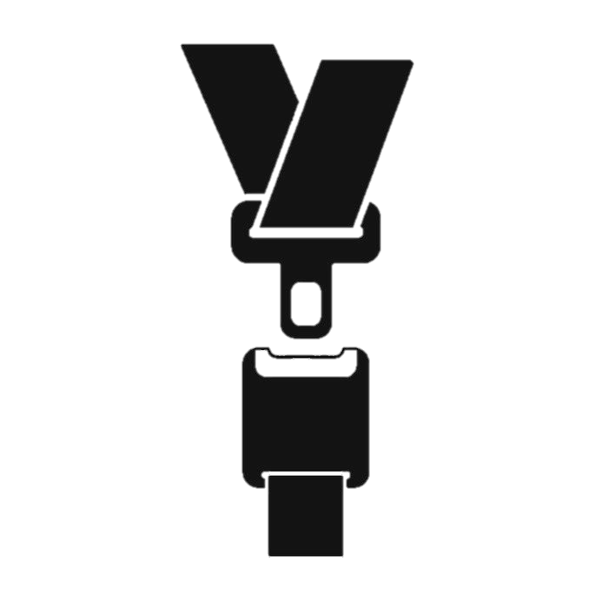
OCCUPANT PROTECTION
SAFETY RESTRAINTS / SEAT BELTS – HOW THEY WORK
  Safety Restraint (SEATBELT)
    ACTIVE DEVICE
    First type -lap belt anchored to the seat or vehicle body-( 2- point system)
    The belt helped prevent most complete ejections, but,
    Forcefully stopped the occupant, caused some other types of injuries
    Didn’t completely prevent body to object injuries
DESIGN CHANGES TO DECREASE THE PROBLEMS
    3 – POINT HARNESS SYSTEM (anchored to 3 areas)
      Two Parts
      Lap Belt
      Shoulder Belt
      Connected to:
    PRETENSIONER RETRACTOR SYSTEM
    allows slow movement by occupant-comfort
    pulls harness tight and locks it in a crash
    LOAD LIMITERS
    minimizes belt inflicted injury
    designed to extend belt when TOO much force is applied
This Photo by Unknown Author is licensed under CC BY-NC-ND
Notes:
SAFETY RESTRAINTS SEAT BELTS - HOW THEY WORK
Statistically, the safety belt system is one of the most importantly successful protection device.
It is an active device that has undergone many improvements. The first design was a lap belt solidly anchored to the seat or vehicle body. This is known as a 2-point system. These early belts helped to prevent many complete ejections, and some body to body injuries (when used) , but they didn’t completely prevent most body to object injuries from collision with steering wheels, dashboard, windshields. The early ones also forcefully stopped the person, causing other type of injuries
The major design changes to decrease these problems were to make it a harness system anchored to 3 areas. The harness system is made up of a lap belt and shoulder belt combo. The harness is attached to a pretensioner/retractor that allows the person comfort and slow movements, but will pull tight and lock on impact. Load limiters help minimize belt related injuries by extending when too much force is applied.

Slide 41
OCCUPANT PROTECTION
SAFETY RESTRAINTS
Results of improvements =
Ride down effect- body is slowed down by restraint systems
Air-bag systems
3 POINT SYSTEM
Harness
Stops Forward Motion of Upper Torso
Better Distribution of Stopping Force
Reduce pelvic injuries
Reduced Head & Upper-body Injuries
Reduced Ejection Injuries
Reduced Body to Body Injuries
Pretensioner Retractor, & Load Limiter
Absorbs inertia, slows the body down in a crash
Works with Air-Bag System
Ride - down effect
This Photo by Unknown Author is licensed under CC BY-NC-ND
Notes:
SAFETY RESTRAINTS-RESULTS OF IMPROVEMENTS
A major result of these improvements was the “ride-down” effect that they created. That is where forward momentum of the body in a crash is slowed down by the system. This is enhanced by the addition of the air-bag to the system. The combination 3-point, harness, pretensioners, and air-bags have helped provided more efficient protection and reductions injury severity and fatalities.

Slide 42
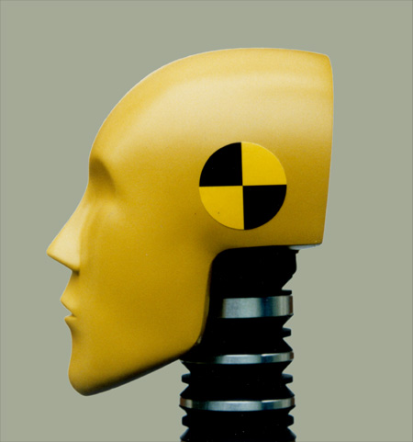
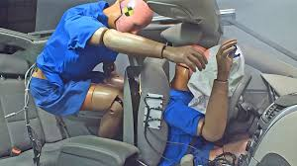
OCCUPANT PROTECTION
SAFETY RESTRAINTS / SEATBELTS- PROPER USE
  DELIBERATE ACTION AND RESPONSIBLE DECISION
  ALWAYS BUCKLE-UP, NO MATTER HOW SHORT THE TRIP
  USE IS IMPORTANT, BUT CORRECT USE IS ALSO IMPORTANT
  Pre-start routine-
  Adjust: Seat, head restraint, mirrors, steering wheel
    Always adjust these first, so seatbelt won’t interfere with movements
  Buckle and adjust seat belt- Passengers buckled
  CELL PHONE PROCEDURE
https://www.youtube.com/watch?v=0jqOOFs9-7o
This Photo by Unknown Author is licensed under CC BY-NC-ND
This Photo by Unknown Author is licensed under CC BY-SA
Notes:
RESTRAINTS/ SEAT BELTS-PROPER USE-CONT.
The proper seat belt adjustment is extremely important for it to work as designed. Incorrect adjustments and can defeat the purpose of the restraint system as a whole.
When buckling snug the belt after fastening across the hips, not the stomach.
Adjust the center post mounting for height
Correct height allows for the harness belt to go over top of the shoulder and across the chest. Check for snug fit. Remember the pretensioner allows for movement.
It’s very important to have the seat in an almost totally upright position, not reclining. This helps avoid sliding downward instead of forward in a frontal crash. This can cause serious injuries to neck, head, spine and legs. The video shows correct procedure and fit.
5. Unbuckle only after the vehicle is shut off, and the parking brake is set. It could not be completely in park, or some other mechanical issue or driver error.

Slide 43
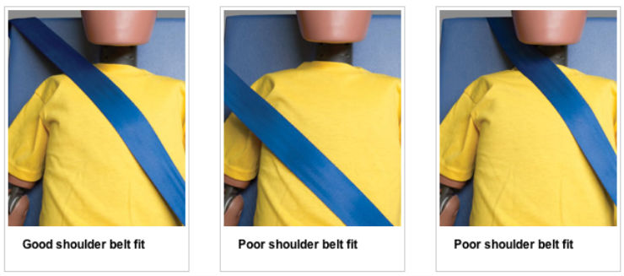
OCCUPANT PROTECTION
SAFETY RESTRAINTS / SEATBELTS- PROPER USE
Snug lap belt after fastening across hips
  Adjust center post mounting for height
  Belt over top of shoulder and across chest to distribute force in event of crash. Check frequently for snug fit.
  Keep seat back in upright position to avoid sliding out of the seat in frontal crash (submarine)
  Unbuckle AFTER vehicle is shut off.
https://www.wikihow.com/Adjust-Your-Seat-Belt
This Photo by Unknown Cartoq
This Photo by Unknown Author is licensed under CC BY-NC-ND
Notes:
RESTRAINTS/ SEAT BELTS-PROPER USE-CONT.
The proper seat belt adjustment is extremely important for it to work as designed. Incorrect adjustments and can defeat the purpose of the restraint system as a whole.
When buckling snug the belt after fastening across the hips, not the stomach.
Adjust the center post mounting for height
Correct height allows for the harness belt to go over top of the shoulder and across the chest. Check for snug fit. Remember the pretensioner allows for movement.
It’s very important to have the seat in an almost totally upright position, not reclining. This helps avoid sliding downward instead of forward in a frontal crash. This can cause serious injuries to neck, head, spine and legs. The video shows correct procedure and fit.
5. Unbuckle only after the vehicle is shut off, and the parking brake is set. It could not be completely in park, or some other mechanical issue or driver error.

Slide 44
OCCUPANT PROTECTION
SAFETY RESTRAINTS / SEATBELTS- PROPER USE
  USE IS IMPORTANT,
  BUT CORRECT USE IS ALSO IMPORTANT
NEVER:
Behind you
Across stomach
Against neck
Loose
Reclining seat
AIR BAGS and SEAT BELTS
Designed to work TOGETHER
are supplemental restraints
Lose the combined benefits
Can cause injury or death
Air bag systems do fail, you should not depend solely of them
This Photo by Unknown Author is licensed under CC BY-SA
This Photo by Unknown Author is licensed under CC BY-NC-ND
Notes:
RESTRAINTS/ SEAT BELTS-PROPER USE-
For the whole restraint system to work properly , there are some things one should never do. air bags and seat belts are designed to work together. They are meant to supplement the use of seat belts, not to be depended on only. By not using seat belts or using them incorrectly, you lose the combined benefits of both, and risk death or serious injury. Air bag systems do fail, do not depend solely on them without seat belt use.
So NEVER :
Put the shoulder belt behind you.
Put the lap belt across your stomach
Allow the shoulder belt to ride against you neck
Leave the belts too loose
Recline the seat or have it set too far back.

Slide 45
OCCUPANT PROTECTION
SAFETY RESTRAINTS / AIR BAGS
  AIR BAGS: SUPPLEMENTAL RESTRAINT SYSTEM
  Triggered by a sensors and explosive
  Protect against head, chest, knee, flank injuries
  Absorbs motion force of body by:
  Inflating quickly & deflating immediately
  Provides ride down effect
  Passive secondary system –
    no action needed by person
    designed to work with primary system –SEAT BELTS
    new technology –
      adjusts to speed, force and weight of occupant
      systems that anticipate collision prepare restraints for the potential crash
  Locations:
    Front-dashboard and steering wheel
    Side/side curtain/door, posts, roof rail
This Photo by Unknown Author is licensed under CC BY-SA
This Photo by Unknown Author is licensed under CC BY-NC-ND
https://www.youtube.com/watch?v=U6gNknUQbio
Notes:
SAFETY RESTRAINTS/ AIR BAGS
Air Bags: Supplemental Restraint System
Air bags are triggered by numerous sensors and are set off by explosive charges when needed. They’re meant to protect against head, chest, side and knee injuries. The bags absorb the momentum .f the body by inflating quickly and deflating immediately. This helps provide ride-down effect also. Especially when combined with seat belts.
It is a passive secondary system, so no action is needed for it to engage when needed. Sensors also detect when a seat is occupied so there is no unnecessary deployment. Other technology includes adjusting to the speed, force and weight of occupant, and pre-collision systems that prepare restraints for the potential crash.
Some locations for them are the steering wheel, dashboard doors, side door posts, roof rail and some models of seatbelts

Slide 46
OCCUPANT PROTECTION
SAFETY RESTRAINTS / AIR BAGS - PROPER USE
  AIR BAGS: CORRECT USE IS IMPORTANT
  Seat Adjustment- is important
    Driver should adjust seat for minimum 10 inch clearance between chest and steering wheel
    Raise seat (no power seat? - use wedge-shaped cushion), adjust steering wheel downward if possible to direct air bag at chest instead of face
NEVER:
Passenger under 12 years of age in front seat
Infant seats in front
Rest feet on dash area
Hold child or pet in lap
This Photo by Unknown Author is licensed under CC BY-SA
This Photo by Unknown Author is licensed under CC BY-NC-ND
https://www.youtube.com/watch?v=U6gNknUQbio
Notes:
AIR BAGS- PROPER USE
Correct use is important, just because air bags are passive devices, there are steps that should be taken to reduce the potential risks.
The seat and steering wheel should be set for a minimum of about a foot of clearance between the chest and wheel Too far back will also cause problems. Raising the seat and setting the steering wheel so that the air bag is aimed toward the chest, not head.
NEVER
allow children under 12 years old to sit in the front.
place infant seat in the front (There are shut off switches in some trucks to allow this)
hold a child or pet in your lap

Slide 47
OCCUPANT PROTECTION
SEAT BELT LAWS
  PENNSYLVANIA VEHICLE CODE
  It is a law in Pennsylvania that :
  All drivers and front seat passengers in vehicles…must wear seat belts.
  All passengers age 8 or older but less than 18, must wear seatbelts no matter where they are riding in the vehicle
  Drivers under the age or 18, number of passengers may not exceed the number of seat belts
  These are primary summary offenses with fines up to $75
This Photo by Unknown Author is licensed under CC BY-SA
This Photo by Unknown Author is licensed under CC BY-NC-ND
Notes:
SEAT BELT LAWS
Seat belt laws and penalties may vary between states.
In Pennsylvania, it’s the law. It is a primary, summary offense with fines up to $75.
PA Vehicle Code Section 4581, requires all drivers and front seat passengers in vehicles, light trucks and motorhomes must wear seat belts. All passengers age 8 or older, but less than 18, must wear seatbelts no matter where they are riding. Drivers under the age of 18 may not transport more passengers than seatbelts available in the vehicle.

Slide 48
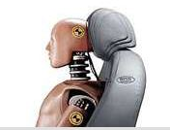
OCCUPANT PROTECTION
Other Restraints
  Head Restraints
    Effective for frontal and rear end collisions
    Protection from “whiplash”, neck injuries
  Proper adjustment
    Top of the ear to top of head
  Seat position
    Upright-not reclining
This Photo by Unknown Author is licensed under CC BY-NC-ND
This Photo by Unknown Author is licensed under CC BY-SA
This Photo by Unknown Author is licensed under CC BY-NC-ND
Notes:
OTHER RESTRAINTS
There are other parts of the restraint system to also consider. As an important part of the whole system, head restraints may be one device that are overlooked.
They are effective for most frontal and rear end collisions. Their main purpose is to protect the neck and upper spinal area from injury and whiplash. Proper use is for the restraint to set from the top of the ear to the top of the head. A seat that is not reclining is an important adjustment to make.

Slide 49
OCCUPANT PROTECTION
Other Restraints Infants, Children and Youth
  Safest if seated in back seat
    Middle=why?
    Up to 12 years of age should be seated in back
    What about truck seating ?
  It’s the law
  Must be federally approved child safety seat or booster
  Infant seats
    Rear facing/birth to outgrowing maximum height and weight limits of seat
  Child safety seats
    Forward facing
    for children 4 to 8 booster seat
      Booster seats Raise child to seat belt level
  Ages 8 and older, under 18 MUST be buckled
Drivers are responsible for properly securing children and ensuring children under 18 are buckled
This Photo by Unknown Author is licensed under CC BY-NC-ND
This Photo by Unknown Author is licensed under CC BY-SA
Notes:
Other Restraint, Infants, Children , and Youths
The driver is responsible for properly securing children and ensuring all passengers under 18 are buckled.
Some studies shown that the middle of the backseat may be the safest for passengers. It’s suggested that children up to the age of 12 should be seated in the back seat. Truck seating for that age group should be in a booster seat or safety seat that raises them to seat belt level.
All infants or children up to the age of 8 MUST be in a federally approved safety seat or booster.. Ages 8 to less than 18 must be buckled.

Slide 50
OCCUPANT PROTECTION
Other Restraints –Infants, Children and Youths
  DO NOT:
    Use infant or child seats in front seat
    Hold a child or infant on lap or share seat belt
    Fasten a child with you in your restraint
    Buy older, used seats- (Check expiration)
    Seats that have been in any accident
    If you are in need of proper safety seats, there are organizations that may supply one at minimal or no cost.
    There are PennDot safety programs that properly fit and secure safety seats
ALWAYS DOUBLE CHECK FOR CHILDREN AND INFANTS BEFORE LEAVING THE CAR
This Photo by Unknown Author is licensed under CC BY-NC-ND
This Photo by Unknown Author is licensed under CC BY-SA
Notes:
DO NOT:
Use infant or child seats in front seat
Hold a child or infant on lap or share seat belt
Fasten a child with you in your restraint
Buy older, used seats- (Check expiration)
Seats that have been in any accident
If you are in need of proper safety seats, there are organizations that may supply one at minimal or no cost.
There are also PennDot safety programs that properly fit and secure safety seats.
Be sure that you follow all the manufactures recommendations and instructions
ALWAYS check the backseat for infants or children before leaving the vehicle.

Slide 51
Occupant Protection
STATISTICS LINKS
https://crashinfo.penndot.gov/PCIT/featuredReports.html?param=109
https://cdan.nhtsa.gov/SASStoredProcess/guest
  https://crashstats.nhtsa.dot.gov/#/PublicationList/17
VIDEO LINKS
https://www.bing.com/videos/search?q=seat+belt+use&&view=detail&mid=5374DF13DE84DA7598CA5374DF13DE84DA7598CA&rvsmid=E94054130511250BA745E94054130511250BA745&FORM=VDQVAP
https://www.youtube.com/watch?v=U6gNknUQbio
Notes:
Instructors may use these supplemental videos and links to statistics.

