Slide 1
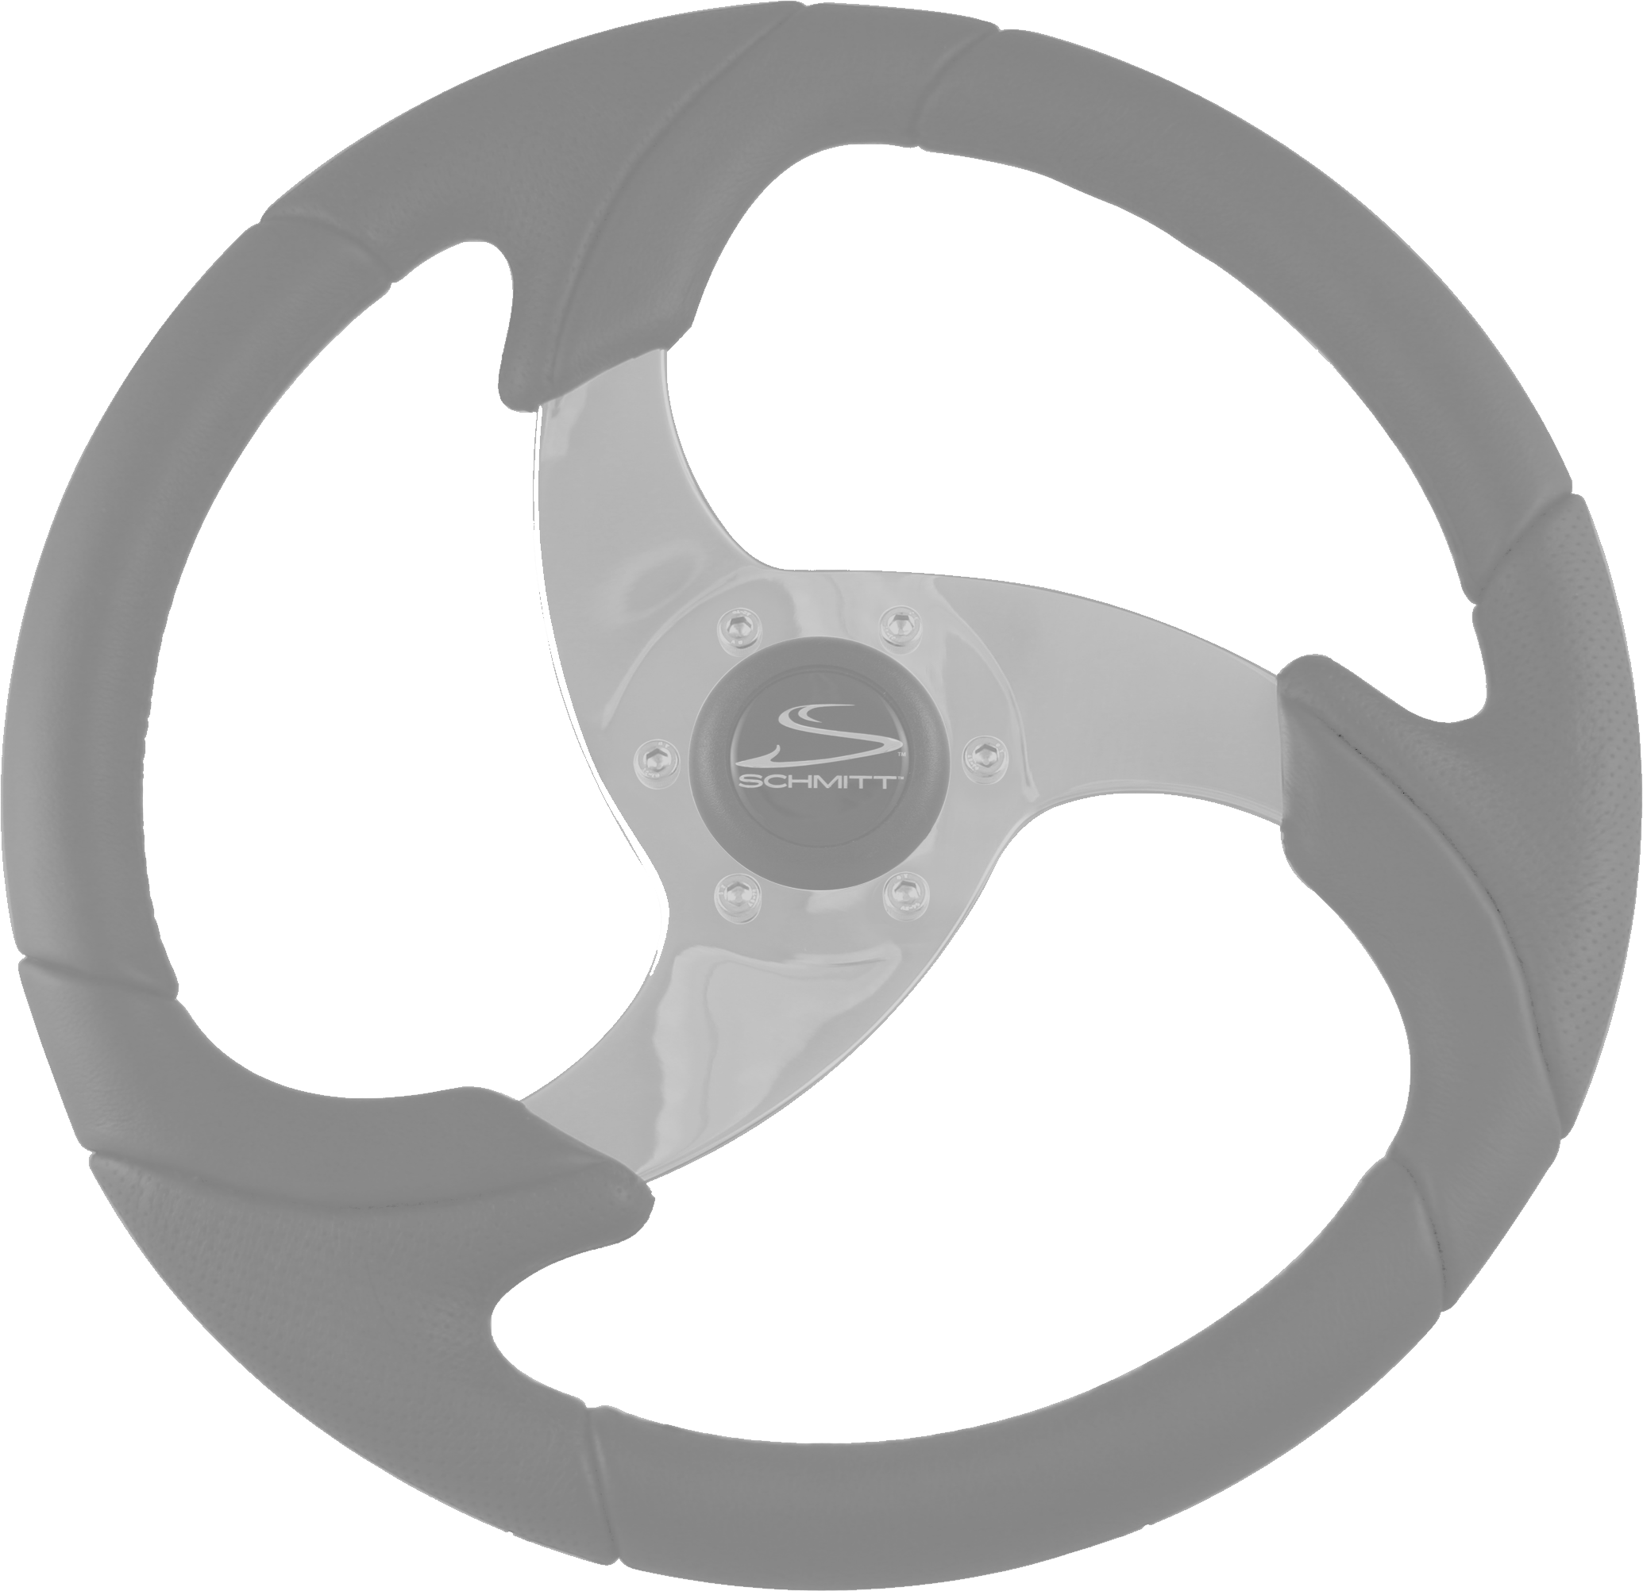
The Perceptual Driving Program
Perception and Driving Strategies for Different Environments
Module III of the
Pennsylvania Enhanced Driver Education Program
A-Session 1 Part 1B Perception
This Photo by Unknown Author is licensed under CC BY-NC

Slide 2
A-Session 1 Part 1B
Perception
Highway Transportation System
Nature of Perception

Slide 3
The Perceptual Driving Program
Session One
Nature of Perception
Habits to Improve Perception
Eye Habits for Vehicle Control
Search Habits for Identification
Notes:
Nature of Perception
Perception is an ongoing process that involves a number of mental operations such as associating, comparing and matching. It can be done skillfully or haphazardly.
Involves our senses and brain
Awareness is the first step in the process of perception. We can't identify something of which we are not aware. To become aware of something means we must not only observe it, we must also give attention to it. A driver is usually aware of traffic controls such as stop signs, traffic lights, and posted speed signs and they are easily identified. Traffic controls that are not so easily identified are warning signs. Drivers see the warning sign, but they do not identify it. We become aware of things through our senses.

Slide 4
Session One Objectives Improving Perceptual Skills
Identify
those parts of the Highway Transportation System (HTS) that must be quickly perceived
Define
perception as a mental process that is selective and can be improved
Define
the concept “Projected Path of Travel”
Identify
the three general habits for improving perception of the HTS events
List
the eye habits for vehicle control and selective scanning of the traffic scene; they can state at least three errors drivers make when not using good scanning habits.
Notes:
Session 1 Objectives
Identify those parts of the Highway Transportation System that must be quickly perceived.
Define perception as a mental process that is selective and can be improved.
Define the concept "Projected Path of Travel"
Identify three general habits for improving a driver's perceptual skills.
List the eye habits for vehicle control and selective scanning of the traffic scene; they can state at least three errors drivers make when not using good scanning habits.

Slide 5
The Perceptual Driving Program
HTS
Highway Transportation System
It is complex
Has many interacting parts that
Can result in many problems
Notes:
The complexity of the Highway Transportation System
Own Vehicle
Each has its own set of handling characteristics (steering, accelerating, braking, suspension) and a number of accessories. They vary in width, length and height. A number of engine sizes, transmissions, safety devices and other options are available.
Highway
There are almost four million miles of highways linking together all parts of our country. They range from multilane freeways to dirt roads. As perceptive drivers, we must identify all roadway conditions in advance and make proper allowances.
Unrelated
Many unrelated events can distract the driver from observing the more important occurrences affecting the path of travel. A driver's attention should be given to such events only when traffic is light.
Traffic Controls
Any complex system must have a set of controls if it is to be operated safely and efficiently. A variety of signs, signals, and markings are provided to regulate, warn and guide traffic. These are evaluated and changed, so we must keep up-to-date.
Other Users
Almost everyone uses the HTS - as passengers, drivers, pedestrians, joggers or bicyclists. There are over 160 million persons licensed to drive. Each has different goals and personal traits. There are more than 170 million registered motor vehicles of varying size, performance capability, kind and condition. As you can see, the HTS is truly a dynamic and complex system. As a result, driving involves the constant observation and analysis of many things in the traffic scene. You must also realize that as a driver, you will have only a limited amount of time to perceive these events. Unfortunately, many drivers have collisions because they have not learned how to use their eyes in an efficient manner. Nor do they know what to search for in an orderly way. Their perceptual skills are just not good enough for today's traffic problems.

Slide 6
Complexity
Condition
HTS
Age
Signs
Type
Condition
Laws
Roads
Experience
Drivers
Type
Signals
Vehicles

Slide 7
Awareness of HTS Events
Own Vehicle
Traffic Controls
Unrelated
Gauges
Sounds
Motions
Odors
Highway
Markings
Signs
Signals
Other Laws
Other Users
Passengers/Pets
Phone
Navigation
Music
Scenic Views
Pets
Advertisements
Roadway Condition
Shoulders
Obstructions
Vehicle Types
Driver Types
Pedestrians
Bicyclists
Notes:
Own Vehicle
Each has its own set of handling characteristics (steering, accelerating, braking, suspension) and a number of accessories. They vary in width, length height. A number of engine sizes, transmissions, safety devices and other options are available.
Highway
There are almost four million miles of highways linking together all parts of our country. They range from multilane freeways to dirt roads. As perceptive drivers, we must identify all roadway conditions in advance and make proper allowances.
Unrelated
Many unrelated events can distract the driver from observing the more important occurrences affecting the path of travel. A driver's attention should be given to such events only when traffic is light.
Traffic Controls
Any complex system must have a set of controls if it is to be operated safely and efficiently. A variety of signs, signals, and markings are provided to regulate, warn and guide traffic. These are evaluated and changed, so we must keep up-to-date.
Other Users
Almost everyone uses the HTS - as passengers, drivers, pedestrians, joggers or bicyclists. There are over 160 million persons licensed to drive. Each has different goals and personal traits. There are more than 170 million registered motor vehicles of varying size, performance capability, kind and condition. As you can see, the HTS is truly a dynamic and complex system. As a result, driving involves the constant observation and analysis of many things in the traffic scene. You must also realize that as a driver, you will have only a limited amount of time to perceive these events. Unfortunately, many drivers have
collisions because they have not learned how to use their eyes in an efficient manner. Nor do they know what to search for in an orderly way. Their perceptual skills are just not good enough for today's traffic problems.

Slide 8
Nature of Perception
Involves our Senses and Brain
Takes Time – Must Be Selective A Process
Can Be Improved With Directed Practice
Certain Factors Affect Perception
Notes:
Nature of Perception
Perception is an ongoing process that involves a number of mental operations such as associating, comparing and matching. It can be done skillfully or haphazardly.
Involves our Senses and Brain
Takes Time - Must be Selective Process
Can be Improved with Directed Practice
Certain Factors Can Affect Perception

Slide 9
Perception
Involves our Senses and Brain
Awareness is:
The first step in the process of perception.
Can't identify something if we are not aware.
Ability to be able to observe things quickly, and be able to identify or recognize what was observed.
Awareness of something = observe & Identify it → give attention to it
Notes:
Involves our senses and brain
Awareness is the first step in the process of perception. We can't identify something of which we are not aware. To become aware of something means we must not only observe it, we must also give attention to it. A driver is usually aware of traffic controls such as stop signs, traffic lights, and posted speed signs and they are easily identified. Traffic controls that are not so easily identified are warning signs. Drivers see the warning sign, but they do not identify it.

Slide 10
Perception
The senses bring information to the brain about what is happening around us
We become aware of things through our senses.
Primary senses in driving, that bring information to the brain for processing are: sight, feel, hear, and smell.
The Brain processes the information into something understandable
It makes sense of what is sensed
Notes:
The senses bring information to the brain about what is happening around us. The brain then processes the information. The primary senses in driving, that bring information to the brain for processing are: sight, feel, hear, and smell.
Incoming information, (data or input), is changed into something meaningful. Then we say, "Oh, now I see," or "I understand," or "Now I know what you mean." So, it is the mind that does the seeing or perceiving. For example, we become aware of a four legged and hairy animal through our senses. If the tail is wagging, we then identify the dog as friendly.
To be a safe driver, you must not only be able to observe things quickly, you must also be able to identify or recognize what was observed.

Slide 11
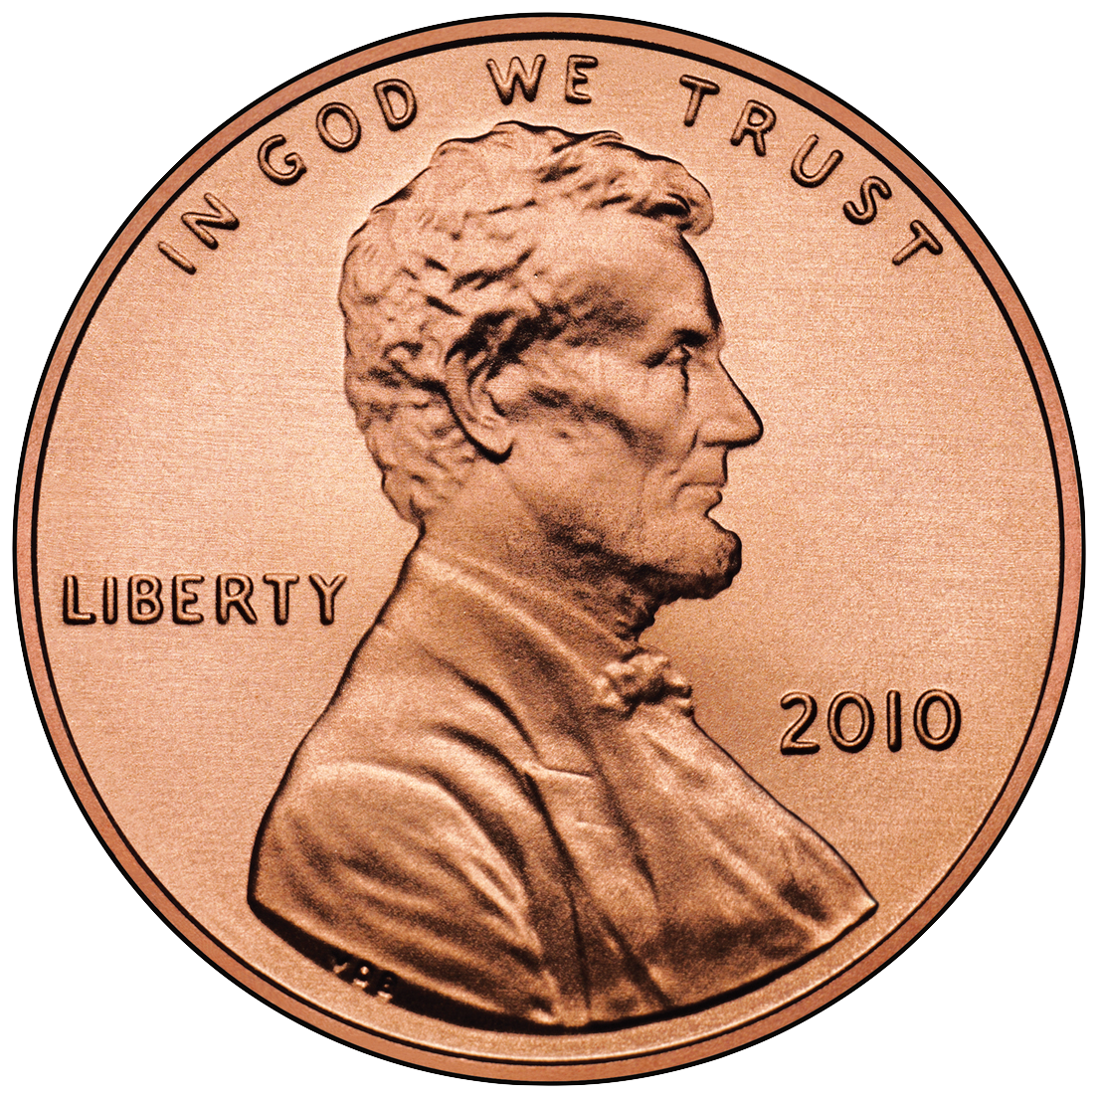
Takes Time – A Selective Process
Identification Process
You can only identify and process one thing at a time.
The familiar can be identified quickly versus what is not familiar- that will take longer to identify and process.
This Photo by Unknown Author is licensed under CC BY-SA
This Photo by Unknown Author is licensed under CC BY-SA
This Photo by Unknown Author is licensed under CC BY-SA
This Photo by Unknown Author is licensed under CC BY-SA
This Photo by Unknown Author is licensed under CC BY-SA
This Photo by Unknown Author is licensed under CC BY-SA
Notes:
Takes Time - Must be Selective Process
Our eyes and other senses can send more information to the brain than the brain can attend to in a moment.
You can only identify and process one thing at a time. Those items that are familiar can be identified rather quickly versus something that is not familiar will take longer to identify and process.
Familiar symbols and objects may be processed more quickly than sentences or words

Slide 12
Takes Time – A Selective Process
Two main parts to your field of vision
Central Vision (Focus)
about 10⁰
Details -read and identify
Peripheral Vision
(Sides)
other 90⁰
Size, color, movement -can draw central vision to these.
Notes:
Takes time - must be a selective process
Identifying something is done with two parts of your vision.
The one part is peripheral-vision and the second part is central vision.
The latter is no more than 10 degrees of your vision and you primarily use this part to identify and read.
The first part is peripheral and this is your field of vision on either side of central vision.
What you see with this vision is size, color and movement.
Many times something seen in this vision will cause you to direct your central vision at the object.

Slide 13
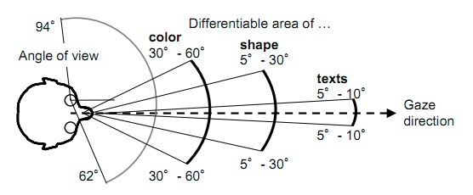
Takes Time – A Selective Process
Vision- Central and Peripheral
This Photo by Unknown Author is licensed under CC BY-SA
Notes:
It takes the mind time to process the incoming information-to organize it, classify it and make it meaningful. In a moving vehicle, time is limited. Therefore, our perception of the traffic scene must be a selective process. We must choose what we will attend to and perceive.

Slide 14
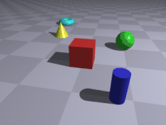
Factors affecting perception
Binocular Vision Allows Depth Perception
Having two eyes gives us binocular vision
Allows us to have depth perception
Ability to judge distance
This Photo by Unknown Author is licensed under CC BY-SA-NC
This Photo by Unknown Author is licensed under CC BY-NC-ND
This Photo by Unknown Author is licensed under CC BY-SA
This Photo by Unknown Author is licensed under CC BY-SA
Notes:
Factors affecting perception

Slide 15
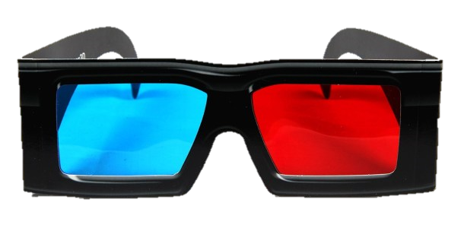
Takes Time – A Selective Process
Binocular Vision = Depth Perception-3-D
This Photo by Unknown Author is licensed under CC BY-SA
This Photo by Unknown Author is licensed under CC BY-SA-NC
This Photo by Unknown Author is licensed under CC BY-SA
This Photo by Unknown Author is licensed under CC BY-NC-ND
This Photo by Unknown Author is licensed under CC BY-SA
This Photo by Unknown Author is licensed under CC BY-SA
Notes:
Factors affecting perception

Slide 16
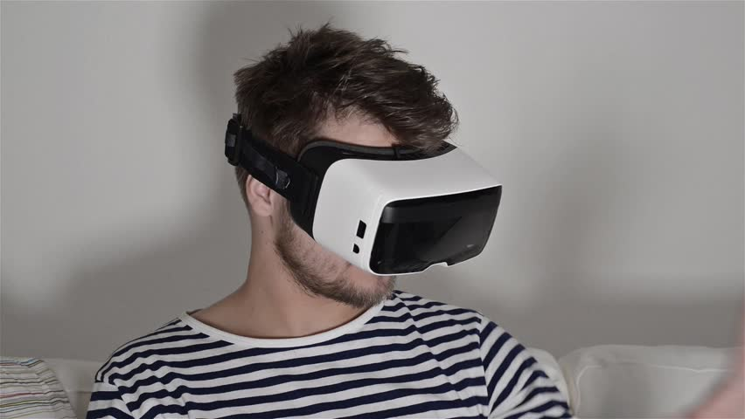
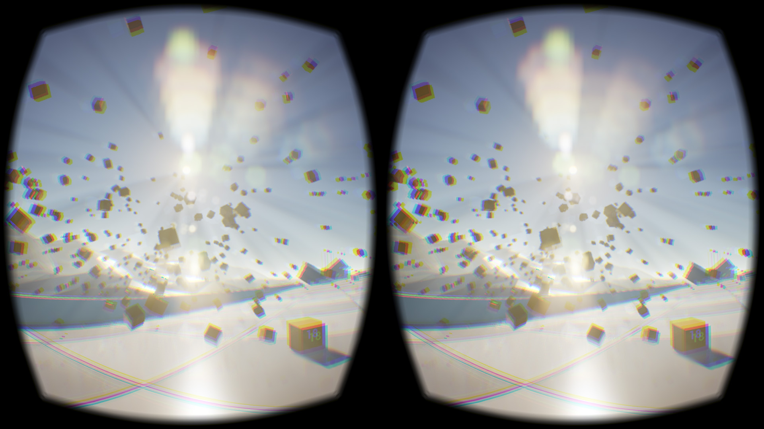
Vision Factors Affecting Perception
Binocular Vision = Depth Perception-3-D
This Photo by Unknown Author is licensed under CC BY-SA
This Photo by Unknown Author is licensed under CC BY-SA-NC
This Photo by Unknown Author is licensed under CC BY-SA
This Photo by Unknown Author is licensed under CC BY-NC-ND
This Photo by Unknown Author is licensed under CC BY-SA
This Photo by Unknown Author is licensed under CC BY-SA
Notes:
Factors affecting perception

Slide 17
Factors affecting perception
Monocular Vision = NO Depth Perception = 2-D
This Photo by Unknown Author is licensed under CC BY-NC-ND
This Photo by Unknown Author is licensed under CC BY-SA-NC
Notes:
Factors affecting perception

Slide 18
Perception
We can learn to improve the perceptual process
Perceptions improve with training and practice.
Knowing:
What to look for, and what may happen
When to look, and where
Where to look, and when
Experience and practice will make the process more efficient
Notes:
Can be improved with direct practices
We perceive in order to learn, but we can also learn to improve the perceptual process itself. Powers of observation develop as they are trained and used in a directed way. No matter how well we think we can perceive, perceptions improve with training and practice
It takes the mind time to process the incoming information-to organize it, classify it and make it meaningful. In a moving vehicle, time is limited. Therefore, our perception of the traffic scene must be a selective process. We must choose what we will attend to and perceive.

Slide 19
Perception
What can affect how we sense and think?
Physical Condition
Health
Injuries
Fatigue
Medications, Alcohol, Drugs
Vision /Eye problems
Anger, sadness, happiness
Anxiety, depression
Mental distractions
Medications, Alcohol, Drugs
Notes:
Factors affecting perception
Even an expert has problems if the body is not kept in good physical condition. Health, fatigue, drugs and emotions affect perceptions. What our mind selects to process at a given moment depends on our goals or what is important to us.

Slide 20
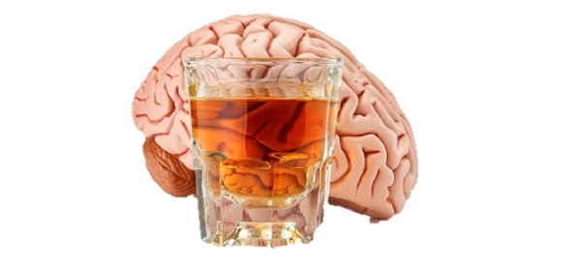
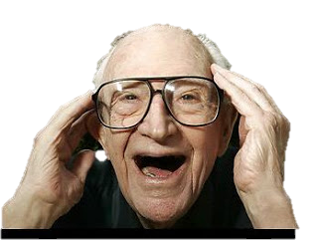
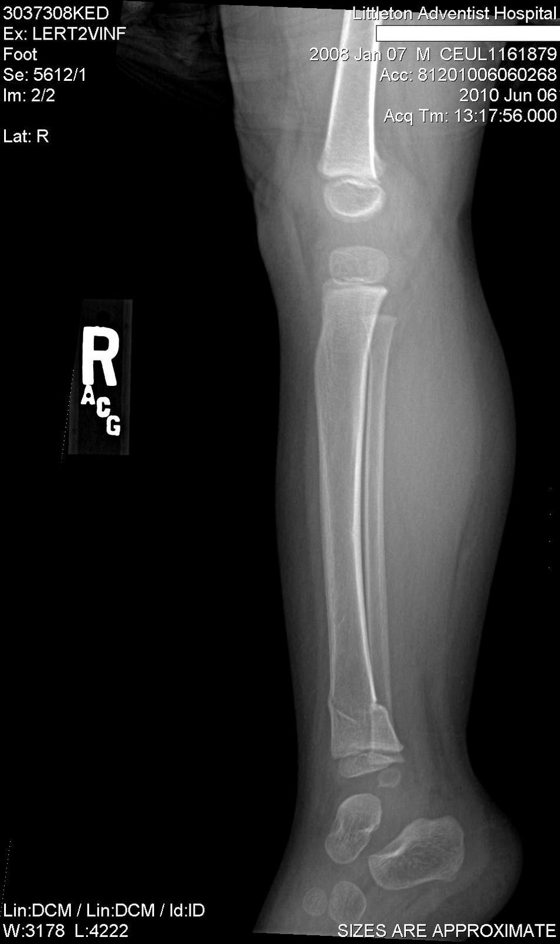
Perception
What can affect how we sense and think?
Physical Condition
Health
Injuries
Fatigue
Medications, Alcohol, Drugs
Vision /Eye problems
This Photo by Unknown Author is licensed under CC BY-NC-ND
This Photo by Unknown Author is licensed under CC BY-SA
This Photo by Unknown Author is licensed under CC BY
Notes:
Factors affecting perception
Even an expert has problems if the body is not kept in good physical condition.
Health, fatigue, drugs and emotions affect perceptions.
What our mind selects to process at a given moment depends on our goals or what is important to us.

Slide 21
Perception
Physical Condition
This Photo by Unknown Author is licensed under CC BY-NC-ND
Notes:
Mental and emotional conditions can affect your perceptual abilities and the driving task.
Anger, sadness, happiness
Anxiety, depression
Mental distractions
Medications, Alcohol, Drugs

Slide 22
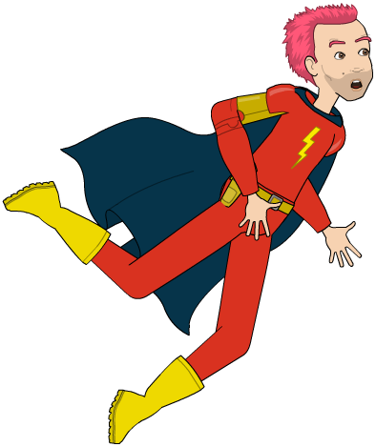
Effects
of
Speed
on Visual Perception
Central Vision
Decreases
&
Blurs
Peripheral Vision
Decreases
Notes:
Extra slide –effects of speed on FOV
It takes time for the brain to process the incoming information that it receives. It must organize it, classify it and make it meaningful. In a moving vehicle , that time is limited. The speed that a vehicle is travelling can affect the field of vision of the driver.

Slide 23
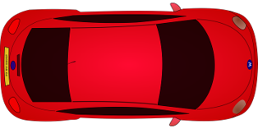
Speed and Effects on Visual Perception
The Field of Vision Narrows
Peripheral
Peripheral
Central Vision
Central Vision
Peripheral
Peripheral
Notes:
Extra slide- effects of speed on FOV
It takes the mind time to process the incoming information-to organize it, classify it and make it meaningful. In a moving vehicle, time is limited.

Slide 24
Speed and Effects on Visual Perception
The Field of Vision Narrows
Notes:
Extra slide- effects of speed on FOV

Slide 25
End Session 1 Part 1B
Next: Session 1-1C
Habits to Improve Perception

