Slide 1
SESSION THREE
C-Session 3 A Identifying Highway Conditions

Slide 2
C-Session 3A
Identifying Highway Conditions
Space
Sight
Conditions
Visibility
Traction

Slide 3
Session Three Objectives
Define
Define an area of less space
Identify
Identify static highway conditions that affect space
Identify
Identify dynamic traffic conditions that affect space
Define
Define less sight distance and view to the sides
Identify
Identify static highway conditions that affect visibility
Identify
Identify dynamic traffic conditions that affect visibility
Identify
Identify clues to hidden side roads
Define
Define an area of less traction
Identify
Identify roadway conditions that affect traction
Identify
Identify Surface materials that affect traction

Slide 4
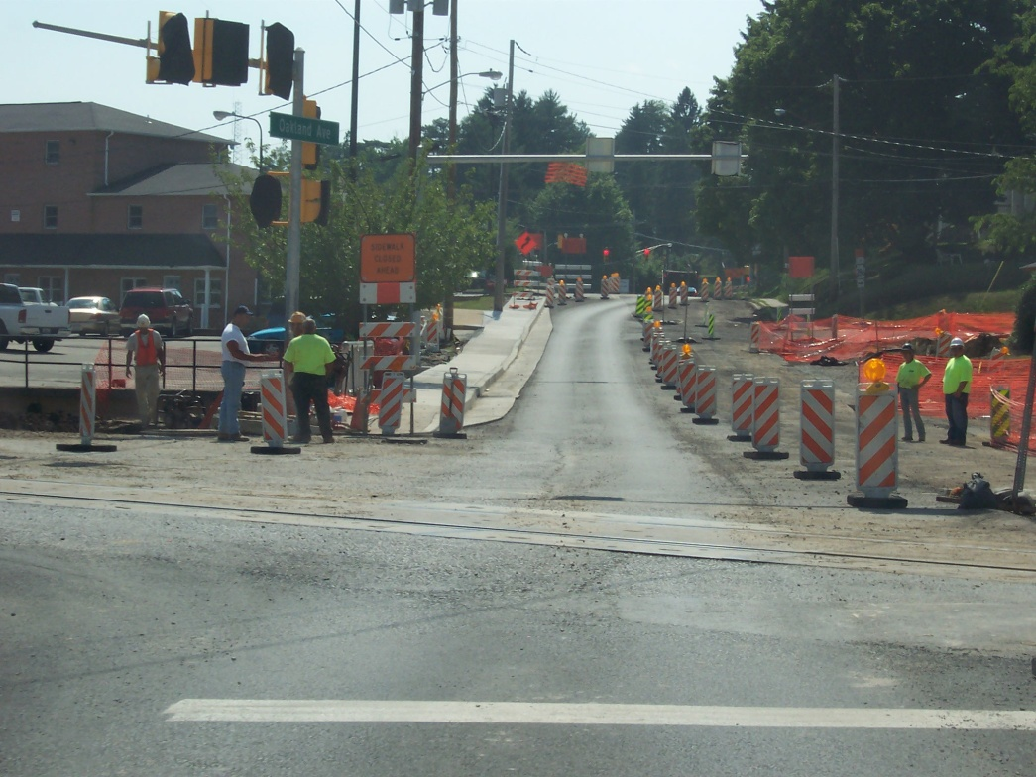
Defining Less Space to Sides
IDENTIFYING HIGHWAY CONDITIONS
Less than one car width to one side
Roadway ahead gets narrower
Notes:
Changes in Space to Sides
A driver needs adequate space for crossing, turning, merging or performing any other maneuver. Such space. also gives the driver better visibility and more time to react to the changing conditions.
The amount of space required varies with the speed being traveled and the maneuver to be made.
Definition of Less Space to Sides
We shall define an area of less space to the sides as a condition in which one of the following is true:
The driver does not have at least one car width of safe, drivable space next to the intended path.
The roadway itself gets narrower ahead.
In other words, ahead of the driver’s current path of travel, there is a change in the amount of available space.
Even though the focus here is on reduced space, areas of increased space to the sides are changes that also need to be identified and responded to.

Slide 5
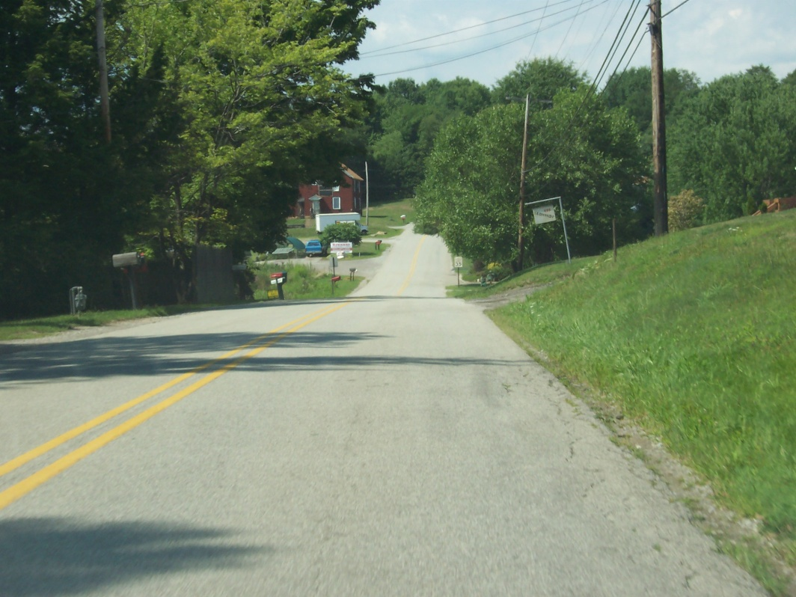
Changes in Space due to Highway Conditions
IDENTIFYING HIGHWAY CONDITIONS
Number of lanes, width of pavement, width of shoulders, guard rails
Embankments, fencing post, trees, snow bank, rock slide, barricades
Notes:
Changes Due to Highway Conditions
Many changes in space to the sides are due to highway conditions or features. Here are examples:
Pavement width changes from 24 feet to 20 feet;
There may be one or two whole lanes less;
Corner curbing may be less rounded;
Shoulders may become narrower;
Guardrails, embankments, snow banks or rock slides may prevent you from having an escape path;
There may be fencing, posts, trees, barricades or other objects that cut down on the space available; and/or
Ask the class for other examples of "static" conditions.

Slide 6
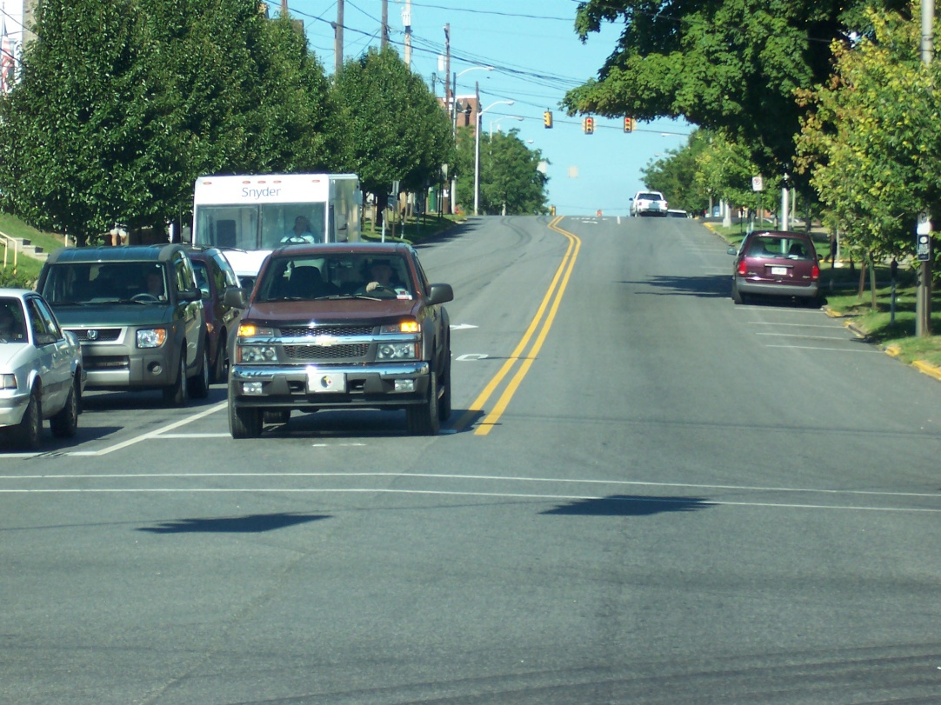
Changes in Space due to Other Traffic
IDENTIFYING HIGHWAY CONDITIONS
Oncoming line of cars,
Cars waiting to turn left
Parked Delivery trucks, turning trucks, bikes pedestrians, stalled cars
Notes:
Changes Due to Other Traffic
Other traffic can limit side space temporarily. Here are examples:
Oncoming line of cars, with parked cars to the sides;
Double-parked cars or delivery trucks, stalled vehicles or vehicles waiting to turn;
Large vehicles coming or going around a comer; and/or
Bike riders or pedestrians in combination with less roadway space at a certain location.

Slide 7
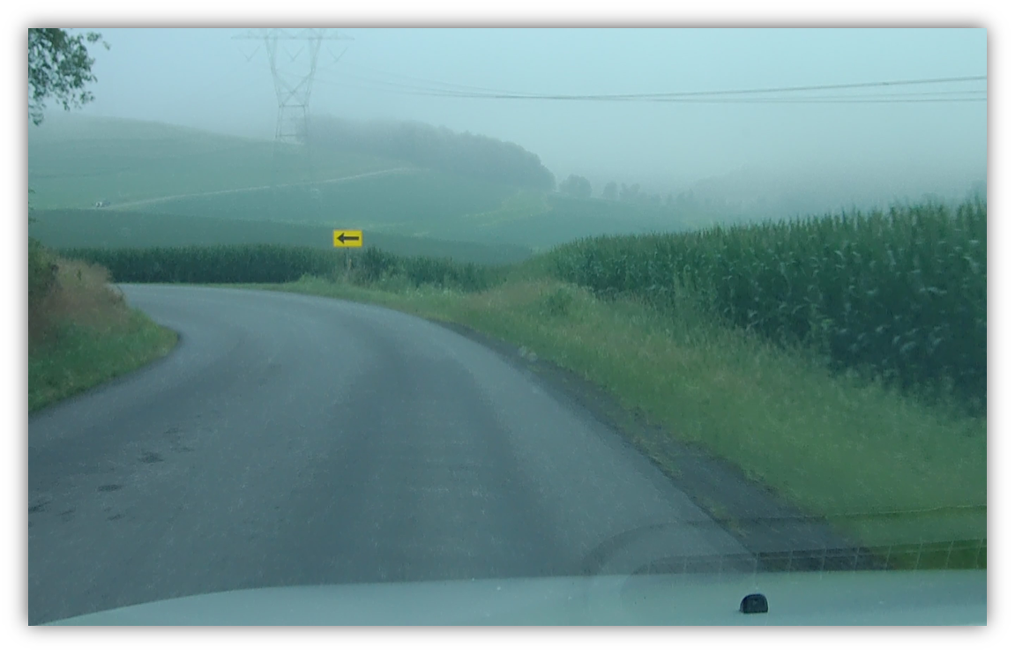
Less Sight Distance Ahead Less View to Sides
IDENTIFYING HIGHWAY CONDITIONS
Present speed becomes unsafe for changes in sight distance or view to sides
Stopping distance becomes greater than seeing distance
Notes:
Changes in Visibility
How well and how fast you can guide your car along the road will depend a great deal on adequate visibility. You must be able to see ahead and to the sides if you are to avoid collisions.
Definitions of Less Sight Ahead and Less View to Sides
An area of less sight distance and an area of less view to the sides shall be defined as a highway area in which the sight distance ahead or to the sides is less than that required for safe travel at the speed being driven.
In other words, without an adjustment in speed, you. wouldn't be able to stop in time if a car came into your path of travel.
At speeds in excess of35 mph, if you can't see a minimum of four seconds to the front or to the sides, you are driving into an area of less visibility.
At speeds less than 35 mph, the less sight distance or view to the sides is two seconds.
The line of sight is the imaginary straight line that connects the eyes with the point focused on. It is the line along which you are looking at any given time.
The view to the sides, or field of view, is the entire area of the highway and its surroundings that can be seen at a particular moment.

Slide 8
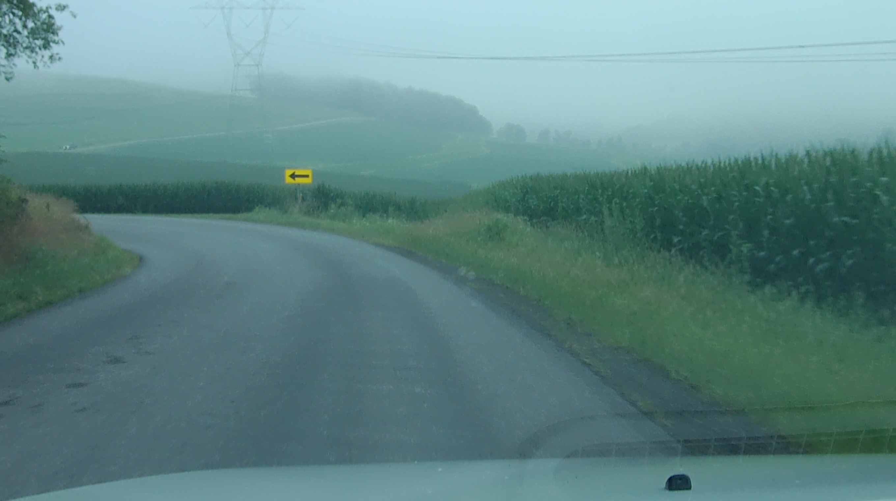
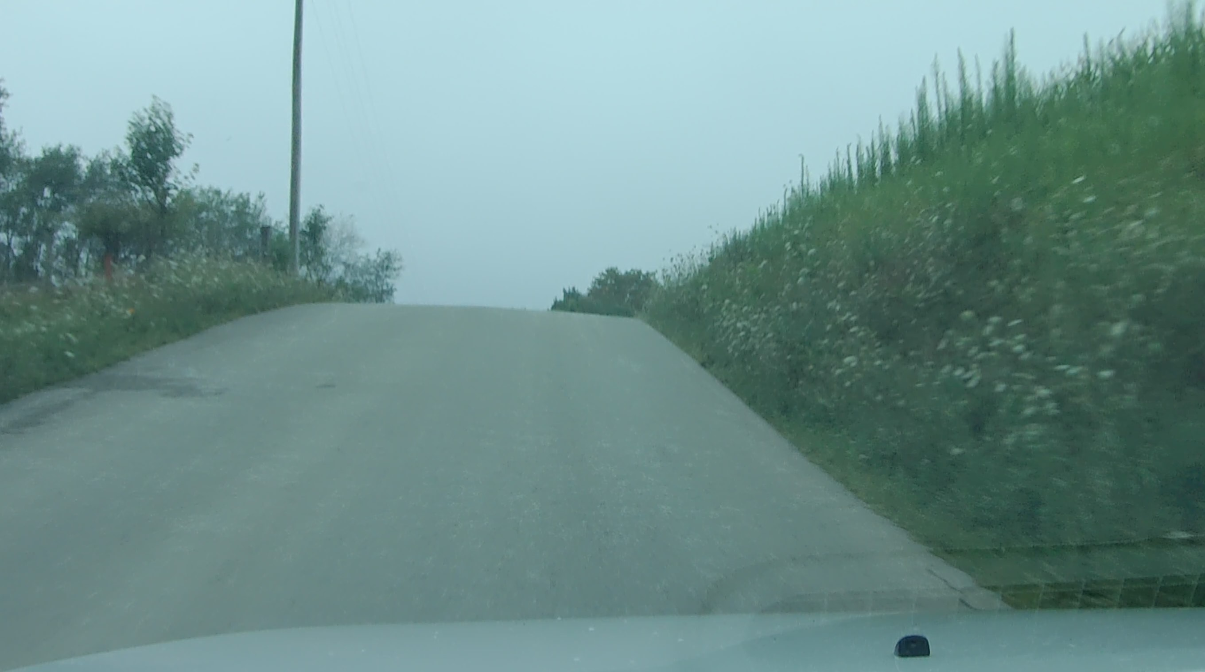
Changes Due to Highway Conditions
IDENTIFYING HIGHWAY CONDITIONS
Hills, curves, dips in road, embankments
Signs, shrubs, farm crops, buildings, snow banks
Notes:
Changes Due to Highway Conditions
Most changes in visibility are the result of highway conditions. Here are some examples:
Embankments, curves, shrubs, buildings and signs;
Hills, curves and hillcrests, which can easily hide a disabled car or slow-moving vehicle;
The time of year - such as planting and harvesting seasons in rural areas;
The time of day - such as rush hours or times when school buses are on the road; and
Sudden changes in weather - such as rain, snow or fog.

Slide 9
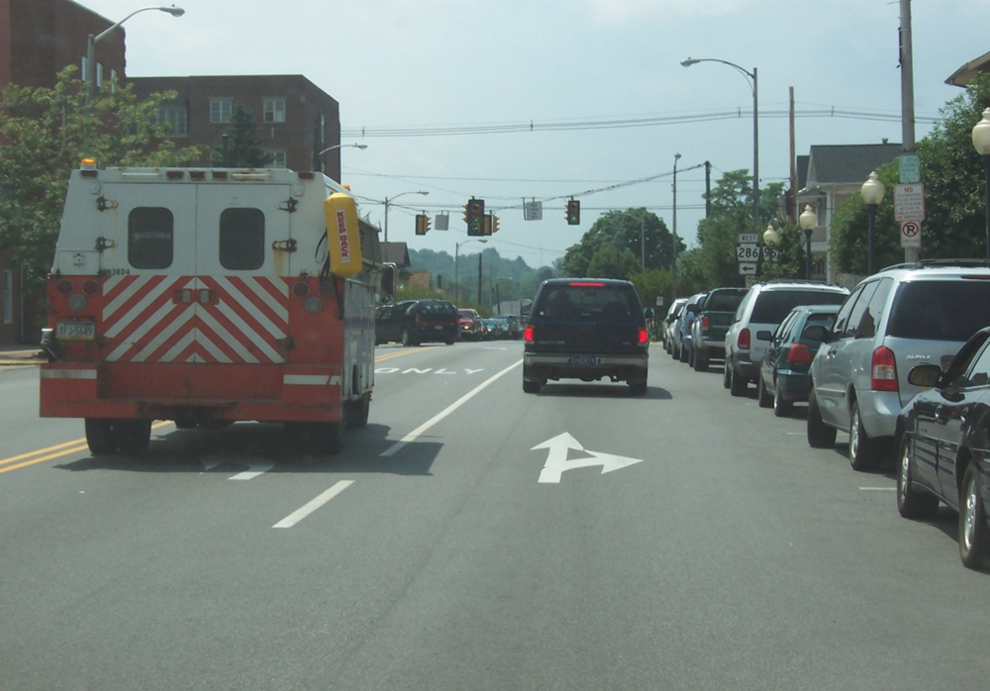
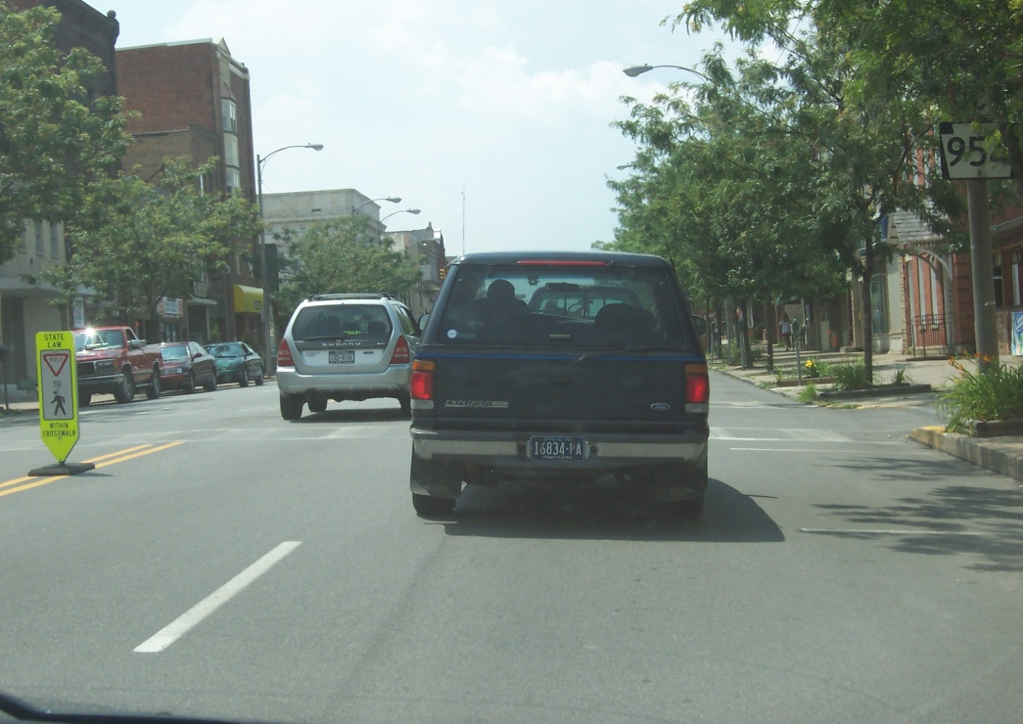
Changes in Visibility due to Other Traffic
IDENTIFYING HIGHWAY CONDITIONS
Large trucks or buses ahead, cars or trucks standing, parking, turning or waiting to turn
Notes:
Changes Due to Other Traffic
Other traffic can create both visibility problems and space problems. Large trucks and buses can reduce the view ahead or to the sides.

Slide 10
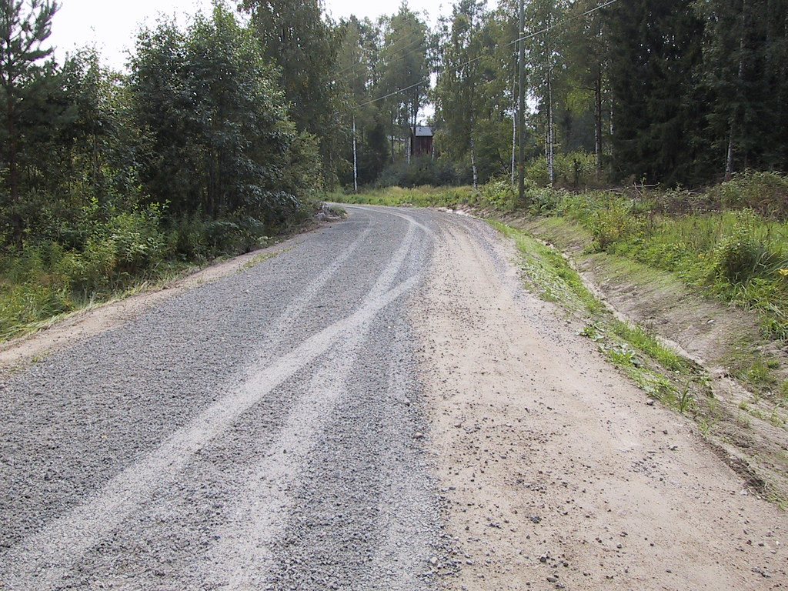
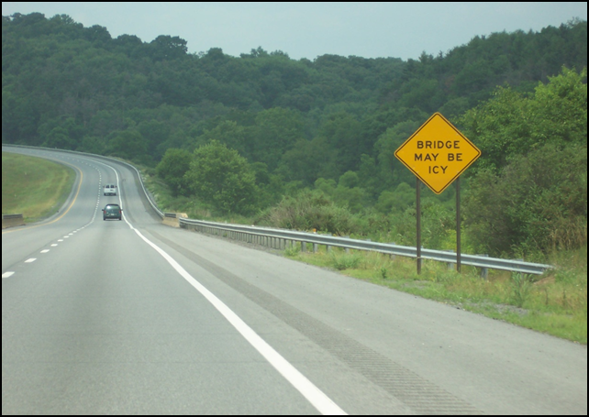
Defining Areas of Less Traction
IDENTIFYING HIGHWAY CONDITIONS
Less grip of tires on road surface, less ability to control car
This Photo by Unknown Author is licensed under CC BY
Notes:
Changes in Traction
Without traction, vehicle movement and control would not be possible. A driver must always be alert for areas of less traction and be able to evaluate its effect on vehicle control. Less traction usually increases the possibility of skidding.
Definition of Less Traction
An area of less traction is a condition of the roadway ahead which will cause the friction or grip between the tires and the driving surface to be reduced. It represents a change of the surface on which you are driving.

Slide 11
Notes:
Clues to Hidden Side Roads
Ask class to give other clues that might indicate hidden side roads
In rural areas, many side roads may be hidden from view. Look for clues such as these: mailboxes, telephone wires, cloud of dust from gravel roads, animals, pedestrians or slow-moving vehicles.

Slide 12
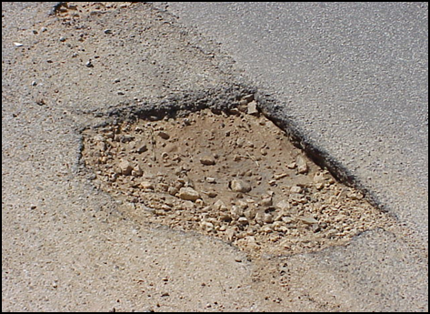
Changes due to Roadway Conditions
IDENTIFYING HIGHWAY CONDITIONS
Slope of Surface – flat, high in middle, low on one side
Shoulders – not level with pavement, soft, rough
Type of Surface – concrete, blacktop, brick, gravel
Surface Roughness – chuck holes, railroad tracks, sewer covers
Notes:
Changes Due to Roadway Conditions
Slope of the Roadway Surface - Is it flat, banked or crowned? This is especially important on curves.
Condition of Shoulders - Is it level with the pavement? Is it soft or rough?
Breaks in Surface - Are there railroad tracks, sewer covers or drain grills? Are there large cracks or pot holes? These are especially important for two-wheelers.

Slide 13
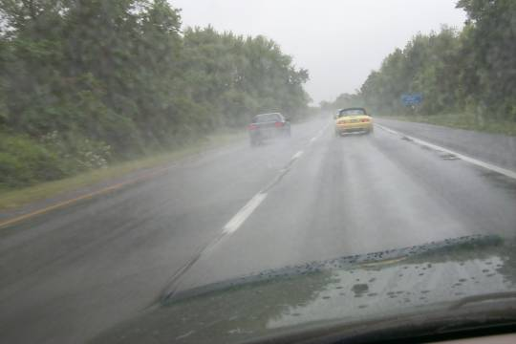
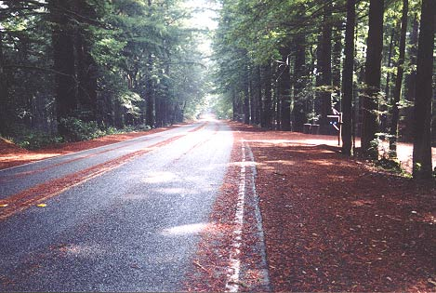
Changes due to Surface Materials
IDENTIFYING HIGHWAY CONDITIONS
Sand, mud, rock slides, oil, tar, water, ice, snow, frost
This Photo by Unknown Author is licensed under CC BY
Notes:
Changes Due to Surface Materials
Be alert for hazardous weather conditions in combination with the presence of mud, leaves, tar, ice, snow, or spillage from trucks
Wind gusts from the sides, the beginning of rain, or quick changes in temperature need to be evaluated
Ask class to give other examples of surface materials affecting traction

Slide 14
End Session 3A
Next: Session 3B

