Slide 1
Financing Your IUP Education
Financial Aid
Student Billing

Slide 2
Financial To-Do List
If you see this icon, more info is on your Financial To-Do List in your folder

Slide 3
Applications
Free Application for Federal Student Aid (FAFSA)
File annually at https://fafsa.gov
PA State Grant Information Form (PHEAA)
Complete at www.pheaa.org
Some students may be selected for verification; Upload documents to https://iup.studentforms.com

Slide 4
Scholarships
IUP uses admissions application to determine eligibility*
Most are renewable for a total of 8 semesters
Require full-time enrollment each semester and
Maintain a 2.0 cumulative GPA and pass at least 67% of all credits
Requires you to write a thank you to the donor of the scholarship
Outside organizations typically require additional applications
www.iup.edu/scholarships
*Fine Arts and Honors College may have additional applications/requirements

Slide 5
Federal Direct Subsidized/Unsubsidized Loans
Awarded from filing FAFSA based on grade level and eligibility
Only borrow what you need to cover your costs!
Must accept, reduce, or decline in MyIUP
If accepting, complete MPN/Entrance Counseling

Slide 6
Federal Direct Subsidized/Unsubsidized Loans
Subsidized
Must demonstrate “need”
Unsubsidized
Not based on “need;” interest accrues
Interest Rate, Fees, and Repayment
Fixed interest rate 5.50%*
1.057% origination fee
6-month grace period
*Interest rate can change annually in July

Slide 7
Other Loans
Federal Direct Plus Loan
Parent applies online at https://studentaid.gov
Interest rate is 8.05%*
4.228% origination fee
60-day grace period**
Alternative Loan
See “ELM Select” link on Financial Aid website
Apply online or by phone
If denied, student may be eligible for additional Unsub
Only borrow what you need to cover your costs!
We also have payment plan options that will be discussed later!
*Interest rate can change annually in July
**Deferment options available

Slide 8
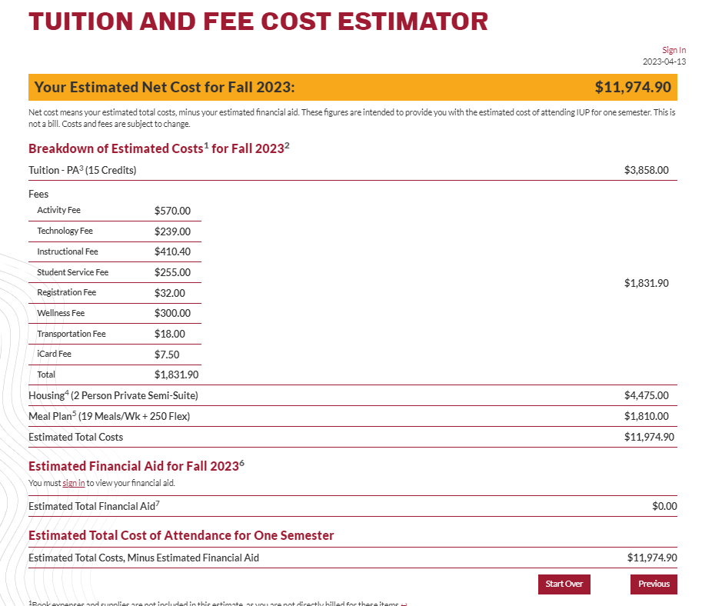
Tuition & Fee Cost Estimator
Available online at www.iup.edu/studentbilling to help you estimate your bill
Customize with housing and meal plan rates
Log in to get your estimated financial aid offer to be included

Slide 9
How to Buy Books with Financial Aid
If your financial aid exceeds your bill, you can use your credit balance to buy books/supplies at The Co-Op Store
Just show your Icard and tell the cashier you are using financial aid
Available through the first week of classes
Free Resources: Some books are available through library lending or can be downloaded for free
Contact Financial Aid if you’ve exhausted all other options

Slide 10
Maintaining Eligibility
Verification of Enrollment – Important that you go to class regularly!
PA State Grant: Pass 24 credits each academic year
Federal Aid: Cumulative 2.0 GPA and pass 67% of all credits
IUP Admissions Scholarships: Cumulative 2.0 GPA, pass 67% of credits, full-time enrollment
Other Scholarships: Check your scholarship offer letter or with the awarding organization for renewability criteria

Slide 11
What if my Circumstances Change?
Loss of Job
Please contact the financial aid office
Separation or Divorce
Loss of untaxed income (disability benefits, child support, etc.)

Slide 12
Electronic Access
Financial aid, billing, grades and other important information are all available at https://my.iup.edu
IUP email is our official form of communication. Letters, bills, etc. will not be mailed home

Slide 13
Student Record Release Authorization
Family Educational Rights and Privacy Act protects students’ financial aid and billing information
If you are not the student, but want student-specific information--you must provide security keyword and phrase when contacting our office
Student sets up your authorization in MyIUP

Slide 14
How to Contact Financial Aid
Location: Clark Hall
Telephone: 724-357-2218
FAX: 724-357-2094
Email: financial-aid@iup.edu
Website: www.iup.edu/financialaid
Address: 200 Clark Hall
1090 South Drive
Indiana, PA 15705

Slide 15
Tuition Rates
PA Board of Governors will meet in mid-July to establish the tuition rate for state schools within the PA State System of Higher Education (PASSHE)
IUP will generate electronic billing statements on 7/2/2024 based on the prior academic year rates.
The billing statement will be ‘ESTIMATED”
Tuition/Fees will be adjusted and updated billing statements will be generated.
ESTIMATED

Slide 16
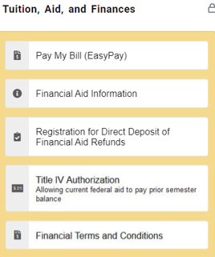
Financial Terms & Conditions Promise to Pay
It is a promissory note agreement whereby the student accepts full responsibility to pay all tuition and fees as a result of their registration for classes. Students must accept the Financial Terms and Conditions before they can register for classes. Once accepted, the promissory note remains in effect for all registered terms at IUP. More information and the entire agreement can be found on our Website and MyIUP
www.iup.edu/student-billing
MyIUP
>Tuition, Aid, and Finances
>Financial terms and conditions

Slide 17
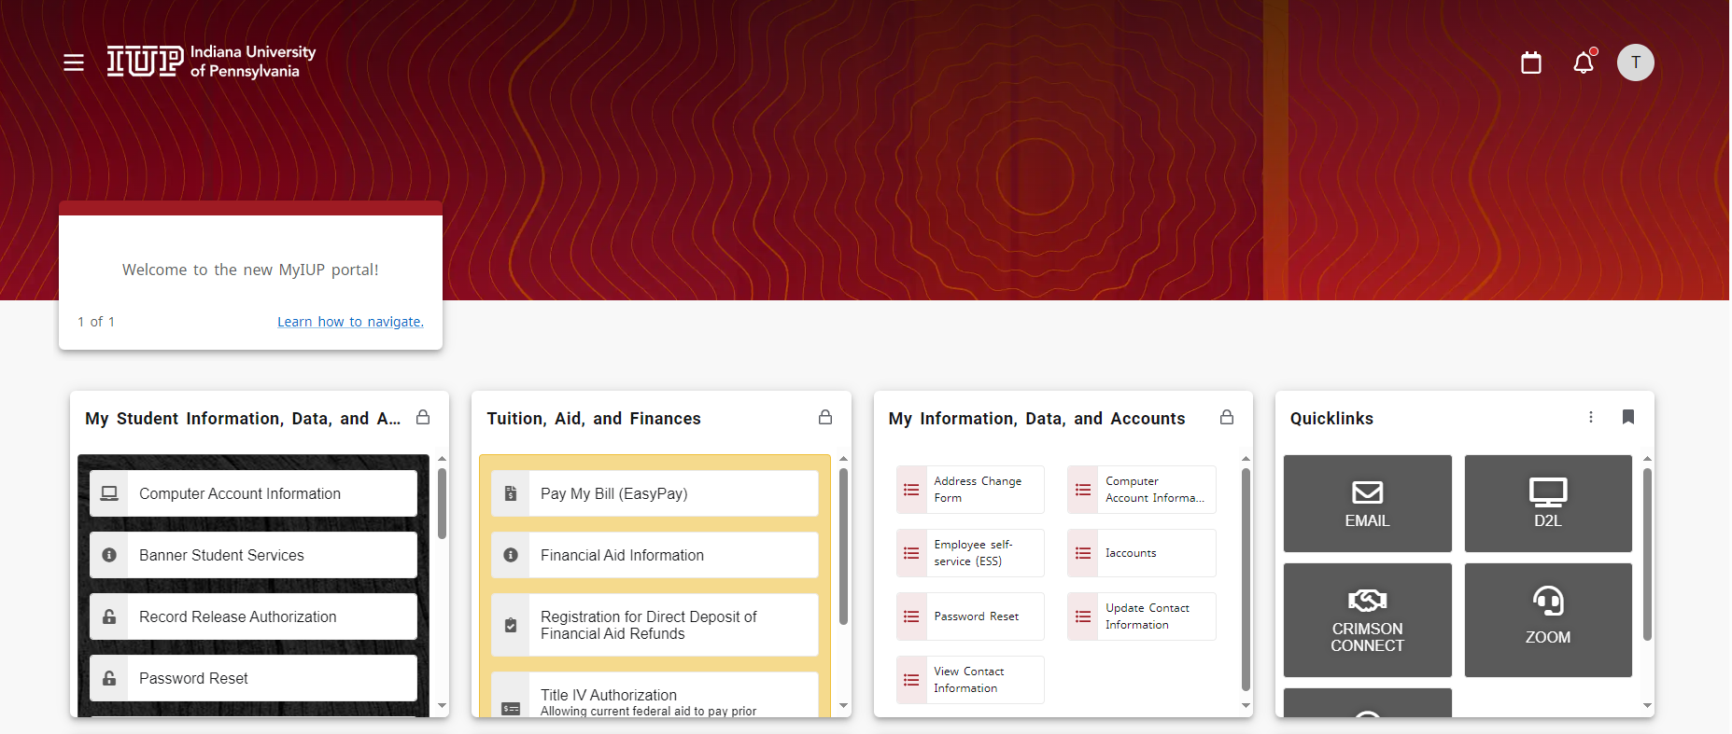
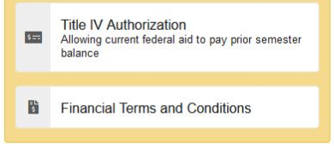
EasyPay
NEW MyIUP Portal > Finances > IUP EasyPay

Slide 18
IUP EasyPay
Encourage students to give parent/guardians authorization.
Parents/guardians access IUP EasyPay from www.iup.edu/student-billing. Click the IUP EasyPay link using their authorized log in information only.
Emails are sent to student’s IUP email account and to authorized user(s) email account.
You can also sign up for Text messaging. You will receive a short text when there is an updated billing statement available.

Slide 19
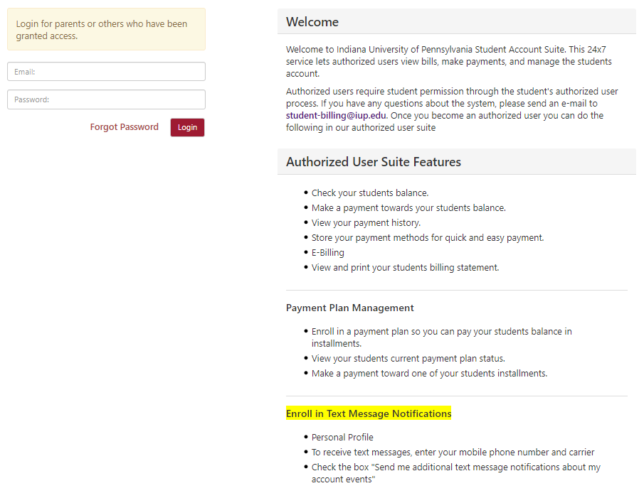
Authorized User Suite
How to Access the Suite
www.iup.edu/student-billing

Slide 20
IUP EasyPay
e-billing Information
Students access bills through the ‘Finances’ link in the MyIUP portal, by clicking the IUP EasyPay link.
“Real-time system”
Bill is static – month to month, snapshot in time
All changes appear under the Current Activity tab
Generate “Real Time” statement - Blue Bar in EasyPay

Slide 21
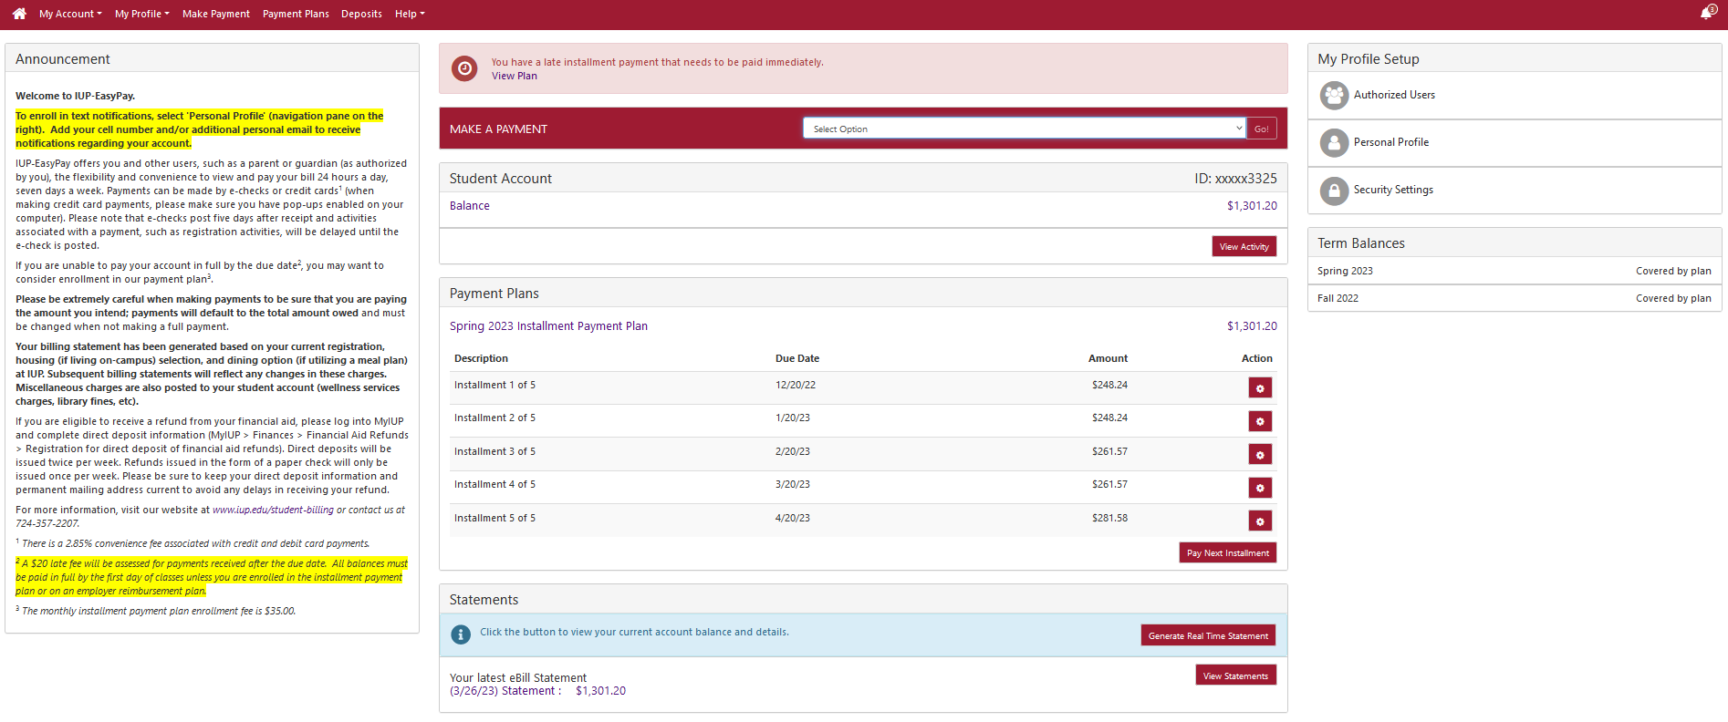
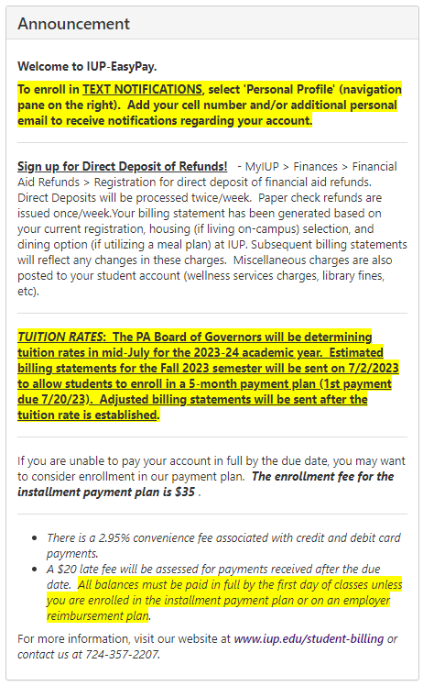
Notification Center
Make A Payment
Add Authorized Users
Enroll in Text Messaging!!!
Account Balance
Late Payment Notification
Generate Real Time Statement
(Includes course schedule)

Slide 22
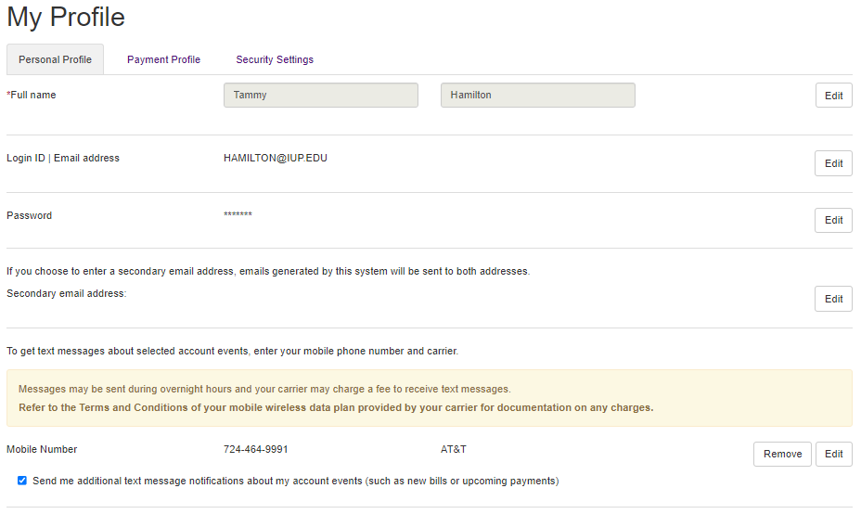
Enroll in Text Messaging
MyIUP > Finances > EasyPay > Personal Profile
Who Can Enroll?
Students
AND
Authorized Users
First
Last
724-555-xxxx

Slide 23
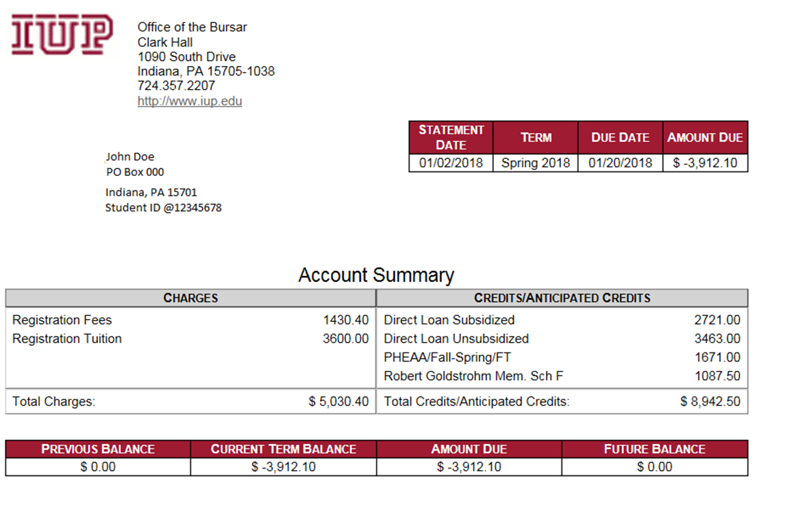

Slide 24
TAP / College Savings Plans
Tuition Account Programs, College Savings Plans
PA TAP -Contact account administrator with copy of statement
529 accounts outside Pennsylvania are billed after we receive authorization
Payment remitted directly to IUP for the benefit of the student

Slide 25
Payment Methods
IUP EasyPay
Payment by credit card; 2.95% convenience fee
Discover
MasterCard
Visa
ACH e-checks; no fees
Mail payment with check or money order to Office of Student Billing, 1090 South Drive, Clark Hall, IUP, Indiana, PA 15705

Slide 26
Installment Payment Plans
Students have the option of paying their student account in full by the first day of class (8/26/24) or enrolling in an installment payment plan.
Installment Payment Plan $35
Any outstanding balance will be calculated into your installment payments
Sum of Tuition/Fees/Housing/Meals/Books (minus financial aid) is your outstanding balance
5 installments – First payment due July 21, 2024
Enrollment after July - 4 installments, [after August - 3 installments / after September - 2 installments]
August 26th, September 20th, October 20th, November 20th
Students with Balances - Late fees will be assessed to students with balances who are not enrolled in the installment plan

Slide 27
Refunds
Financial Aid disburses onto the student’s accounts after drop/add. Direct deposit of refunds are processed that day and paper checks are processed the following day.
Students eligible for refunds should complete a direct deposit form through their MyIUP account. These are on Monday.
MyIUP > Finances > Financial Aid Refunds > “Registration for direct deposit of financial aid refunds”
Paper checks are mailed/issued once a week (processed on Tuesday).
Near future – Migrating to a new refund system
Sign up for direct deposit through EasyPay
More details at a later date

Slide 28
1098T Tax Form
1098T form must be printed from ECSI website
Email notification to request electronic 1098T; otherwise mailed
Check with tax preparer for eligibility
Further information about 1098T
https://www.iup.edu/student-billing/forms/1098t-information.html
https://heartland.ecsi.net

Slide 29
Refund Policy
Refund policy in on the Student Billing website: www.iup.edu/student-billing
You will be responsible for the number of credits that you are registered for at the end of the drop/add period.
Withdrawing from courses after the drop/add period
Full-time students withdrawing to part-time – no reduction in charges
Part-time students paying the per-credit rate – no reduction in charges
Total University Withdrawal – percentage of tuition/fees charged in accordance with the policy
Amount of Tuition/Fees you’re charged
Week 1 – 20% Week 4 – 60%
Week 2 – 40% Week 5 – 100%
Week 3 – 50% After Week 5 – 100%

Slide 30
How to Contact Student Billing
Location: Clark Hall
Telephone: 724-357-2207
FAX: 724-357-5578
Email: student-billing@iup.edu
Website: www.IUP.edu/student-billing
Address: 1090 South Drive
Clark Hall, Indiana University of Pennsylvania
Indiana, PA 15705

