Slide 1
Learning that Persists: Facilitating Transfer Across Courses, Disciplines, and Contexts
Dr. Dana Lynn Driscoll
Professor of English
Director, Jones White Writing Center
Indiana University of Pennsylvania
dana.driscoll@iup.edu

Slide 2
Workshop Overview
Activity #1 - Block Activity
Part I: Introduction to Learning Transfer & Challenges
Activity #2: Key Challenges
Part II: Teaching for Transfer
Activity #3: Transfer Planning
Discussion and Questions

Slide 3
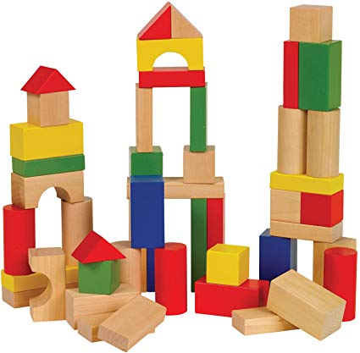
Opening Activity: Block Activity Once you are finished, with your partner consider: what does this teach us about learning and teaching?

Slide 4
Introduction to Learning Transfer & Challenges with Transfer

Slide 5
Workplace
Disciplinary Courses
Introductory Courses
High School Courses

Slide 6
Transfer of Learning: The ability of a learner to use, repurpose, adapt, or build upon prior learning experiences in new situations

Slide 7
Transfer = Learning (National Research Council, 2000)

Slide 8
College Writing Courses
Writing in the Workplace and Beyond
Disciplinary
Courses with Writing
High School English
Example from my discipline: Writing

Slide 9
“….transfer is like an antibiotic resistant bacterium, whatever we attack it with, it won’t go away.” (Haskell, 2001)
“Transfer of learning is universally accepted as the ultimate aim of teaching. However, achieving this goal is one of teaching’s most formidable problems. Researchers have been more successful in showing how people fail to transfer learning than they have in producing it, and teachers and employers alike bemoan students’ inability to use what they have learned.” —Ann McKeough, Judy Lupart, and Anthony Marini, Teaching for Transfer (1995)
“100+ years of research suggests that students are more likely to fail to transfer than to succeed.” – McKeough, Lupart, and Marini (1995)

Slide 10
Challenges with Transfer
Over-contextualization of knowledge, or lack of mindful abstraction: I learned this skill only for this course; it has no real world bearing or I can’t see the connection
Assumption that contexts are too different. These are entirely different skills.
Problematic expectations or theories of learning; (E.g. I only need to learn this once)
Focus on performance-based activity. Learning for a grade, once the class is over, the material goes “under the bed.”
Lack of curriculum and support for learning transfer. None of these courses connect.
Lack of real-world connections. This only applies to this course. I’m going to memorize it for the test and forget it.

Slide 11
Activity: Have you experienced these or “transfer challenges” in your own teaching? How do they manifest? What are areas that you see your students most struggle with with regards to learning transfer? (consider making a list)

Slide 12
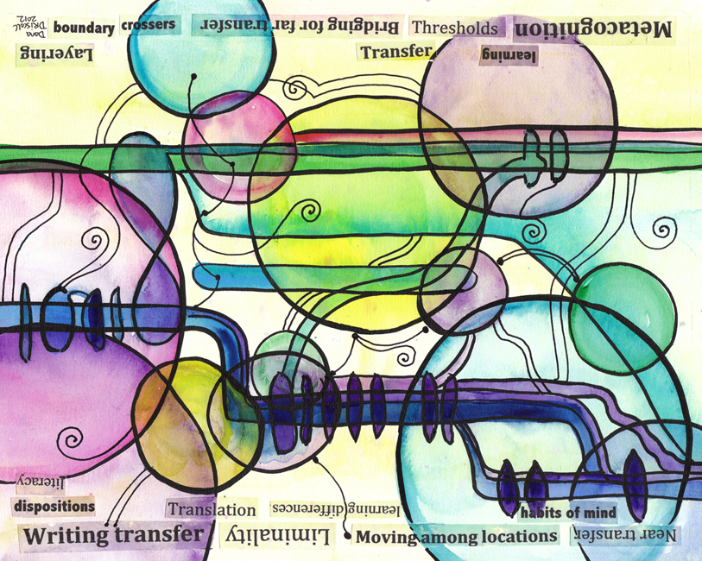
Mechanisms that Help Facilitate Transfer

Slide 13
What can transfer?
Knowledge
Practices
Learner
Tools and Strategies
Learning Dispositions
Driscoll, 2016
Notes:
The question of what students can transfer is an important – and this slide provides some overall understanding of the kinds of things students transfer. Note that what they can use is not just limited to a set of knowledge, but also strategies of approaching their assignments, confidence in themselves as learners, and writing and reading processes.
Knowledge: knowing material upon which practices are based. For ecology, this would include knowledge of plant families and plant reproductive cycles. For mathematics, this would include knowing what numbers are prime, what the quadratic formula is, and so on. For history this might include specific periods of time.
Practices: This is what we actually do with the knowledge—knowing how to implement that knowledge in a way that achieves a goal. That is, knowing when how to identify a plant, revision strategies and applying the quadratic it in a real-world example. (Even if you know something, you may not be able to apply that knowledge)
Tools and strategies: things that can help a person apply their knowledge to specific practices or complete a tasks. These can include time management skills, study habits, research skills, various professional skills.
Learning-related Dispositions– The “dispositions” or internal qualities that students bring to learning situations like their ability to persevere in the face of difficulty (persistence), their beliefs about themselves as learners (self-efficacy), their confidence or overconfidence, their emotional maturity, their willingness to seek help (help seeking), and so forth.
--All of these things play into each situation where transfer can occur and in situations where transfer may fail to happen.

Slide 14
Mindful Abstraction
New situation
Specific Course
New situation
Mindful abstraction
(Mindful Abstraction: taking knowledge out of a specific context and generalizing it)
New situation
Specific Learning
Salomon and Perkins, 1989;
Driscoll, 2013
Notes:
One of the keys for transfer of any kind is on this slide. Students need to be able to “abstract” or “generalize” their knowledge such that it can move across contexts.

Slide 15
Mindful Abstraction
Knowledge beyond
College (workplace,
civic, personal)
Knowledge in other
college classes
Knowledge in other
Disciplinary classes
Knowledge in
a specific class
Specific skills
for an assignment
or activity
Notes:
I want to take a minute to explore the idea of mindful abstraction more explicitly here, as its not immediately apparent.
When students take courses with us, we are essentially in a set of nested systems (these may be called domains, activity systems, communities of practice, or discourse communities depending on the theory you are discussing).
Students are most likely to see material as only applicable to the first one or two domains – the specific assignment or a specific class.
Each of the solid lines here represents the barriers we have between these contexts—barriers that exist for a number of reasons as I mentioned before.

Slide 16
Mindful Abstraction
Knowledge beyond College
Knowledge in College Classes
Knowledge in
English Classes
Knowledge in
a specific class
Specific skills
for an assignment
or activity
Notes:
What mindful abstraction does, is basically to make those barriers more permeable and encourage students to conceptualize knowledge between these different domains. While the tasks and contexts are still present, the barriers are lessened and more movement between domains is encouraged.
This, essentially, is a big part of what facilitates transfer—and a lot of this has to do not so much with what we teach but how we teach it.
A lot of this abstraction takes place while students are engaged in coursework—and this is where faculty across the disciplines can assist with specific pedagogies designed to facilitate transfer.

Slide 17
How can we promote mindful abstraction, and thus, transfer?

Slide 18
For successful transfer students need:
Rich, initial learning contexts that support content development and transfer
Clear and direct activities in classes that facilitate transfer
Understanding how learning works and themselves as learners
Explicit discussion and activities that connect learning between domains
Encouraging mindful abstraction of their learning so that they can transfer
Support structures for long-term learning, to engage in connecting their learning to new places
Opportunities throughout the curricula to encourage transfer and cultivate a “transfer focused mindset”
Driscoll, 2013

Slide 19
Connection is the key to transfer.
Your Course
Transfer in
Transfer out
Transfer
within
Transfer across

Slide 20
Beginning of Term: Activating Prior Knowledge or “Transfer In”
Reflection and activities at beginning of course to activate prior knowledge and help students bring it into the course
Examples:
Creating a “toolkit” that a students describe at the start of the term and “add to” throughout the term (threshold concepts)
Reflecting on previous learning experiences and key knowledge
Asking them to engage with use prior knowledge and then showing how it will be built upon in course
Activities that require them to draw upon previous prerequisite course knowledge (accountability)
Driscoll, 2016; Haskell 2001

Slide 21
Mindful Abstraction
Disciplinary: Drawing upon real-world examples and real-world experts
Interviewing professionals practicing in the field
Professional problems and case studies
Professional practices, statements, procedures
Interviewing and internship experiences
General Education: Stressing professional competencies gained through coursework
Connection of skills to career goals
Developing a professional knowledge base
Encouraging transfer between concurrent courses
After any such practices:
Reflection on what they learned, integrating this knowledge, and moving forward with it
Salomon and Perkins, 1989; Driscoll, 2011

Slide 22
Encouraging “Transfer out”
Asking students to use the same developing skillset for a variety of different problems in the course to “generalize” the knowledge
Encouraging transfer between courses and subjects
Encouraging transfer between college and workplace/professional contexts
Reflective activity and self-identity as a growing professional with a key set of expertise
Reflect on the learning in the course and where it goes next

Slide 23
Activity
Consider building several activities into your course (or other educational experience). Choose one or more of the three:
Design a “transfer in” activity or assignment that focuses on prior knowledge and activating (or adapting/expanding) what students already know
Design a “mindful abstraction” activity or assignment that helps students take knowledge from you course beyond a specific activity or assignment during the semester
Design a “transfer out” activity or assignment that fosters mindful abstraction and primes them for detecting, electing, and connecting to new contexts beyond the course/semester

Slide 24
Questions and Discussion

Slide 25
References
DePalma, M. J. and Ringer, J. (2011). Toward a theory of adaptive transfer: Expanding disciplinary discussions of ‘‘transfer’’ in second-language writing and composition studies. Journal of Second Language Writing, 20, 134-147. doi:10.1016/j.jslw.2011.02.003
DePalma, M. J. and Ringer, J. (2013). Adaptive transfer, genre knowledge, and implications for research and pedagogy: A response. Journal of Second Language Writing, 22, 465-470.
Driscoll, D. L., & Harcourt, S. (2012). Training vs. learning: Transfer of learning in a peer tutoring course and beyond. Writing Lab Newsletter, 36(7–8), 1–6. http://dx.doi.org/10.1016/j.jslw.2013.09.002
Driscoll, D. L. (2017). Ideals and realities in students’ literacy development: Writing Center/ELT collaborations to support learning transfer. TESOL Arabia Perspectives. Vol 24 No. 3, November Issue.
Driscoll, D. L. and Powell, R. (2016). States, traits, and dispositions: The impact of emotion on writing development and writing transfer across college courses and beyond. Composition Forum (Special Issue on Emotions) 34.
Haskell, R. E. (2000). Transfer of learning: Cognition and instruction. New York: Academic Press.
Herrington, A. J. (1985). Writing in academic settings: A study of the context for writing in two college chemical engineering courses. Research in the Teaching of English, 19, 331–361.
Herrington A. J. & Curtis, M. (1990). Persons in Process. Urbana, IL: NCTE
Haskell, R. E. (2000). Transfer of learning: Cognition and instruction. New York: Academic Press.
National Research Council. (2000). How people learn: Brain, mind, experience, and school: Expanded edition. National Academies Press.
James, M. (2006). Teaching for transfer in ELT. ELT Journal, 60.2, 151-159. doi:10.1093/elt/cci102
Perkins, D. N., & Salomon, G. (2012). Knowledge to go: A motivational and dispositional view of transfer. Educational Psychologist, 47(3), 248–258. doi: 10.1080/00461520.2012.693354
Thompson, I. and Malkewicz, M. J. (2015). Talk about Writing. New York: Routledge.

